Slide 1
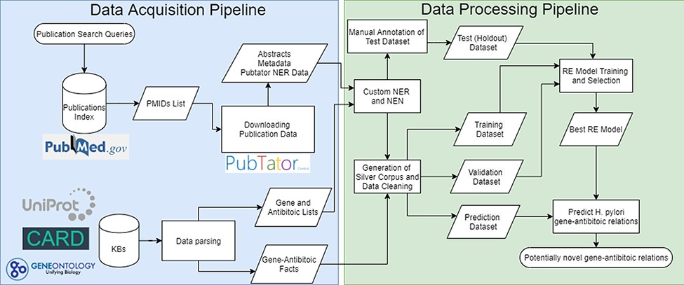
Figure 1. Complete flowchart of the developed pipeline which is divided as data acquisition on the left and data ...
Notes:
Figure 1. Complete flowchart of the developed pipeline which is divided as data acquisition on the left and data processing on the right. PMIDs—PubMed IDentifiers; NER—Named Entity Recognition; NEN—Named Entity Normalization.
Unless provided in the caption above, the following copyright applies to the content of this slide: © The Author(s) 2022. Published by Oxford University Press.This is an Open Access article distributed under the terms of the Creative Commons Attribution License (https://creativecommons.org/licenses/by/4.0/), which permits unrestricted reuse, distribution, and reproduction in any medium, provided the original work is properly cited.

