Slide 1
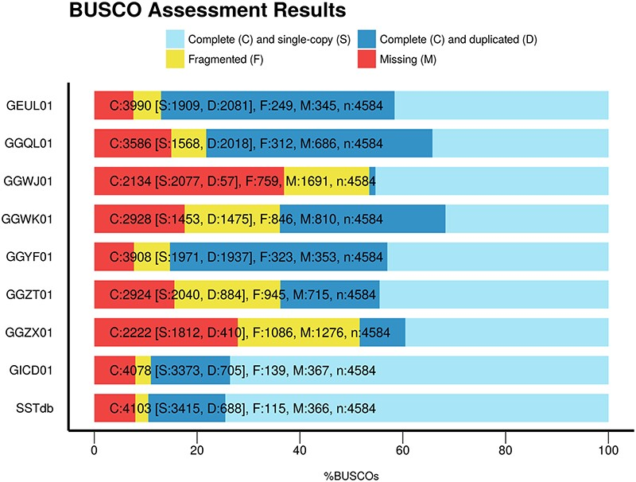
Figure 1. BUSCO scores of the eight sturgeon transcriptome assemblies found in TSA plus the sturgeon reference database ...
Notes:
Figure 1. BUSCO scores of the eight sturgeon transcriptome assemblies found in TSA plus the sturgeon reference database named SSTbd.
Unless provided in the caption above, the following copyright applies to the content of this slide: © The Author(s) 2020. Published by Oxford University Press.This is an Open Access article distributed under the terms of the Creative Commons Attribution License (http://creativecommons.org/licenses/by/4.0/), which permits unrestricted reuse, distribution, and reproduction in any medium, provided the original work is properly cited.

Slide 2
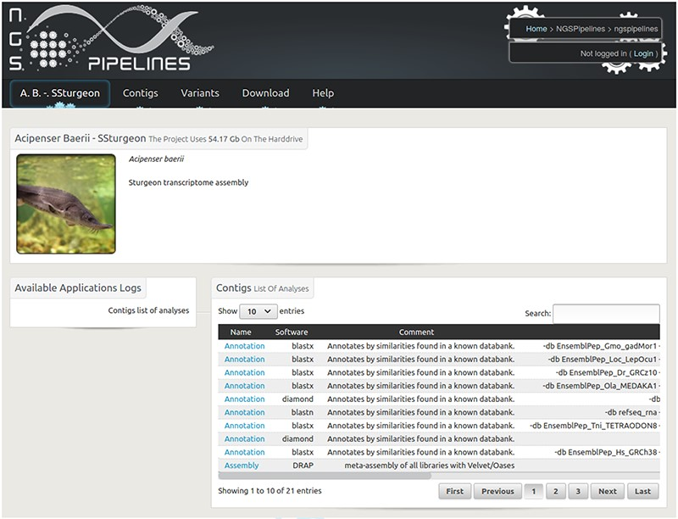
Figure 2. Home page of the Siberian sturgeon transcriptome database website. The main menu enables to visualize and ...
Notes:
Figure 2. Home page of the Siberian sturgeon transcriptome database website. The main menu enables to visualize and query contigs and variants as well as download the raw and result files.
Unless provided in the caption above, the following copyright applies to the content of this slide: © The Author(s) 2020. Published by Oxford University Press.This is an Open Access article distributed under the terms of the Creative Commons Attribution License (http://creativecommons.org/licenses/by/4.0/), which permits unrestricted reuse, distribution, and reproduction in any medium, provided the original work is properly cited.

