Slide 1
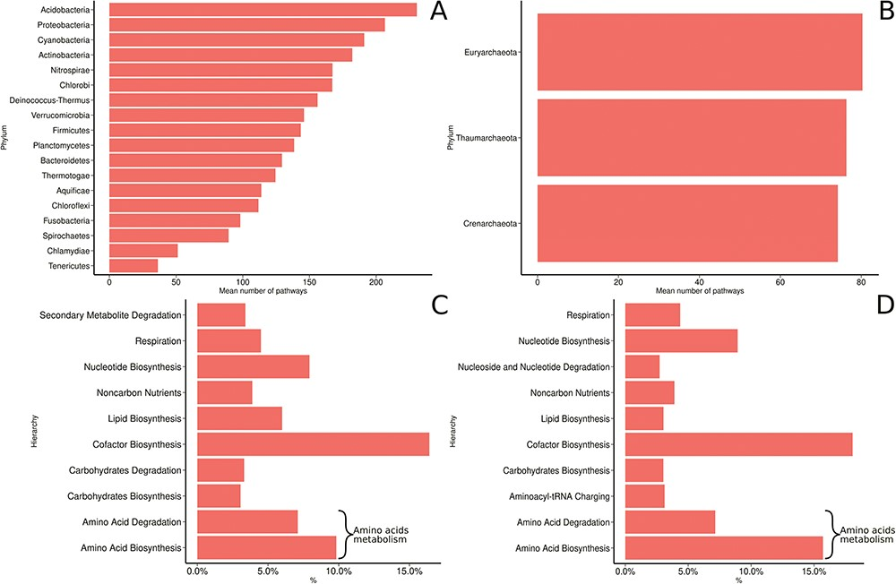
Figure 8 MACADAM functional diversity for phyla with >10 PGDBs in MACADA (A) among bacterial phyla, (B) among archaea ...
Notes:
Figure 8 MACADAM functional diversity for phyla with >10 PGDBs in MACADA (A) among bacterial phyla, (B) among archaea phyla, (C) the 10 main hierarchical groups of pathways in all bacterial organisms and (D) the 10 main hierarchical groups of pathways in all archaea organisms.
Unless provided in the caption above, the following copyright applies to the content of this slide: © The Author(s) 2019. Published by Oxford University Press.This is an Open Access article distributed under the terms of the Creative Commons Attribution License (http://creativecommons.org/licenses/by/4.0/), which permits unrestricted reuse, distribution, and reproduction in any medium, provided the original work is properly cited.

