Slide 1
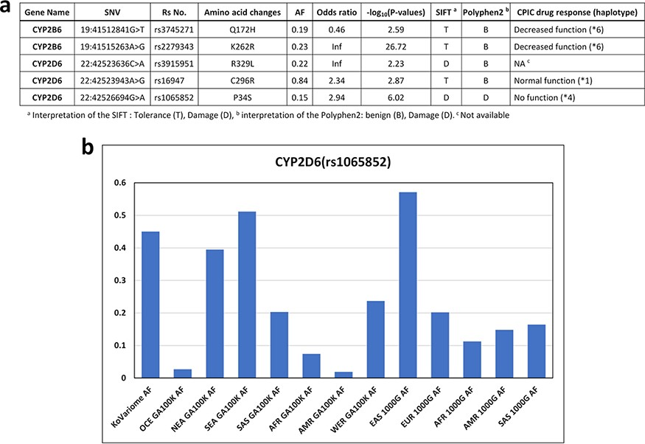
Figure 4. Korean-enriched missense SNVs in the CYP gene family. (a) Example of Korean-enriched missense variants in the ...
Notes:
Figure 4. Korean-enriched missense SNVs in the CYP gene family. (a) Example of Korean-enriched missense variants in the CYP gene family and CPIC information. (b) Example of different allele frequencies for rs1065852 SNV in each ethnic group. The x-axis represents ethnicity and the database that contained the information, and the y-axis represents allele frequencies.
Unless provided in the caption above, the following copyright applies to the content of this slide: © The Author(s) 2022. Published by Oxford University Press.This is an Open Access article distributed under the terms of the Creative Commons Attribution License (https://creativecommons.org/licenses/by/4.0/), which permits unrestricted reuse, distribution, and reproduction in any medium, provided the original work is properly cited.

