Slide 1
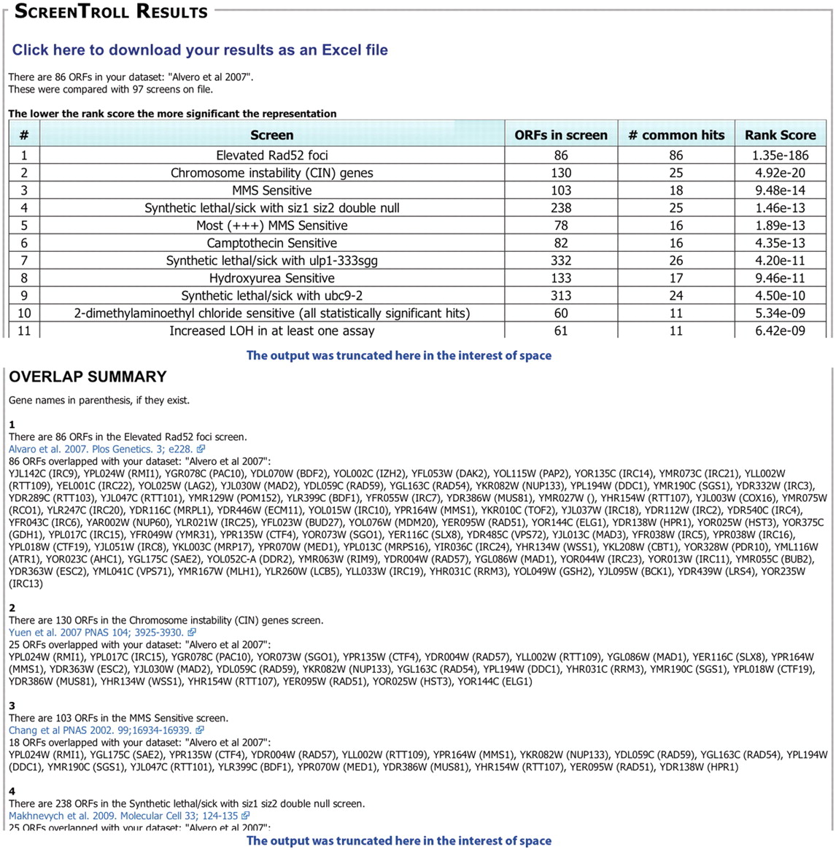
Figure 1. Example of a ScreenTroll Output. Portions of the output from a ScreenTroll search using the set of 86 ORFs ...
Notes:
Figure 1. Example of a ScreenTroll Output. Portions of the output from a ScreenTroll search using the set of 86 ORFs identified by Alvaro et al. (6) are shown. ScreenTroll displays a table of the screens in the database ordered by a rank score of the overlap with the query set (top). Below the table, the ‘overlap summary’ includes more details of each screen including the specific ORFs that overlap with the query set and a link to the PubMed entry for the manuscript that describes the screen (bottom). Both the competition and the Costanzo et al. (8) SGA screens were excluded from this search.
Unless provided in the caption above, the following copyright applies to the content of this slide: © The Author(s) 2012. Published by Oxford University Press.This is an Open Access article distributed under the terms of the Creative Commons Attribution Non-Commercial License (http://creativecommons.org/licenses/by-nc/3.0), which permits unrestricted non-commercial use, distribution, and reproduction in any medium, provided the original work is properly cited.

