Slide 1
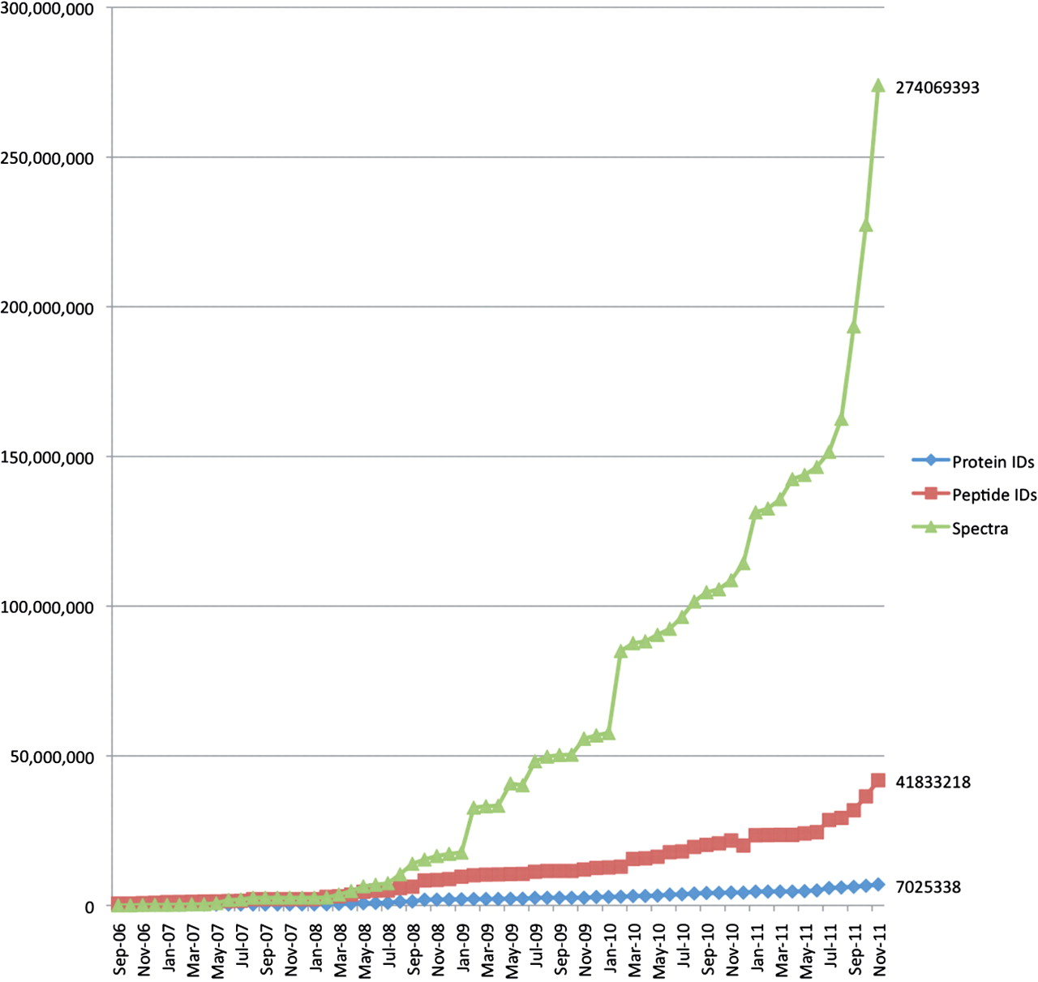
Figure 2. The overall growth of peptide and protein identifications, and mass spectra at PRIDE over time. The increase ...
Notes:
Figure 2. The overall growth of peptide and protein identifications, and mass spectra at PRIDE over time. The increase in data content of three core types of information stored at PRIDE: peptide and protein identifications and mass spectra, from 2006 to November 2011.
Unless provided in the caption above, the following copyright applies to the content of this slide: © The Author(s) 2012. Published by Oxford University Press.This is an Open Access article distributed under the terms of the Creative Commons Attribution Non-Commercial License (http://creativecommons.org/licenses/by-nc/3.0), which permits unrestricted non-commercial use, distribution, and reproduction in any medium, provided the original work is properly cited.

