Slide 1
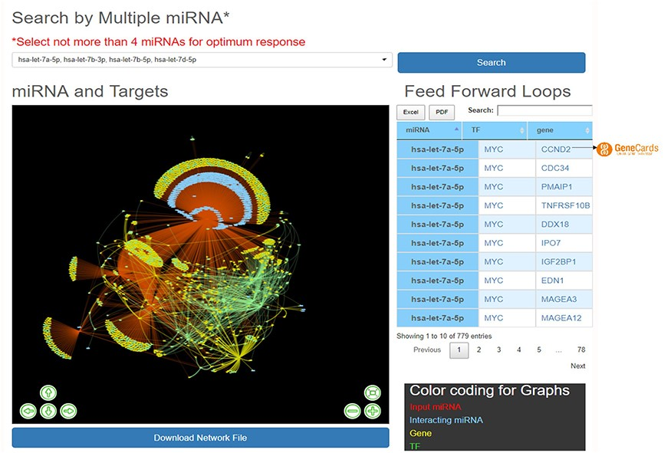
Figure 4. ‘Explore’ option of the database. The web image of the section shows complex network of four miRNA, i.e ...
Notes:
Figure 4. ‘Explore’ option of the database. The web image of the section shows complex network of four miRNA, i.e hsa-let-7b-5p, hsa-let-7a-5p, hsa-let-7b-3p, hsa-let-7d-5p and identified FFLs in the adjacent table.
Unless provided in the caption above, the following copyright applies to the content of this slide: © The Author(s) 2020. Published by Oxford University Press.This is an Open Access article distributed under the terms of the Creative Commons Attribution License (http://creativecommons.org/licenses/by/4.0/), which permits unrestricted reuse, distribution, and reproduction in any medium, provided the original work is properly cited.

