Slide 1
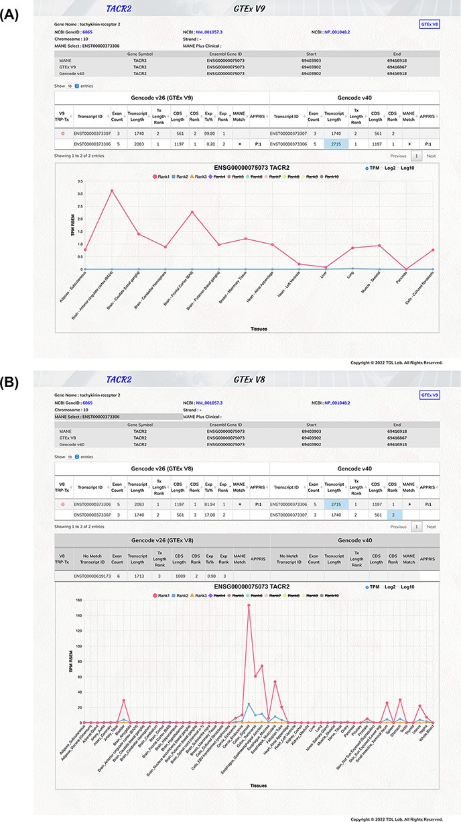
Figure 2. Illustration of TEx-MST gene information webpage for tachykinin receptor 2 (TACR2) protein-coding gene. Basic ...
Notes:
Figure 2. Illustration of TEx-MST gene information webpage for tachykinin receptor 2 (TACR2) protein-coding gene. Basic gene and transcript information of the protein-coding gene are provided. The main transcript expression data table is displayed to provide the GTEx and GENCODE information. The top-ranked protein-coding transcript is marked by a red circle and the MANE select transcript is marked by a star symbol. The important expression graph is provided for Rank 1 to Rank 10 transcripts at the bottom chart of the webpage. (A) GTEx V9 (long-read) expression information is displayed; (B) GTEx V8 (short-read) expression information is displayed. Please note that there are more tissue types in the V8 dataset. The TACR2 gene is mostly expressed in the digestive system.
Unless provided in the caption above, the following copyright applies to the content of this slide: © The Author(s) 2022. Published by Oxford University Press.This is an Open Access article distributed under the terms of the Creative Commons Attribution-NonCommercial License (https://creativecommons.org/licenses/by-nc/4.0/), which permits non-commercial re-use, distribution, and reproduction in any medium, provided the original work is properly cited. For commercial re-use, please contact journals.permissions@oup.com

