Slide 1
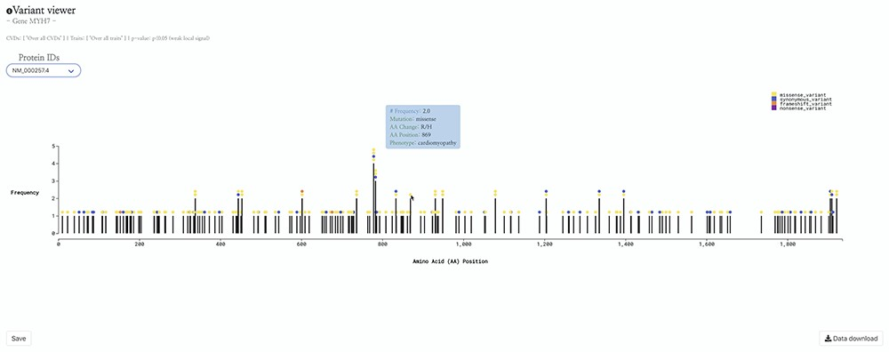
Figure 2. HeartBioPortal2.0’s variant viewer chart feature. The gene MYH7 is known to be associated with ...
Notes:
Figure 2. HeartBioPortal2.0’s variant viewer chart feature. The gene MYH7 is known to be associated with cardiomyopathy—here we see an interactive lollipop plot showing all known clinical genetic variants in MYH7 across multiple biological databases such as ClinVar, NHGRI-EBI GWAS Catalog, Ensembl, gnomAD, etc. The user can learn more information about any variant by hovering over the circles to display, e.g. the MYH7:p.Arg869His variant in this newly updated variant viewer chart. In addition, HeartBioPortal2.0 users can save their chart (for figures/diagrams in publications, seminars, etc.) and press the data download button to obtain additional details/metadata presented in a tidy .csv format amenable to additional follow-up data analyses. There are often multiple accession identifiers present in the dropdown menu of the variant viewer plot (e.g. for the gene DSP or TTN) to display variants found in both the canonical transcript of the gene as well as its alternative splice isoforms. Therefore, the variant viewer plot depicts variants found in all transcripts that have a known protein product associated with the respective CVD phenotype.
Unless provided in the caption above, the following copyright applies to the content of this slide: © The Author(s) 2020. Published by Oxford University Press.This is an Open Access article distributed under the terms of the Creative Commons Attribution License (http://creativecommons.org/licenses/by/4.0/), which permits unrestricted reuse, distribution, and reproduction in any medium, provided the original work is properly cited.

