Slide 1
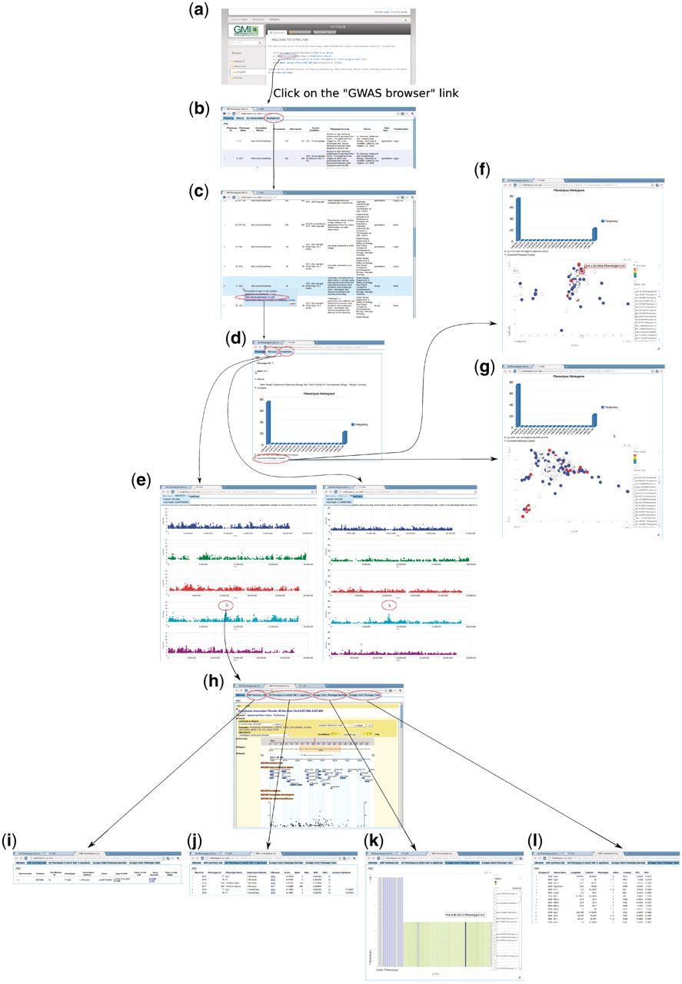
Figure 14. Forward genetics example. The trait of interest is LES (lesioning), which measures the presence of necrotic ...
Notes:
Figure 14. Forward genetics example. The trait of interest is LES (lesioning), which measures the presence of necrotic spots in normal plant leaves. The quest for its underlying genetic cause starts from http://arabidopsis.usc.edu/ (a). Then the researcher finds the trait in the table containing all phenotypes (b and c). Clicking the GWA plot item in the popup menu leads to the phenotype page containing a histogram (d) and genome-wide association plots by two different analysis methods, one that corrects for population structure; the other that does not (e). By clicking the ‘Accession-Phenotype Explorer’ in the phenotype page (d), the user could also explore the geographic distribution of phenotype (f) or check whether the phenotype is confounded by population structure by changing the axis to principal components (g). In this case, there is no population structure confounding, confirmed by the concordance between results by two different analysis methods (e). Clicking the most significant SNP in the association plot (e) leads the user to the SNP page, which displays a zoom-in association plot under the default tab (h). Combined with this SNP’s summary information (i), it points out gene ACD6 as the likely causal locus. The researcher can then find out whether this locus is strongly associated with other phenotypes (j), visually inspect how the phenotype is correlated with two alleles (k), and find out which accession carries which allele to pick accessions for downstream analysis (l).
Unless provided in the caption above, the following copyright applies to the content of this slide: © The Author(s) 2011. Published by Oxford University Press.This is Open Access article distributed under the terms of the Creative Commons Attribution Non-Commercial License (http://creativecommons.org/licenses/by-nc/2.5), which permits unrestricted non-commercial use, distribution, and reproduction in any medium, provided the original work is properly cited.

