Slide 1
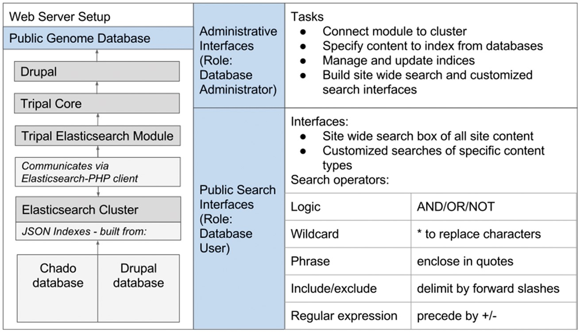
Figure 1. The Tripal Elasticsearch module depends on a number of other software packages. It works within the Drupal ...
Notes:
Figure 1. The Tripal Elasticsearch module depends on a number of other software packages. It works within the Drupal content management system and requires the core Tripal modules. To build indexes and run efficient searchs, it relies on an Elasticsearch cluster, which it communicates with via the Elasticsearch-PHP client. After installation of the software, all functionality can be controlled from web interfaces. The Drupal administrative user can configure and set up site-wide and customized search interfaces. Once those are active, all website users can perform fast, efficient searching with flexible search operators.
Unless provided in the caption above, the following copyright applies to the content of this slide: © The Author(s) 2017. Published by Oxford University Press.This is an Open Access article distributed under the terms of the Creative Commons Attribution License (http://creativecommons.org/licenses/by/4.0/), which permits unrestricted reuse, distribution, and reproduction in any medium, provided the original work is properly cited.

Slide 2
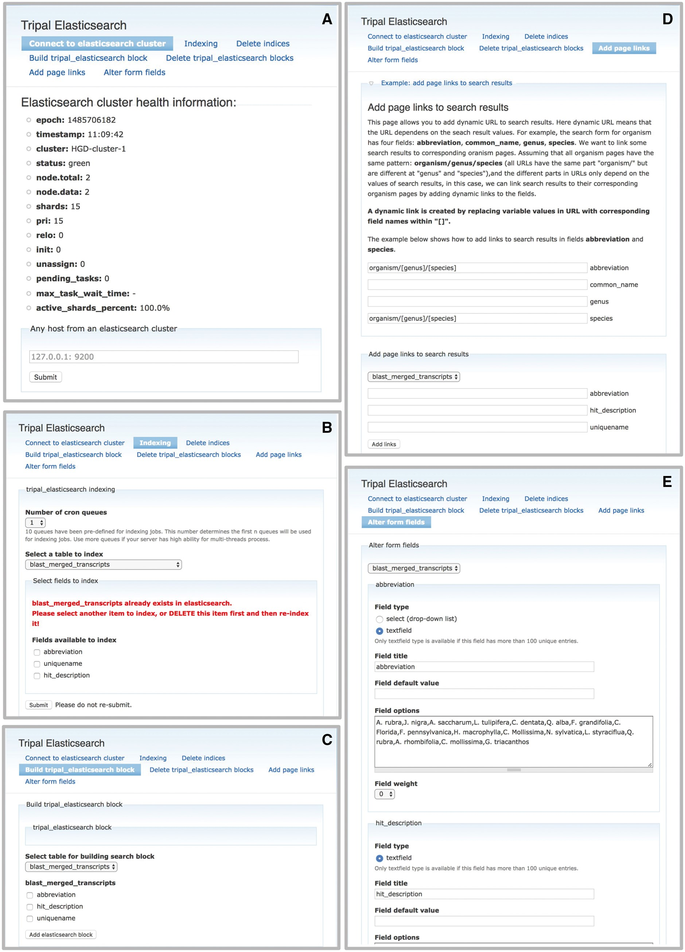
Figure 2. The Tripal Elasticsearch module administrative pages provide centralized control of data indexing and ...
Notes:
Figure 2. The Tripal Elasticsearch module administrative pages provide centralized control of data indexing and construction of search interfaces. (A) The module first needs to be connected to a running Elasticsearch cluster. (B) The user may opt to index the entire site by selecting ‘index_website’ or select individual tables and fields from the database. The index jobs are automatically launched via cron. (C) Based on available search indexes, a search form can be built and placed in a Drupal content block for display to users. (D) For each search block, the search results are linked to site content by constructing custom URLs (universal resource locator). The administrative page gives an example of how to use search results as tokens in the construction of URLs. (E) The search form can be customized for the best final user experience.
Unless provided in the caption above, the following copyright applies to the content of this slide: © The Author(s) 2017. Published by Oxford University Press.This is an Open Access article distributed under the terms of the Creative Commons Attribution License (http://creativecommons.org/licenses/by/4.0/), which permits unrestricted reuse, distribution, and reproduction in any medium, provided the original work is properly cited.

Slide 3
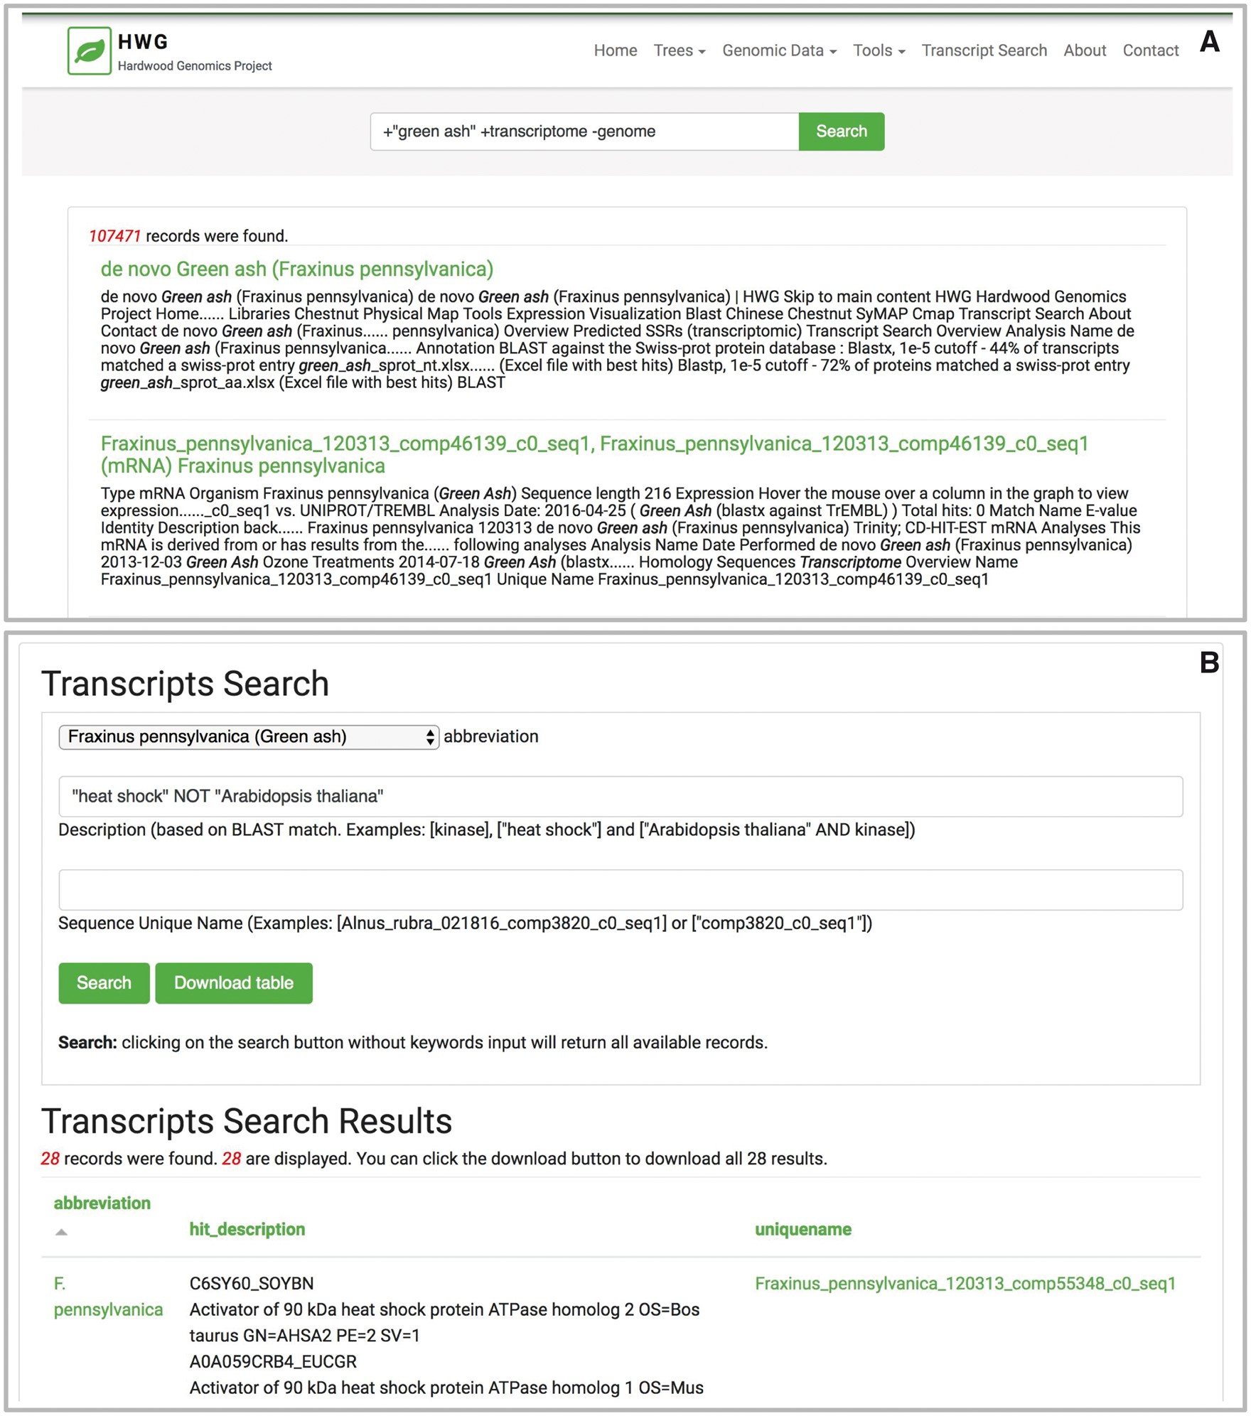
Figure 3. The Tripal Elasticsearch module builds content blocks for search forms. Using the Drupal block system, a ...
Notes:
Figure 3. The Tripal Elasticsearch module builds content blocks for search forms. Using the Drupal block system, a search block may be displayed on every page, on its own dedicated page or on a specific page or pages across the site. Screenshots are taken from the Hardwood Genomics Web where the Tripal Elasticsearch module is in production use. (A) The generic site-wide search block includes a single, global search field and search button. (B) A table-specific search form provides additional search fields for more advanced filtering of results. Here, transcript results are quickly returned from a database containing over 500 000 transcript records and >13 600 000 BLAST hits.
Unless provided in the caption above, the following copyright applies to the content of this slide: © The Author(s) 2017. Published by Oxford University Press.This is an Open Access article distributed under the terms of the Creative Commons Attribution License (http://creativecommons.org/licenses/by/4.0/), which permits unrestricted reuse, distribution, and reproduction in any medium, provided the original work is properly cited.

Slide 4
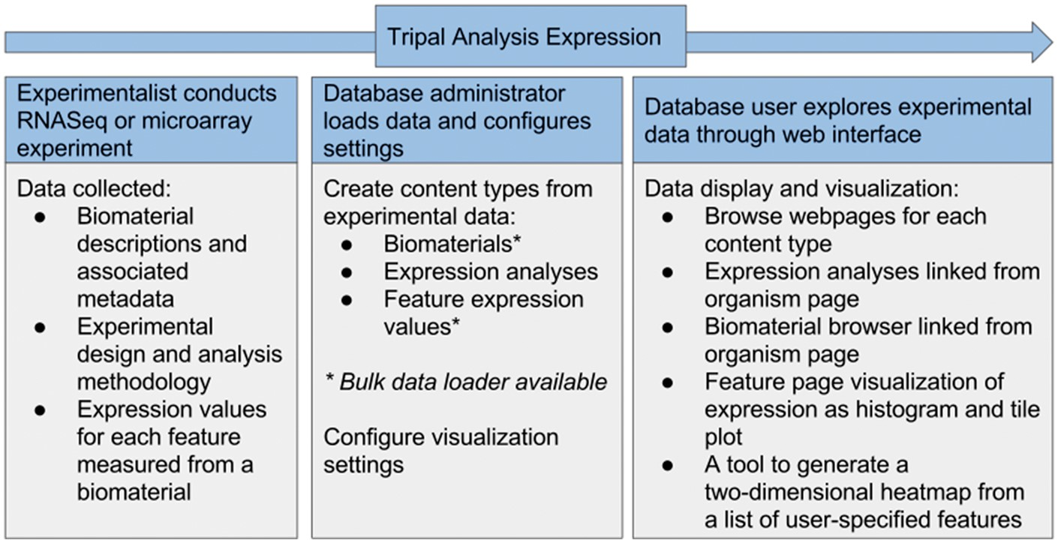
Figure 4. Flow of data in the Tripal Analysis Expression module. Either RNASeq or microarray experimental data can be ...
Notes:
Figure 4. Flow of data in the Tripal Analysis Expression module. Either RNASeq or microarray experimental data can be utilized and needs to include biomaterias, design and analysis methodology and expression values. From within a web interface, a site administrator can add and configure this content, yielding a number of visual interfaces for users to explore the data.
Unless provided in the caption above, the following copyright applies to the content of this slide: © The Author(s) 2017. Published by Oxford University Press.This is an Open Access article distributed under the terms of the Creative Commons Attribution License (http://creativecommons.org/licenses/by/4.0/), which permits unrestricted reuse, distribution, and reproduction in any medium, provided the original work is properly cited.

Slide 5
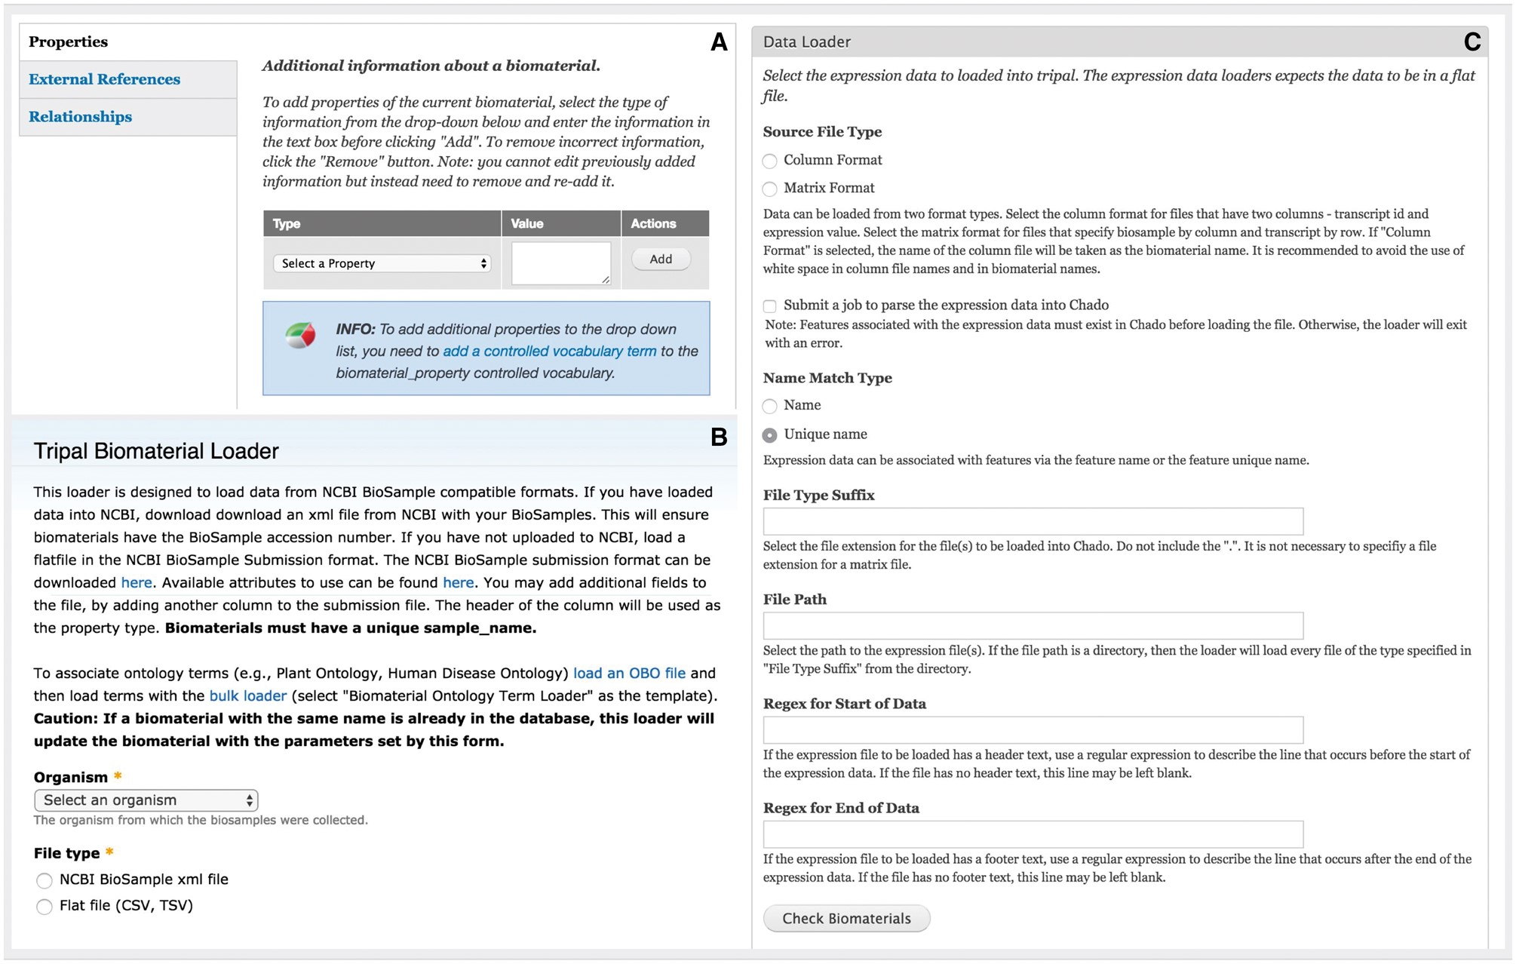
Figure 5. Administration interface of the Expression module. (A) Administrators can add customizable property fields to ...
Notes:
Figure 5. Administration interface of the Expression module. (A) Administrators can add customizable property fields to biomaterial record to provide metadata about experimental conditions, tissue, developmental stage, etc. These fields must be registered as a part of a controlled vocabulary through the core Tripal Controlled Vocabulary module. (B) The module is able to bulk load biomaterials from a CSV file or an NCBI BioSample XML formatted file. (C) The module can load expression data in column or matrix formats. These formats are described at the top of the page. The interface also allows the administrative user to specify regular expressions to exclude any header or footer text in the file that should be ignored such as column headings.
Unless provided in the caption above, the following copyright applies to the content of this slide: © The Author(s) 2017. Published by Oxford University Press.This is an Open Access article distributed under the terms of the Creative Commons Attribution License (http://creativecommons.org/licenses/by/4.0/), which permits unrestricted reuse, distribution, and reproduction in any medium, provided the original work is properly cited.

Slide 6
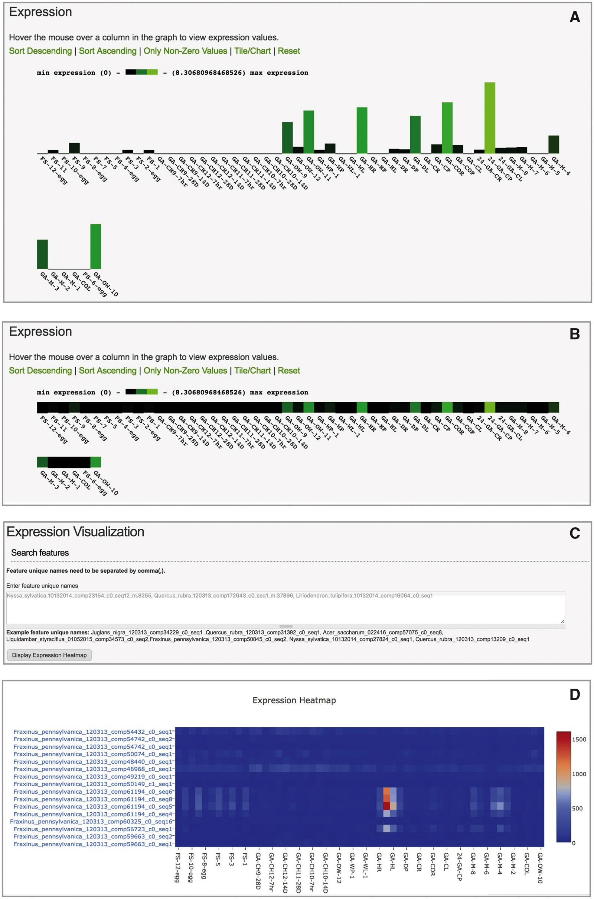
Figure 6. User interface of Tripal Analysis Expression module. (A) The feature page initially displays expression ...
Notes:
Figure 6. User interface of Tripal Analysis Expression module. (A) The feature page initially displays expression values as a bar chart. (B) Users may toggle the the barchart to a one-dimensional heatmap. (C) An interactive tool allows users to paste in a list of feature ids of interest. (D) The tool will create a two dimensional heatmap of the feature expression values across all available biomaterials. This heatmap displays ubiquitin transcripts (top eight rows) vs. heat-shock transcripts (bottom eight rows) from Fraxinus pennsylvanica (green ash). Hovering over the boxes with red and orange color in the online heatmap reveals that they are derived from petioles and leaves exposed to heat stress (40 °C for 24 h).
Unless provided in the caption above, the following copyright applies to the content of this slide: © The Author(s) 2017. Published by Oxford University Press.This is an Open Access article distributed under the terms of the Creative Commons Attribution License (http://creativecommons.org/licenses/by/4.0/), which permits unrestricted reuse, distribution, and reproduction in any medium, provided the original work is properly cited.

