Slide 1
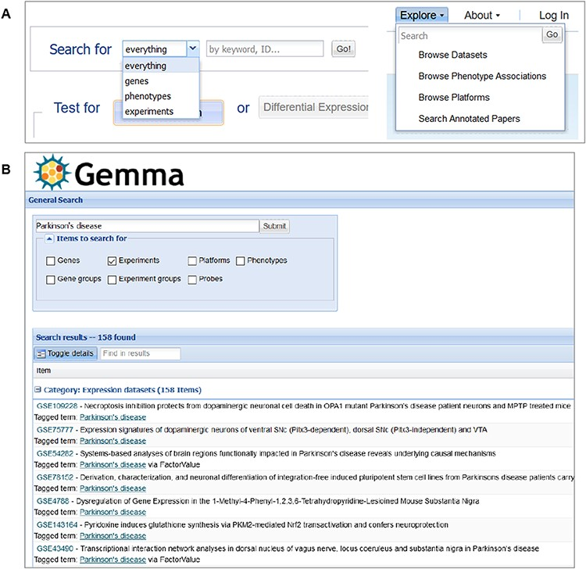
Figure 11. Snapshot of Gemma’s search tools, accessible from the main page (A-left) or upper banner (A-right); and the ...
Notes:
Figure 11. Snapshot of Gemma’s search tools, accessible from the main page (A-left) or upper banner (A-right); and the search results page (B), in which datasets (‘Experiments’) annotated with the term ‘Parkinson’s disease’ is returned.
Unless provided in the caption above, the following copyright applies to the content of this slide: © The Author(s) 2021. Published by Oxford University Press.This is an Open Access article distributed under the terms of the Creative Commons Attribution License (http://creativecommons.org/licenses/by/4.0/), which permits unrestricted reuse, distribution, and reproduction in any medium, provided the original work is properly cited.

