Slide 1
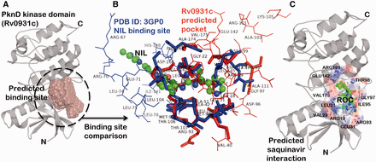
Figure 3. Example for predicted drug interactions using SInCRe. ( A ) A predicted binding site for PknD, a STPK, is ...
Notes:
Figure 3. Example for predicted drug interactions using SInCRe. ( A ) A predicted binding site for PknD, a STPK, is depicted in the form of spacefill. ( B ) The alignment of predicted binding site from PknD (Rv0931c, in red) with the NIL binding site from Human Mitogen Activated Protein Kinase (PDB ID: 3GP0). The corresponding residues are highlighted in sticks, whereas unique residues with no correspondences are represented as wireframe. These distinguishing residues can be targeted to achieve the selectivity. ( C ) The best pose derived from computational docking depicting the interaction of saquinavir (ROC, shown as green ball and stick model) with the residues (represented as sticks) of the predicted binding site in PknD.
Unless provided in the caption above, the following copyright applies to the content of this slide: © The Author(s) 2015. Published by Oxford University Press. This is an Open Access article distributed under the terms of the Creative Commons Attribution License ( http://creativecommons.org/licenses/by/4.0/ ), which permits unrestricted reuse, distribution, and reproduction in any medium, provided the original work is properly cited.

