Slide 1
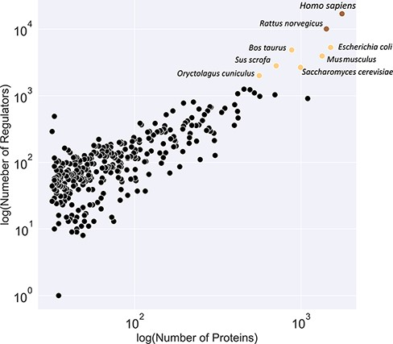
Figure 3. Classification of organisms based on their number of proteins (x-axis) and regulators (y-axis) into three ...
Notes:
Figure 3. Classification of organisms based on their number of proteins (x-axis) and regulators (y-axis) into three classes (brown, yellow and black). The brown class represents intensively studied organisms with more than 10K regulators and 1K proteins, whereas the black category denotes moderately researched models with less than 2K effectors and 500 proteins.
Unless provided in the caption above, the following copyright applies to the content of this slide: © The Author(s) 2022. Published by Oxford University Press.This is an Open Access article distributed under the terms of the Creative Commons Attribution-NonCommercial License (https://creativecommons.org/licenses/by-nc/4.0/), which permits non-commercial re-use, distribution, and reproduction in any medium, provided the original work is properly cited. For commercial re-use, please contact journals.permissions@oup.com

