Slide 1
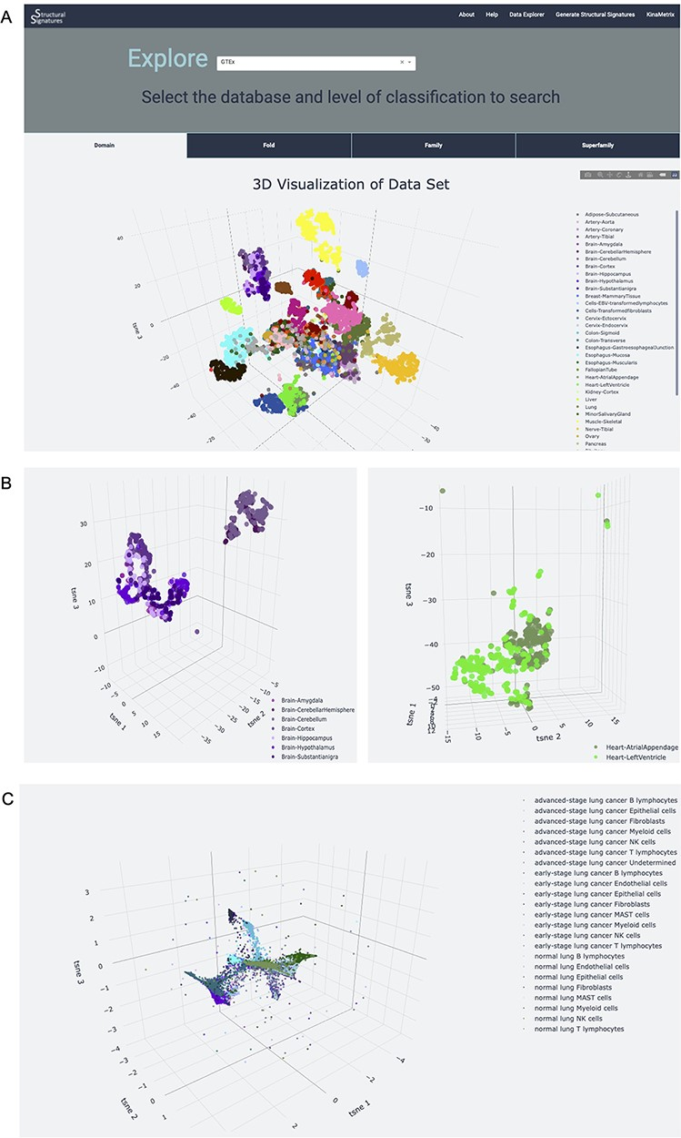
Figure 3. Database explorer page. (A) 3D t-SNE with GTEx tissues based on the features of the expressed proteins. (B) ...
Notes:
Figure 3. Database explorer page. (A) 3D t-SNE with GTEx tissues based on the features of the expressed proteins. (B) 3D t-SNE with brain and heart sub-tissues as seen on the server (C) 3D t-SNE on lung adenocarcinoma structural features.
Unless provided in the caption above, the following copyright applies to the content of this slide: © The Author(s) 2022. Published by Oxford University Press.This is an Open Access article distributed under the terms of the Creative Commons Attribution-NonCommercial License (https://creativecommons.org/licenses/by-nc/4.0/), which permits non-commercial re-use, distribution, and reproduction in any medium, provided the original work is properly cited. For commercial re-use, please contact journals.permissions@oup.com

Slide 2
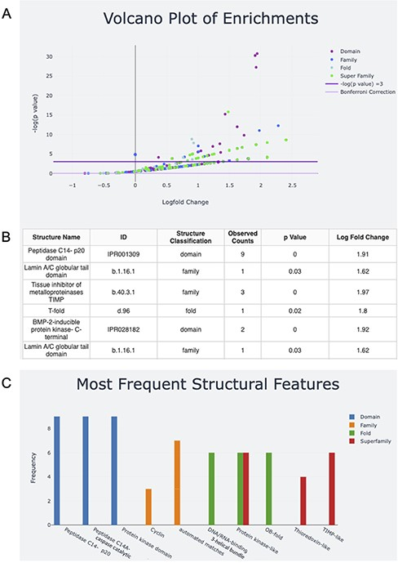
Figure 2. Screen capture of the output page. The user can download a zip file by pressing the Download button. (A) The ...
Notes:
Figure 2. Screen capture of the output page. The user can download a zip file by pressing the Download button. (A) The results are visualized with a volcano plot and a table with more details about the plot points being hovered over or clicked. The legend for this graph can be found on the right and includes domain, family, fold and superfamily, as well as the cutoffs for −log(P) equal to five and the Bonferroni correction. (B) The table corresponding to the hovered-over or clicked data from the volcano plot (C) structural feature information can also be visualized in a frequency bar plot.
Unless provided in the caption above, the following copyright applies to the content of this slide: © The Author(s) 2022. Published by Oxford University Press.This is an Open Access article distributed under the terms of the Creative Commons Attribution-NonCommercial License (https://creativecommons.org/licenses/by-nc/4.0/), which permits non-commercial re-use, distribution, and reproduction in any medium, provided the original work is properly cited. For commercial re-use, please contact journals.permissions@oup.com

Slide 3
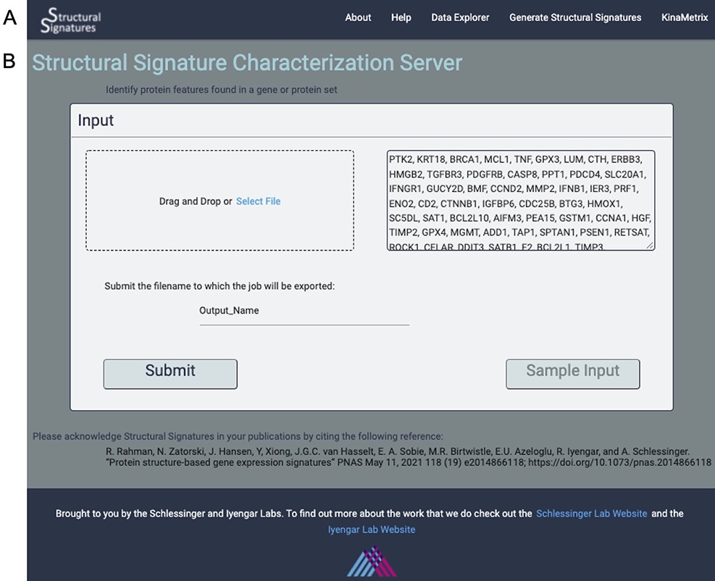
Figure 1. Input page. (A) the web server navigation bar. (B) The user can submit gene lists or protein IDs that they ...
Notes:
Figure 1. Input page. (A) the web server navigation bar. (B) The user can submit gene lists or protein IDs that they wish to transform into structural features as a comma, line or space-separated list of gene names or UniProt IDs or upload a file of the same format. They can also give their job an export name, under which it will be saved, and there is an option to view the output for a sample list of genes.
Unless provided in the caption above, the following copyright applies to the content of this slide: © The Author(s) 2022. Published by Oxford University Press.This is an Open Access article distributed under the terms of the Creative Commons Attribution-NonCommercial License (https://creativecommons.org/licenses/by-nc/4.0/), which permits non-commercial re-use, distribution, and reproduction in any medium, provided the original work is properly cited. For commercial re-use, please contact journals.permissions@oup.com

