Slide 1
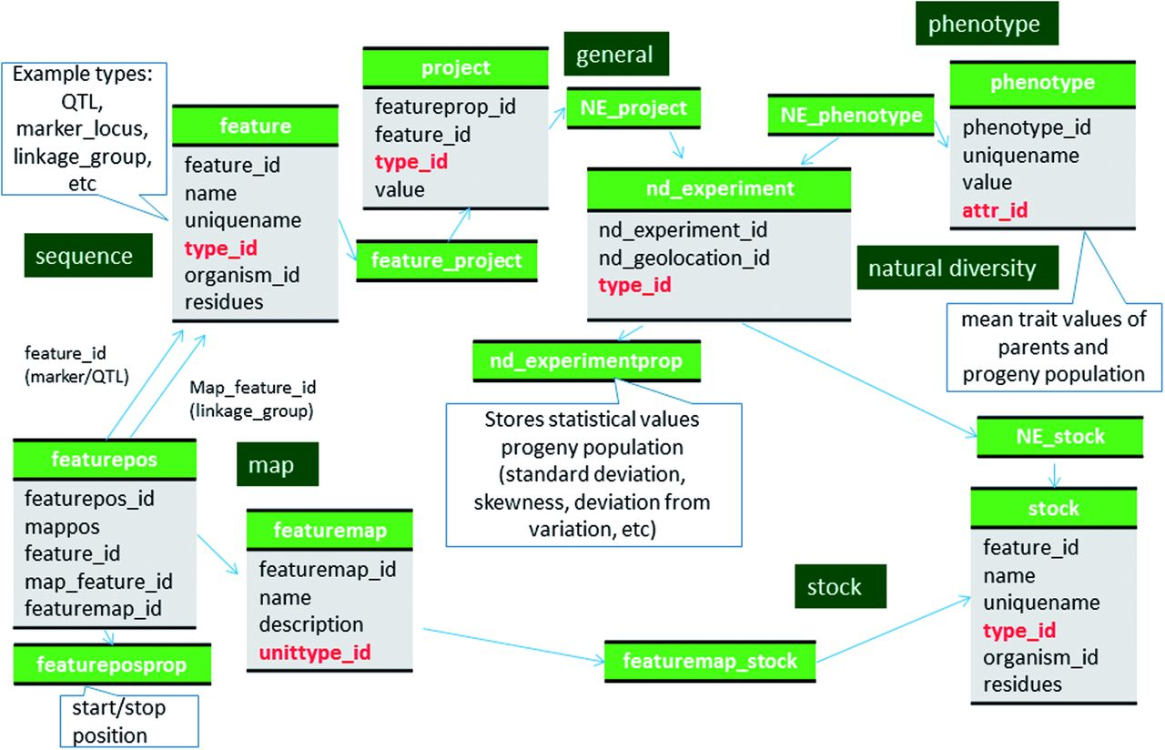
Figure 2 Schematic diagram of how the genetic map data of molecular markers and QTL are stored in Chado. The bold red ...
Notes:
Figure 2 Schematic diagram of how the genetic map data of molecular markers and QTL are stored in Chado. The bold red fields represent foreign keys to the cvterm table which houses vocabulary terms. Boxes in dark green represents the modules of Chado represented in this diagram.
Unless provided in the caption above, the following copyright applies to the content of this slide: © The Author(s) 2016. Published by Oxford University Press.This is an Open Access article distributed under the terms of the Creative Commons Attribution License (http://creativecommons.org/licenses/by/4.0/), which permits unrestricted reuse, distribution, and reproduction in any medium, provided the original work is properly cited.

