Slide 1
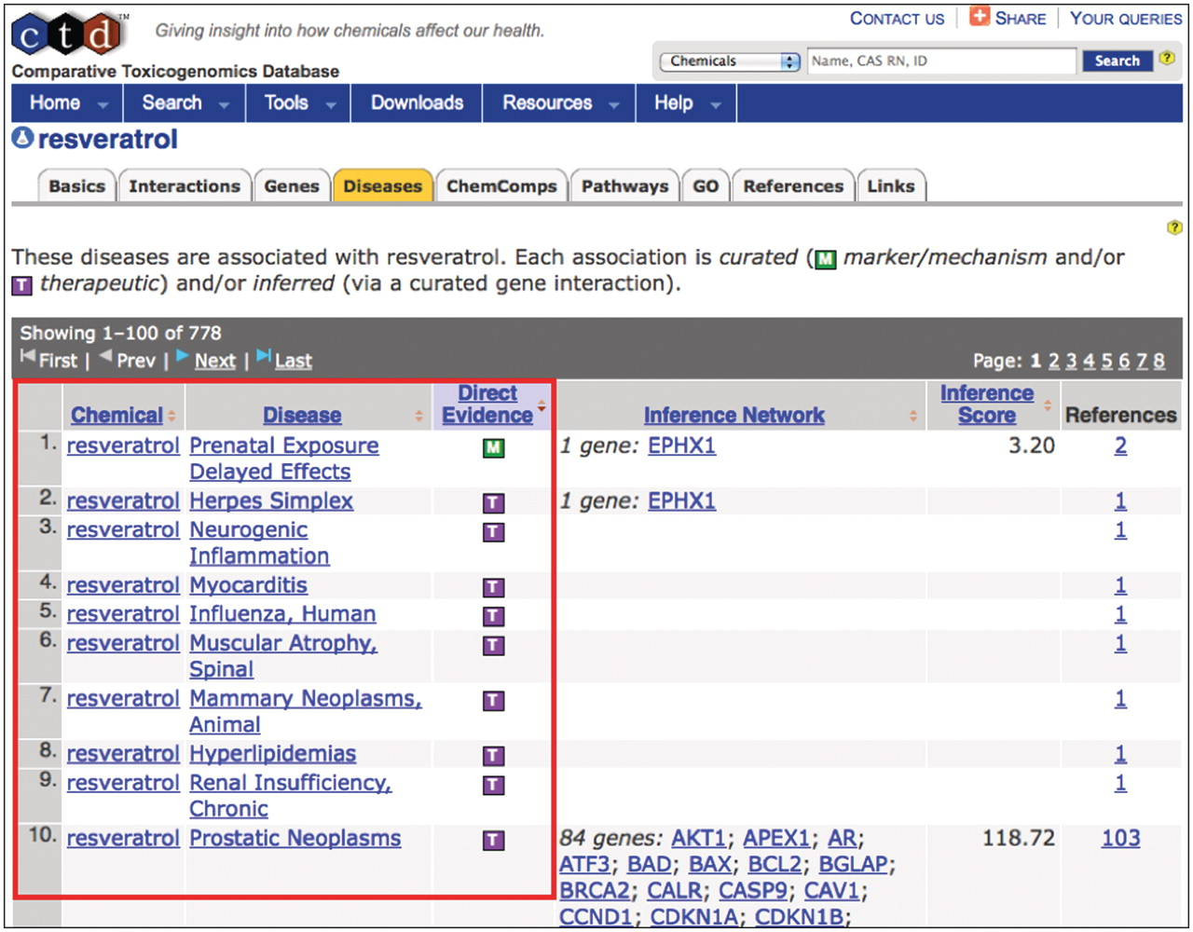
Figure 3. Curating to MEDIC. CTD biocurators use MEDIC as their disease vocabulary when curating chemical–disease and ...
Notes:
Figure 3. Curating to MEDIC. CTD biocurators use MEDIC as their disease vocabulary when curating chemical–disease and gene–disease data. The ‘Diseases’ tab (orange) on CTD's chemical page for resveratrol displays the curated relationships between the chemical and over 50 diseases (red box, partial screenshot). The green M icon indicates resveratrol is a marker for or plays a molecular role in the disease; the purple T icon indicates the chemical is a real or putative therapeutic for the disease. Every disease term is hyperlinked to its own disease page, allowing users to seamlessly explore chemical-gene-disease networks.
Unless provided in the caption above, the following copyright applies to the content of this slide: © The Author(s) 2012. Published by Oxford University Press.This is an Open Access article distributed under the terms of the Creative Commons Attribution Non-Commercial License (http://creativecommons.org/licenses/by-nc/3.0), which permits unrestricted non-commercial use, distribution, and reproduction in any medium, provided the original work is properly cited.

