Slide 1
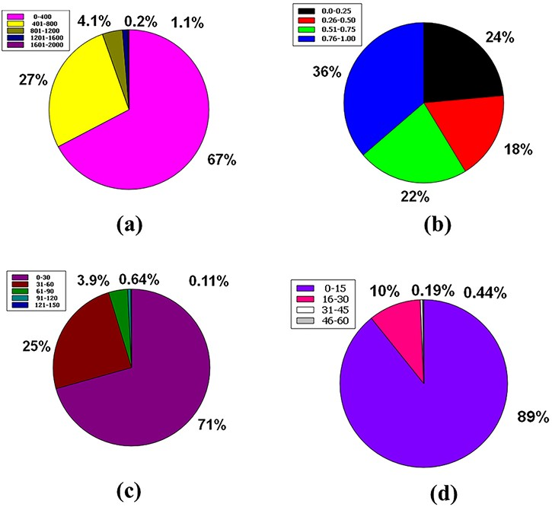
Figure 8. Venn diagram plot illustration of the physicochemical properties of phytochemicals in ‘phytochemdb’ database: ...
Notes:
Figure 8. Venn diagram plot illustration of the physicochemical properties of phytochemicals in ‘phytochemdb’ database: (a) proportions of compounds molecular weight; (b) percentages of phytochemicals that satisfy diverse fraction Csp3 score; (c) and (d) percentages of phytochemicals that fulfil various criteria of heavy atoms and aromatic heavy atoms, respectively.
Unless provided in the caption above, the following copyright applies to the content of this slide: © The Author(s) 2022. Published by Oxford University Press.This is an Open Access article distributed under the terms of the Creative Commons Attribution License (https://creativecommons.org/licenses/by/4.0/), which permits unrestricted reuse, distribution, and reproduction in any medium, provided the original work is properly cited.

