Slide 1
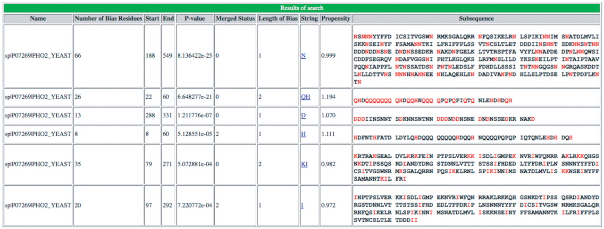
Figure 1. Screenshot of output of initial server portion of database. An example of the initial LPS-annotate program ...
Notes:
Figure 1. Screenshot of output of initial server portion of database. An example of the initial LPS-annotate program server output for the example PHO2, from budding yeast (P07269, PHO2_YEAST).
Unless provided in the caption above, the following copyright applies to the content of this slide: © The Author(s) 2011. Published by Oxford University Press.This is Open Access article distributed under the terms of the Creative Commons Attribution Non-Commercial License (http://creativecommons.org/licenses/by-nc/2.5), which permits unrestricted non-commercial use, distribution, and reproduction in any medium, provided the original work is properly cited.

Slide 2
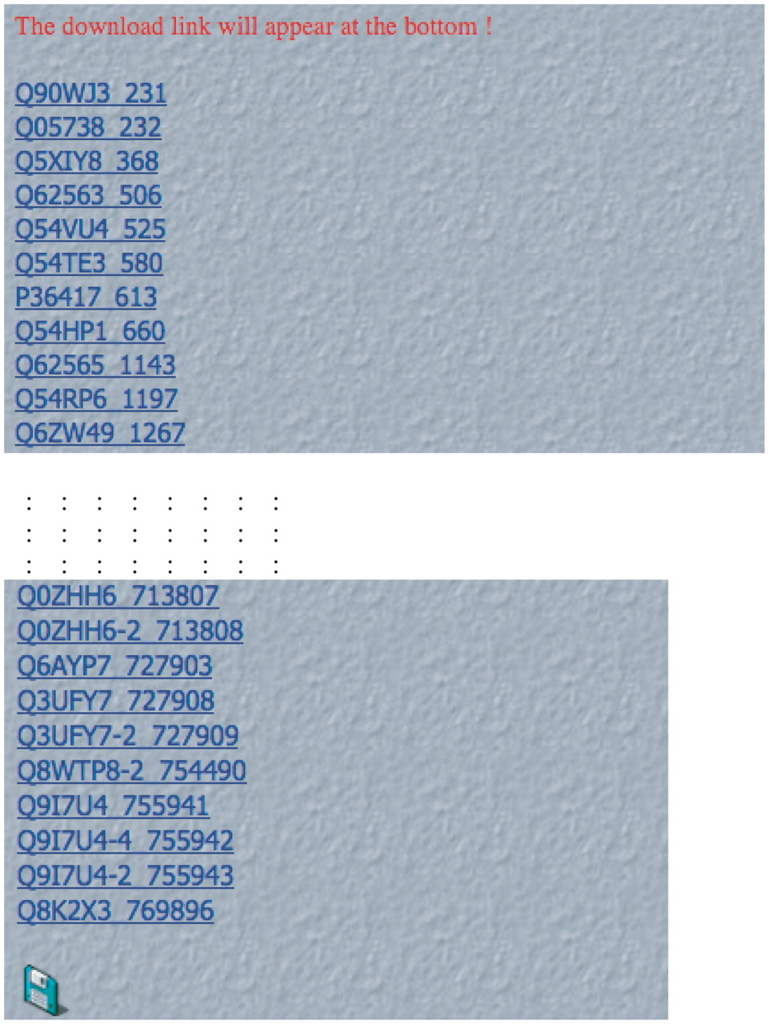
Figure 2. Screenshot of initial output after database search. An example of the initial LPS-annotate Database output ...
Notes:
Figure 2. Screenshot of initial output after database search. An example of the initial LPS-annotate Database output for the search for bias type ‘QH’. Each CB region is a live link in the depicted list. The download link for the data is at the bottom of the page.
Unless provided in the caption above, the following copyright applies to the content of this slide: © The Author(s) 2011. Published by Oxford University Press.This is Open Access article distributed under the terms of the Creative Commons Attribution Non-Commercial License (http://creativecommons.org/licenses/by-nc/2.5), which permits unrestricted non-commercial use, distribution, and reproduction in any medium, provided the original work is properly cited.

Slide 3
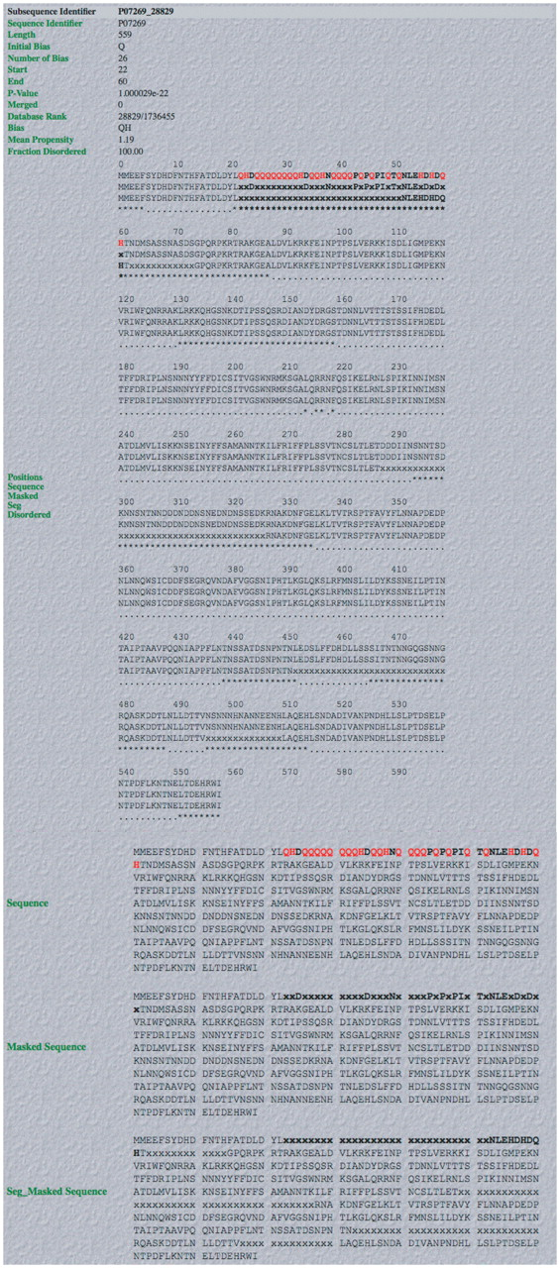
Figure 3. Screenshot of example of output from database. An example of a complete LPS-annotate Database entry (as ...
Notes:
Figure 3. Screenshot of example of output from database. An example of a complete LPS-annotate Database entry (as described in the main text, and in the downloadable Database Help page). This is for the QH region from PHO2 of budding yeast.
Unless provided in the caption above, the following copyright applies to the content of this slide: © The Author(s) 2011. Published by Oxford University Press.This is Open Access article distributed under the terms of the Creative Commons Attribution Non-Commercial License (http://creativecommons.org/licenses/by-nc/2.5), which permits unrestricted non-commercial use, distribution, and reproduction in any medium, provided the original work is properly cited.

Slide 4
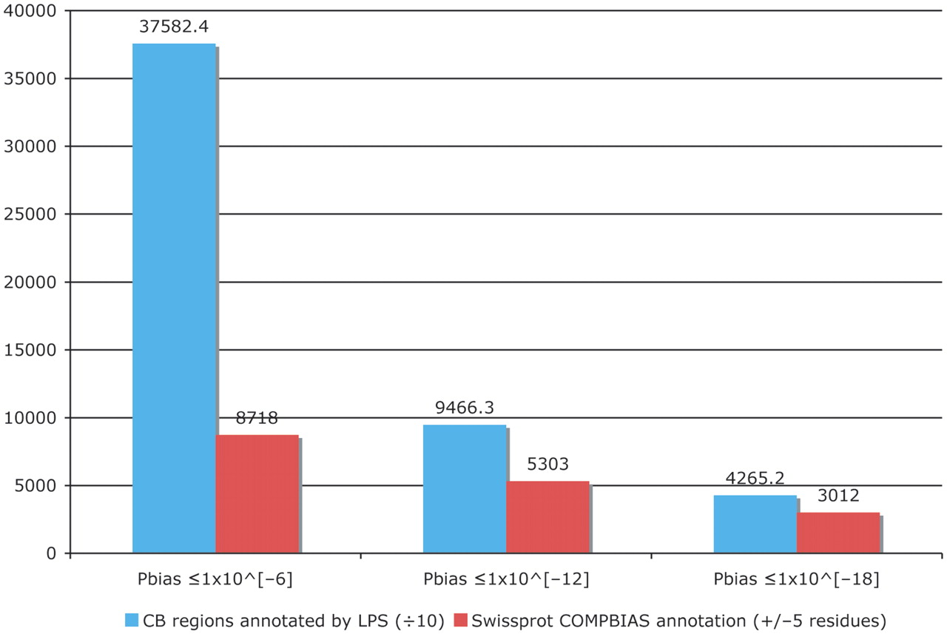
Figure 4. Column chart showing the augmentation of existing COMPBIAS annotations in UniProt, using the LPS algorithm. ...
Notes:
Figure 4. Column chart showing the augmentation of existing COMPBIAS annotations in UniProt, using the LPS algorithm. The blue column shows the number of CB regions annotated with the LPS-annotate algorithm, for three different P-value thresholds (10−6; 10−12; 10−18). The red columns are the existing UniProt COMPBIAS records that overlap the new LPS-annotate annotations (±5 residues at either end of the regions). The UniProt COMPBIAS records are intentionally limited in the UniProt/SwissProt databases to a few, more specific cases, such as homopolymeric runs, with up to one or two short interruptions in the run (26).
Unless provided in the caption above, the following copyright applies to the content of this slide: © The Author(s) 2011. Published by Oxford University Press.This is Open Access article distributed under the terms of the Creative Commons Attribution Non-Commercial License (http://creativecommons.org/licenses/by-nc/2.5), which permits unrestricted non-commercial use, distribution, and reproduction in any medium, provided the original work is properly cited.

Slide 5
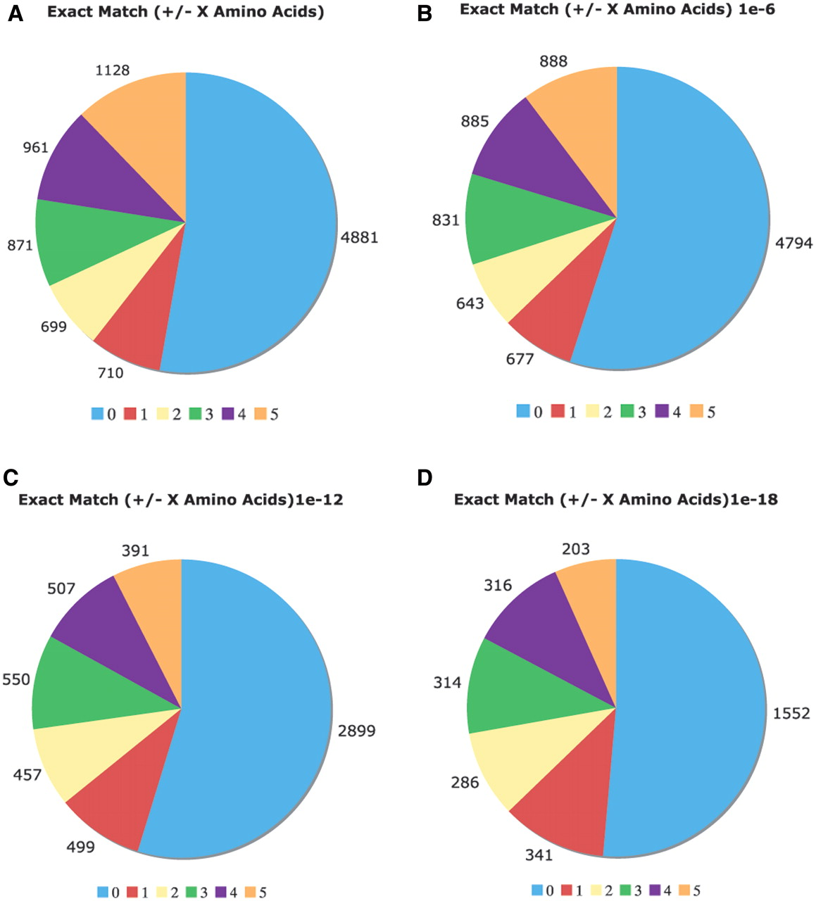
Figure 5. Comparison of the Uniprot COMPBIAS annotations with annotations by the LPS algorithm. Pie charts showing the ...
Notes:
Figure 5. Comparison of the Uniprot COMPBIAS annotations with annotations by the LPS algorithm. Pie charts showing the detailed breakdown of how the new LPS-annotate CB annotations correspond with the UniProt COMPBIAS annotations, for four different P-value thresholds (10−4, i.e. all of the LPS-annotate CB annotations; 10−6; 10−12; 10−18). These are depicted in Figure parts A, B, C and D respectively. Annotations that are exactly matching are colored blue, those that are off by one at either end are colored red and so on. The UniProt COMPBIAS records are intentionally limited in the UniProt/SwissProt databases to a few, more specific cases, such as homopolymeric runs, with up to one or two short interruptions in the run (26).
Unless provided in the caption above, the following copyright applies to the content of this slide: © The Author(s) 2011. Published by Oxford University Press.This is Open Access article distributed under the terms of the Creative Commons Attribution Non-Commercial License (http://creativecommons.org/licenses/by-nc/2.5), which permits unrestricted non-commercial use, distribution, and reproduction in any medium, provided the original work is properly cited.

Slide 6
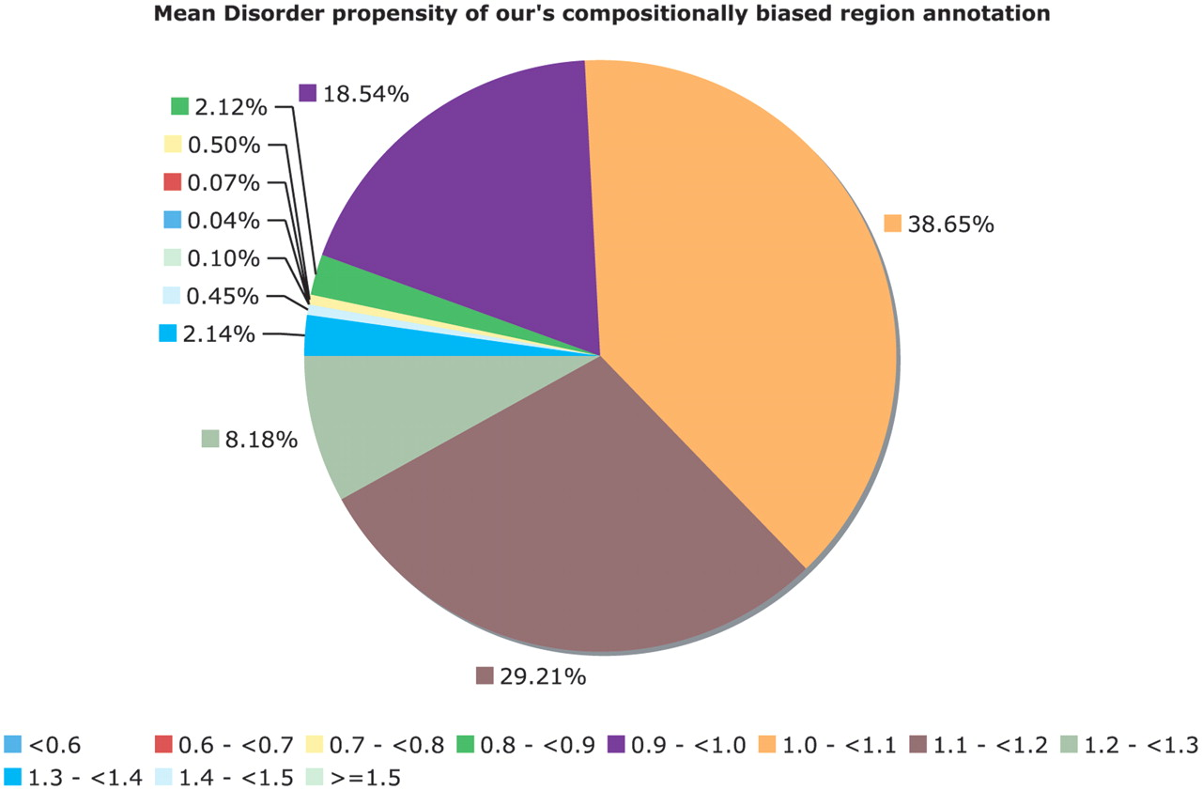
Figure 6. Mean disorder propensity of the CB regions. This is a pie chart for the mean disorder propensity of all CB ...
Notes:
Figure 6. Mean disorder propensity of the CB regions. This is a pie chart for the mean disorder propensity of all CB regions with P < 10−6, with any CB regions that correspond to globular or transmembrane domains removed. The mean disorder propensity is calculated as described in ‘Methods’ section.
Unless provided in the caption above, the following copyright applies to the content of this slide: © The Author(s) 2011. Published by Oxford University Press.This is Open Access article distributed under the terms of the Creative Commons Attribution Non-Commercial License (http://creativecommons.org/licenses/by-nc/2.5), which permits unrestricted non-commercial use, distribution, and reproduction in any medium, provided the original work is properly cited.

