Slide 1
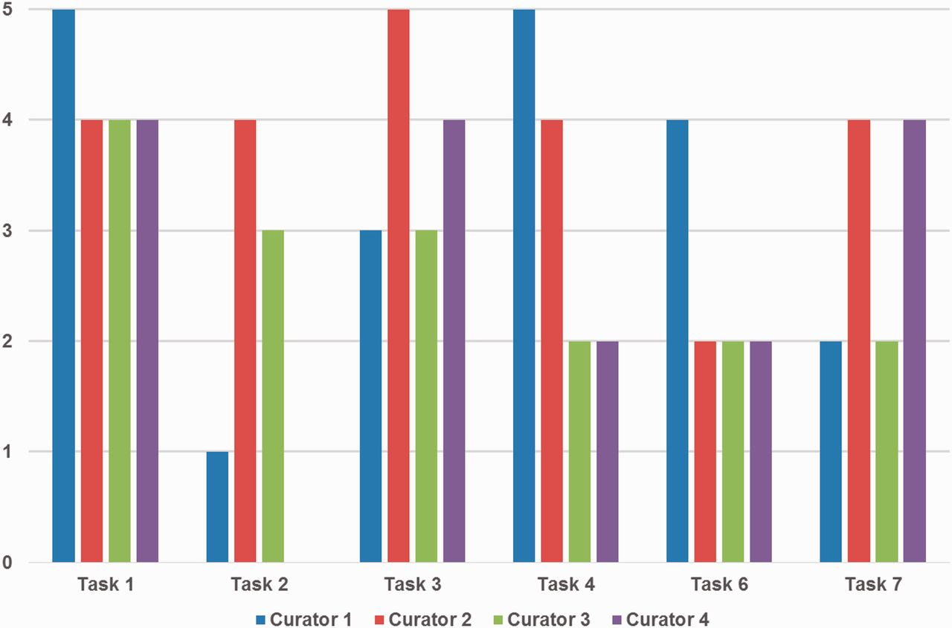
Figure 5. Curators’ ratings for prediction performance for each task. Tasks 1, 2 and 3 are gene/protein named entity ...
Notes:
Figure 5. Curators’ ratings for prediction performance for each task. Tasks 1, 2 and 3 are gene/protein named entity recognition (NER), species/organism NER and gene/protein name normalization, respectively. Tasks 4, 6 and 7 are passages with protein–protein interactions (PPIs), PPI experimental methods and genetic interaction types, respectively. Tasks 1 and 3 received positive responses overall, however ratings were mixed for other tasks depending on curators’ preferences. Curator 4 did not assign a score for Task 2.
Unless provided in the caption above, the following copyright applies to the content of this slide: Published by Oxford University Press 2016. This work is written by US Government employees and is in the public domain in the US.

