Slide 1
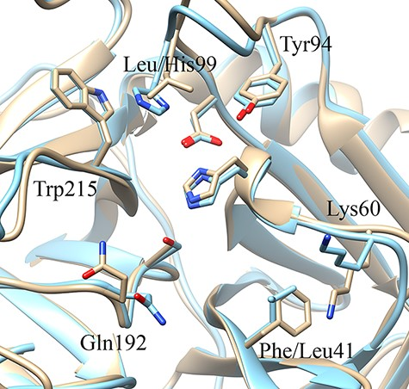
Figure 9. Schematic representation of the three-dimensional structure of the oncogenic protease mesotrypsin [light ...
Notes:
Figure 9. Schematic representation of the three-dimensional structure of the oncogenic protease mesotrypsin [light brown, PDB ID 3L33 (36)] and the closely related kallikrein-6 [blue, PDB ID 1L2E (37)] highlighting similarities and differences in the two subpockets adjacent to the catalytic triad (unlabeled Ser, His and Asp residues) on opposite sides.
Unless provided in the caption above, the following copyright applies to the content of this slide: © The Author(s) 2022. Published by Oxford University Press.This is an Open Access article distributed under the terms of the Creative Commons Attribution-NonCommercial License (https://creativecommons.org/licenses/by-nc/4.0/), which permits non-commercial re-use, distribution, and reproduction in any medium, provided the original work is properly cited. For commercial re-use, please contact journals.permissions@oup.com

