Slide 1
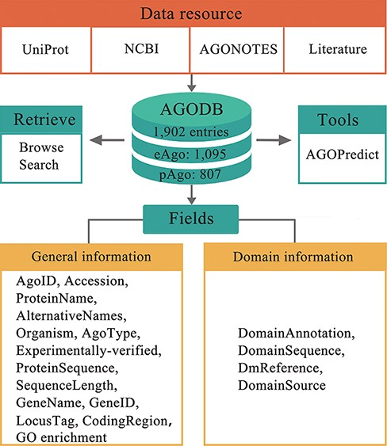
Figure 1. Architecture of AGODB. AGODB consists of 1902 entries, including 1095 eAgo proteins and 807 pAgo proteins. ...
Notes:
Figure 1. Architecture of AGODB. AGODB consists of 1902 entries, including 1095 eAgo proteins and 807 pAgo proteins. The relevant information of each entry in AGODB was collected from UniProt, NCBI, AGONOTES and published articles. The development of AGODB includes the design of fields, the development of the retrieval system and the integration of tool(s).
Unless provided in the caption above, the following copyright applies to the content of this slide: © The Author(s) 2022. Published by Oxford University Press.This is an Open Access article distributed under the terms of the Creative Commons Attribution-NonCommercial License (https://creativecommons.org/licenses/by-nc/4.0/), which permits non-commercial re-use, distribution, and reproduction in any medium, provided the original work is properly cited. For commercial re-use, please contact journals.permissions@oup.com

