Slide 1
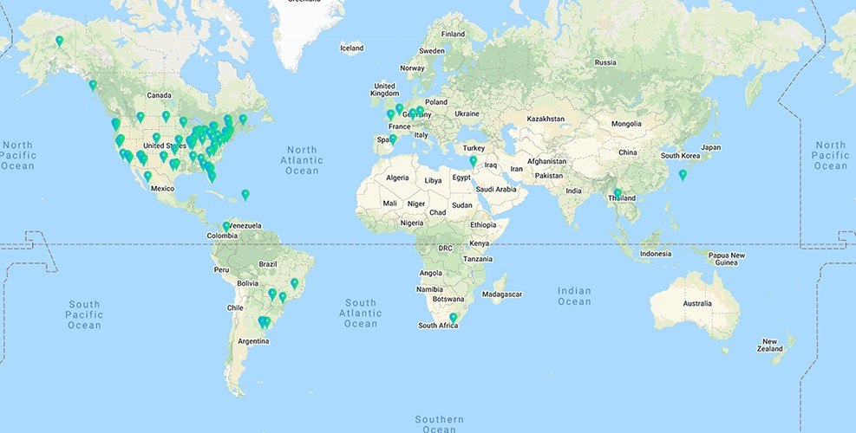
Figure 1. Geographical distribution of the 91 effective respondents. Geolocation resolution was conducted using ...
Notes:
Figure 1. Geographical distribution of the 91 effective respondents. Geolocation resolution was conducted using https://ipapi.co/ on the respondent IP addresses collected by Qualtrics.
Unless provided in the caption above, the following copyright applies to the content of this slide: © The Author(s) 2022. Published by Oxford University Press.This is an Open Access article distributed under the terms of the Creative Commons Attribution License (https://creativecommons.org/licenses/by/4.0/), which permits unrestricted reuse, distribution, and reproduction in any medium, provided the original work is properly cited.

Slide 2
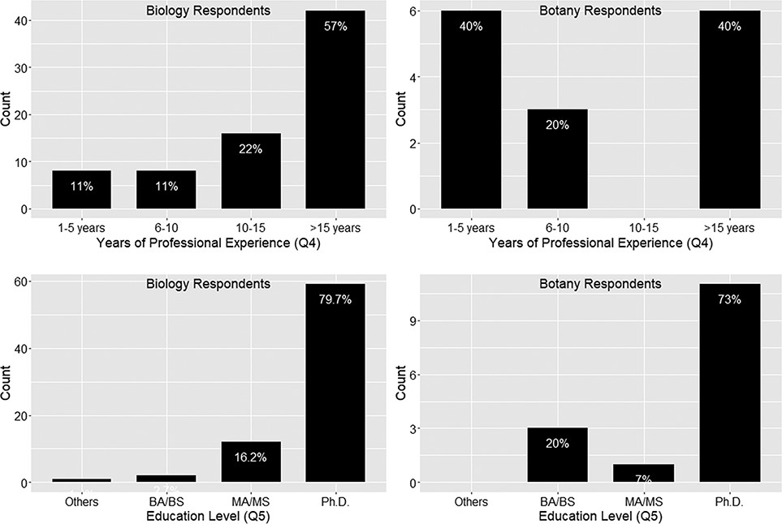
Figure 2. Years of professional experience (Q4) and education level (Q5).
Notes:
Figure 2. Years of professional experience (Q4) and education level (Q5).
Unless provided in the caption above, the following copyright applies to the content of this slide: © The Author(s) 2022. Published by Oxford University Press.This is an Open Access article distributed under the terms of the Creative Commons Attribution License (https://creativecommons.org/licenses/by/4.0/), which permits unrestricted reuse, distribution, and reproduction in any medium, provided the original work is properly cited.

Slide 3
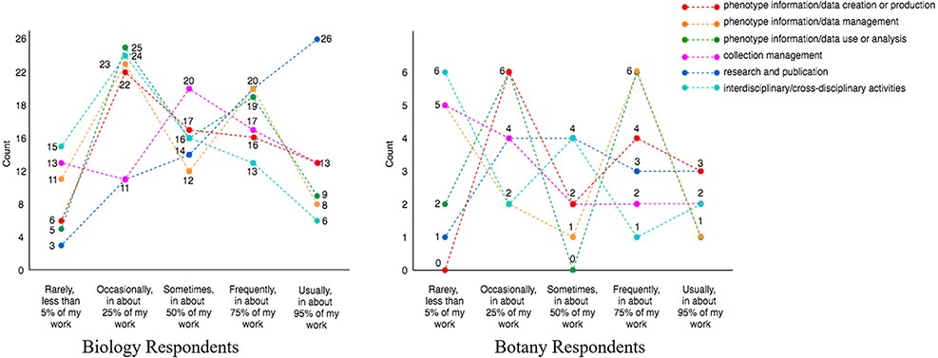
Figure 3. Respondents’ work distribution (Q7).
Notes:
Figure 3. Respondents’ work distribution (Q7).
Unless provided in the caption above, the following copyright applies to the content of this slide: © The Author(s) 2022. Published by Oxford University Press.This is an Open Access article distributed under the terms of the Creative Commons Attribution License (https://creativecommons.org/licenses/by/4.0/), which permits unrestricted reuse, distribution, and reproduction in any medium, provided the original work is properly cited.

Slide 4
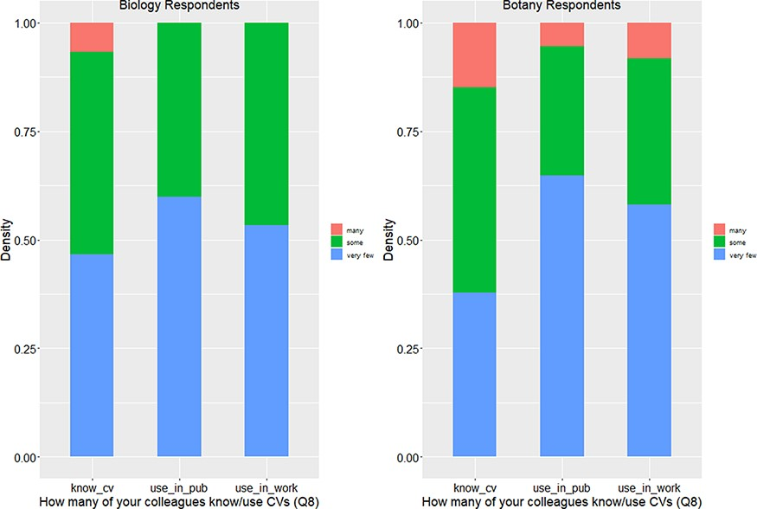
Figure 4. Number of colleagues who know or use controlled vocabularies (Q8).
Notes:
Figure 4. Number of colleagues who know or use controlled vocabularies (Q8).
Unless provided in the caption above, the following copyright applies to the content of this slide: © The Author(s) 2022. Published by Oxford University Press.This is an Open Access article distributed under the terms of the Creative Commons Attribution License (https://creativecommons.org/licenses/by/4.0/), which permits unrestricted reuse, distribution, and reproduction in any medium, provided the original work is properly cited.

Slide 5
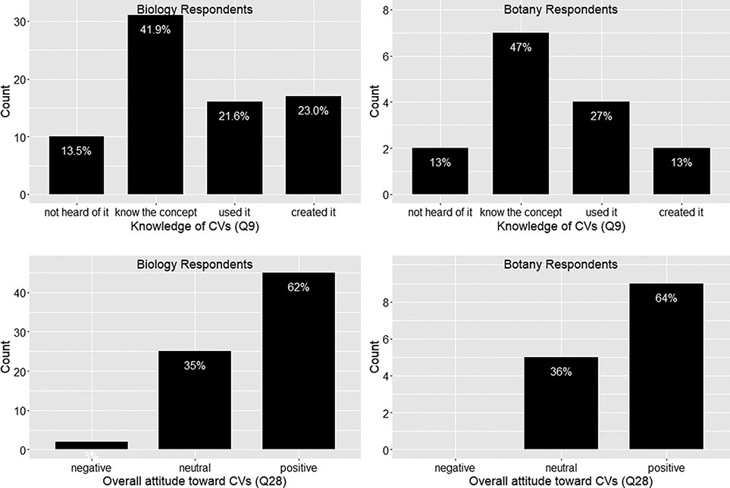
Figure 5. Knowledge of controlled vocabularies (Q9) and overall attitude toward controlled vocabularies (Q28).
Notes:
Figure 5. Knowledge of controlled vocabularies (Q9) and overall attitude toward controlled vocabularies (Q28).
Unless provided in the caption above, the following copyright applies to the content of this slide: © The Author(s) 2022. Published by Oxford University Press.This is an Open Access article distributed under the terms of the Creative Commons Attribution License (https://creativecommons.org/licenses/by/4.0/), which permits unrestricted reuse, distribution, and reproduction in any medium, provided the original work is properly cited.

Slide 6
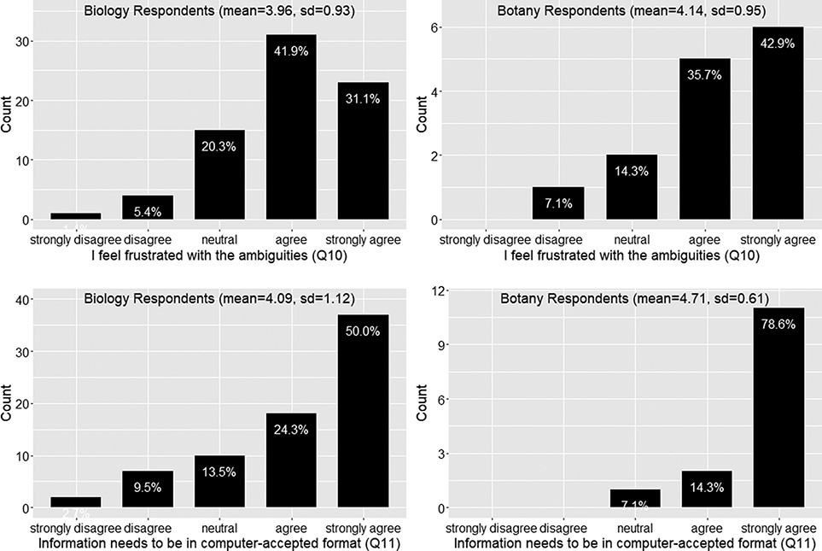
Figure 6. Frustration with ambiguities in phenotype descriptions (Q10) and position on the need for information to be ...
Notes:
Figure 6. Frustration with ambiguities in phenotype descriptions (Q10) and position on the need for information to be in a computer-accepted format for computation” (Q11).
Unless provided in the caption above, the following copyright applies to the content of this slide: © The Author(s) 2022. Published by Oxford University Press.This is an Open Access article distributed under the terms of the Creative Commons Attribution License (https://creativecommons.org/licenses/by/4.0/), which permits unrestricted reuse, distribution, and reproduction in any medium, provided the original work is properly cited.

Slide 7
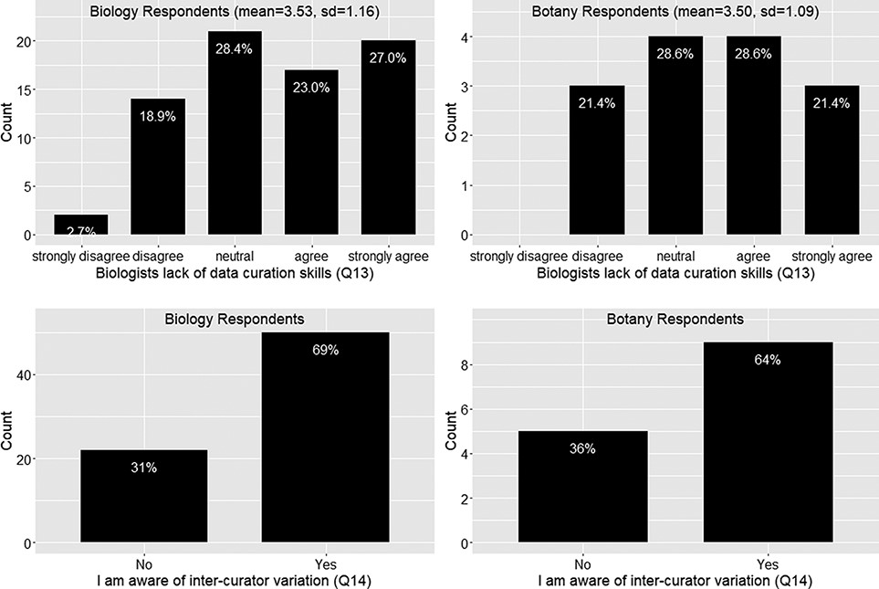
Figure 7. Lack of data curation skills (Q13) and inter-curator variation awareness (Q14).
Notes:
Figure 7. Lack of data curation skills (Q13) and inter-curator variation awareness (Q14).
Unless provided in the caption above, the following copyright applies to the content of this slide: © The Author(s) 2022. Published by Oxford University Press.This is an Open Access article distributed under the terms of the Creative Commons Attribution License (https://creativecommons.org/licenses/by/4.0/), which permits unrestricted reuse, distribution, and reproduction in any medium, provided the original work is properly cited.

Slide 8
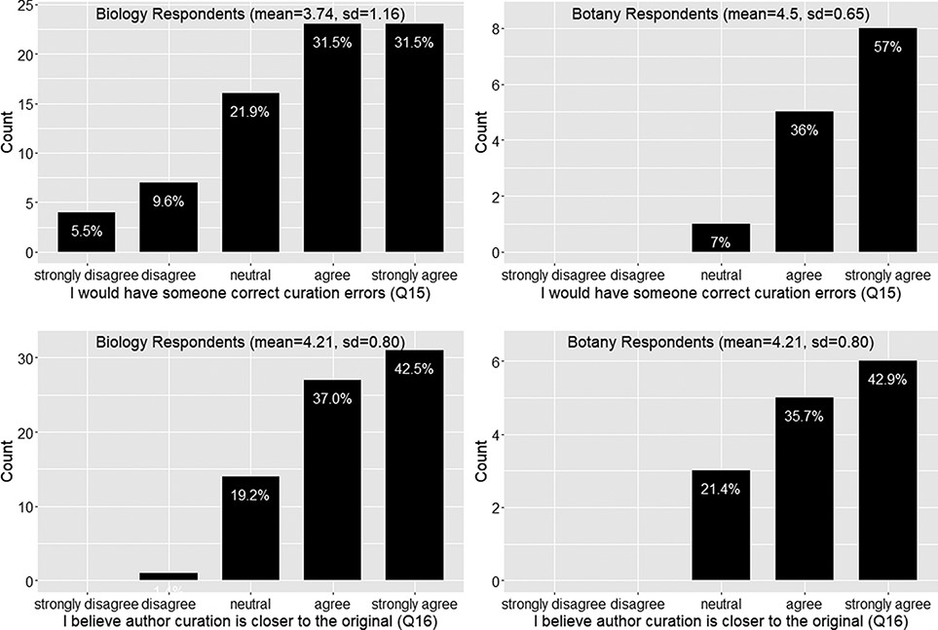
Figure 8. Action to correct curation errors (Q15) and position on whether authors or data curators are more capable of ...
Notes:
Figure 8. Action to correct curation errors (Q15) and position on whether authors or data curators are more capable of retaining the original meaning of a character (Q16).
Unless provided in the caption above, the following copyright applies to the content of this slide: © The Author(s) 2022. Published by Oxford University Press.This is an Open Access article distributed under the terms of the Creative Commons Attribution License (https://creativecommons.org/licenses/by/4.0/), which permits unrestricted reuse, distribution, and reproduction in any medium, provided the original work is properly cited.

Slide 9
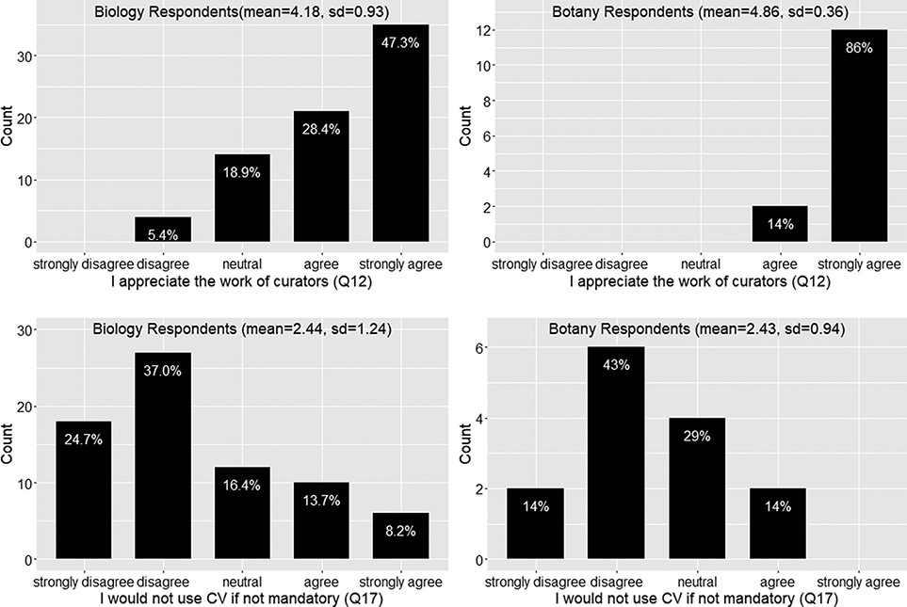
Figure 9. Appreciation of the work of curators (Q12) and willingness to use controlled vocabularies if not mandatory ...
Notes:
Figure 9. Appreciation of the work of curators (Q12) and willingness to use controlled vocabularies if not mandatory (Q17).
Unless provided in the caption above, the following copyright applies to the content of this slide: © The Author(s) 2022. Published by Oxford University Press.This is an Open Access article distributed under the terms of the Creative Commons Attribution License (https://creativecommons.org/licenses/by/4.0/), which permits unrestricted reuse, distribution, and reproduction in any medium, provided the original work is properly cited.

Slide 10
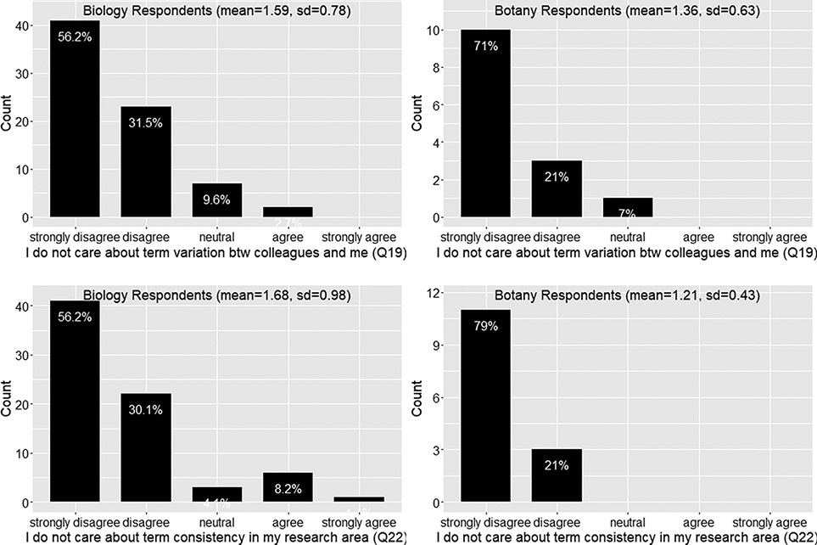
Figure 10. Care about term variation (Q19) and care about term consistency (Q22).
Notes:
Figure 10. Care about term variation (Q19) and care about term consistency (Q22).
Unless provided in the caption above, the following copyright applies to the content of this slide: © The Author(s) 2022. Published by Oxford University Press.This is an Open Access article distributed under the terms of the Creative Commons Attribution License (https://creativecommons.org/licenses/by/4.0/), which permits unrestricted reuse, distribution, and reproduction in any medium, provided the original work is properly cited.

Slide 11
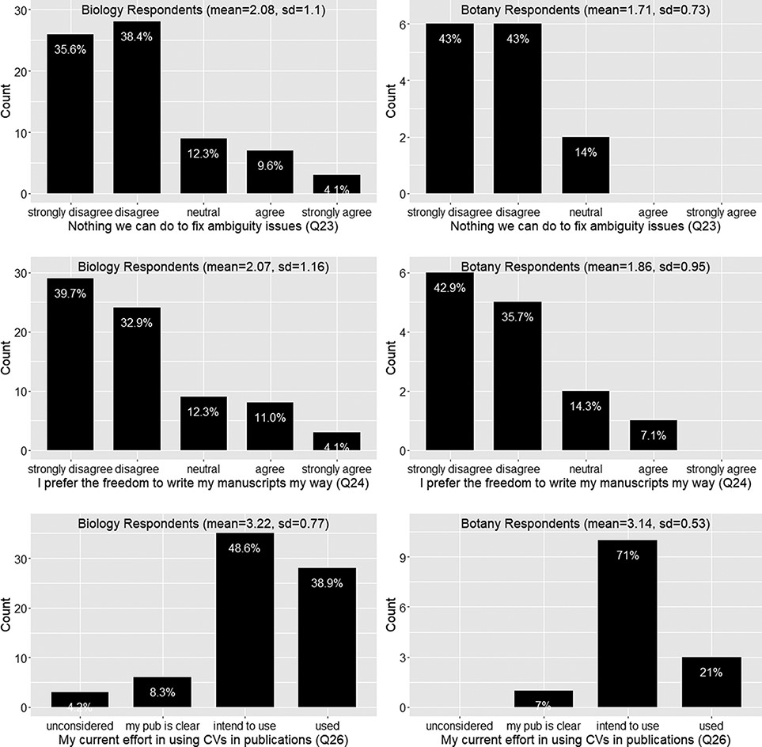
Figure 11. Ambiguity issue cannot be solved (Q23), preference for the freedom to write manuscript own way (Q24) and ...
Notes:
Figure 11. Ambiguity issue cannot be solved (Q23), preference for the freedom to write manuscript own way (Q24) and current effort in using controlled vocabularies in publications (Q26).
Unless provided in the caption above, the following copyright applies to the content of this slide: © The Author(s) 2022. Published by Oxford University Press.This is an Open Access article distributed under the terms of the Creative Commons Attribution License (https://creativecommons.org/licenses/by/4.0/), which permits unrestricted reuse, distribution, and reproduction in any medium, provided the original work is properly cited.

Slide 12
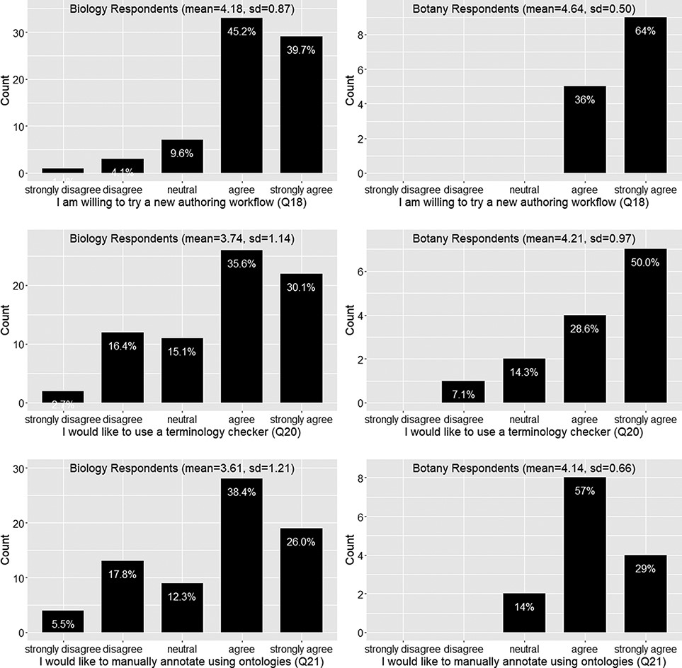
Figure 12. Willingness to use a new authoring workflow (Q18), a terminology checker (Q20), or ontologies to manually ...
Notes:
Figure 12. Willingness to use a new authoring workflow (Q18), a terminology checker (Q20), or ontologies to manually annotate scientific writing (Q21).
Unless provided in the caption above, the following copyright applies to the content of this slide: © The Author(s) 2022. Published by Oxford University Press.This is an Open Access article distributed under the terms of the Creative Commons Attribution License (https://creativecommons.org/licenses/by/4.0/), which permits unrestricted reuse, distribution, and reproduction in any medium, provided the original work is properly cited.

Slide 13
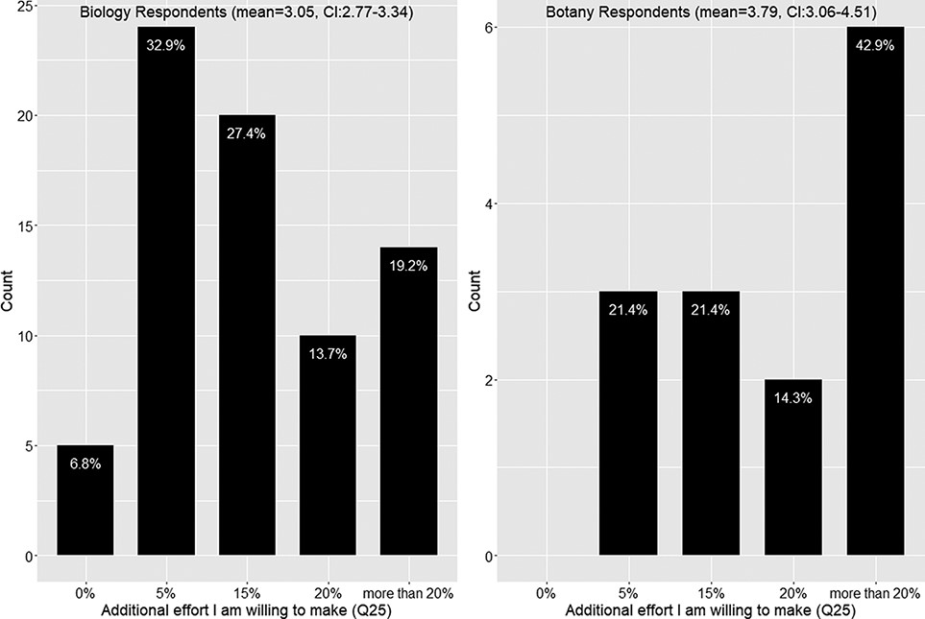
Figure 13. Additional effort respondents are willing to put into making manuscripts more accessible to computation ...
Notes:
Figure 13. Additional effort respondents are willing to put into making manuscripts more accessible to computation (Q25).
Unless provided in the caption above, the following copyright applies to the content of this slide: © The Author(s) 2022. Published by Oxford University Press.This is an Open Access article distributed under the terms of the Creative Commons Attribution License (https://creativecommons.org/licenses/by/4.0/), which permits unrestricted reuse, distribution, and reproduction in any medium, provided the original work is properly cited.

Slide 14
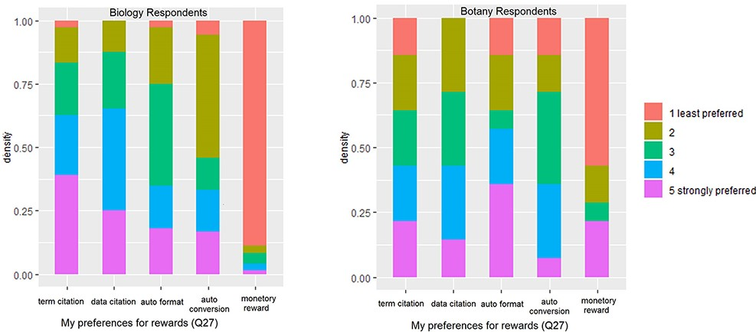
Figure 14. Preferences for rewards (Q27).
Notes:
Figure 14. Preferences for rewards (Q27).
Unless provided in the caption above, the following copyright applies to the content of this slide: © The Author(s) 2022. Published by Oxford University Press.This is an Open Access article distributed under the terms of the Creative Commons Attribution License (https://creativecommons.org/licenses/by/4.0/), which permits unrestricted reuse, distribution, and reproduction in any medium, provided the original work is properly cited.

Slide 15
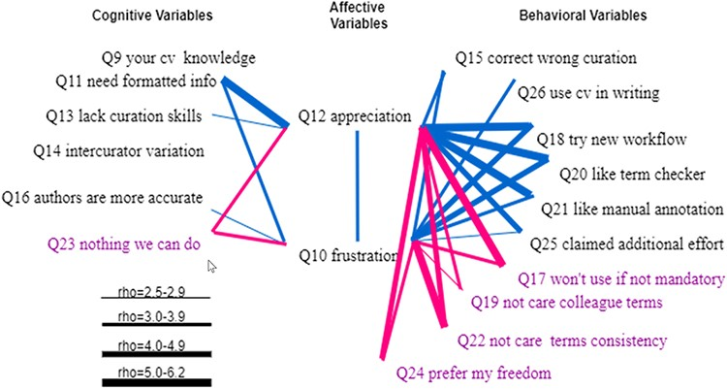
Figure 15. Spearman correlations between affective variables (Q10 and Q12) and (1) cognitive variables (Q9, Q11, Q13, ...
Notes:
Figure 15. Spearman correlations between affective variables (Q10 and Q12) and (1) cognitive variables (Q9, Q11, Q13, Q14, Q16 and Q23) and (2) behavioral variables (Q15, Q26, Q18, Q20, Q21, Q25, Q17, Q19, Q22 and Q24). Variables that indicate a resistance to change are displayed in purple. All links represent statistically significant correlations. Blue links represent positive correlations, while red links for negative correlations. The thickness of the links indicates the strength of a correlation.
Unless provided in the caption above, the following copyright applies to the content of this slide: © The Author(s) 2022. Published by Oxford University Press.This is an Open Access article distributed under the terms of the Creative Commons Attribution License (https://creativecommons.org/licenses/by/4.0/), which permits unrestricted reuse, distribution, and reproduction in any medium, provided the original work is properly cited.

Slide 16
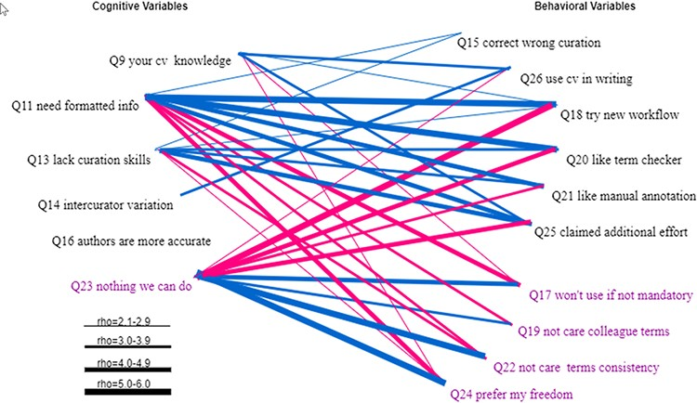
Figure 16. Statistically significant Spearman correlations between the cognitive variables and the behavioral variables. ...
Notes:
Figure 16. Statistically significant Spearman correlations between the cognitive variables and the behavioral variables. Variables that indicate a resistance to change are displayed in purple. All links represent statistically significant correlations. Blue links represent positive correlations, while red links for negative correlations. The thickness of the links indicates the strength of a correlation.
Unless provided in the caption above, the following copyright applies to the content of this slide: © The Author(s) 2022. Published by Oxford University Press.This is an Open Access article distributed under the terms of the Creative Commons Attribution License (https://creativecommons.org/licenses/by/4.0/), which permits unrestricted reuse, distribution, and reproduction in any medium, provided the original work is properly cited.

Slide 17
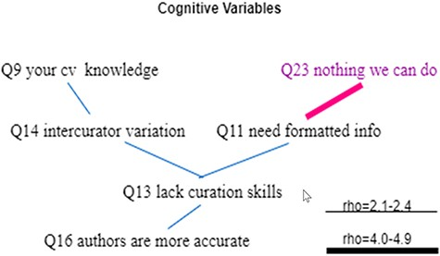
Figure 17. Statistically significant Spearman correlations among cognitive variables. Variables that indicate a ...
Notes:
Figure 17. Statistically significant Spearman correlations among cognitive variables. Variables that indicate a resistance to change are displayed in purple. All links represent statistically significant correlations. Blue links represent positive correlations, while red links represent negative correlations. The thickness of the links indicates the strength of a correlation.
Unless provided in the caption above, the following copyright applies to the content of this slide: © The Author(s) 2022. Published by Oxford University Press.This is an Open Access article distributed under the terms of the Creative Commons Attribution License (https://creativecommons.org/licenses/by/4.0/), which permits unrestricted reuse, distribution, and reproduction in any medium, provided the original work is properly cited.

Slide 18
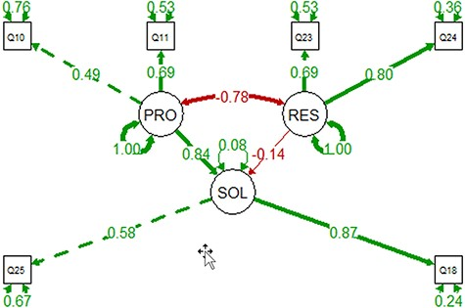
Figure 18. The PRO-SOL-RES model constructed with the 91 observations. Circles are for latent variables, and boxes are ...
Notes:
Figure 18. The PRO-SOL-RES model constructed with the 91 observations. Circles are for latent variables, and boxes are for measured variables. Self-directing, double-arrowed links show the residuals. Double-arrowed links between two variables indicate correlation, where single-arrowed links show causal relationships. Positive correlations are shown in green, and negative in red. The model shows that increased awareness of the problems can reduce resistance and increase adoption.
Unless provided in the caption above, the following copyright applies to the content of this slide: © The Author(s) 2022. Published by Oxford University Press.This is an Open Access article distributed under the terms of the Creative Commons Attribution License (https://creativecommons.org/licenses/by/4.0/), which permits unrestricted reuse, distribution, and reproduction in any medium, provided the original work is properly cited.

