Slide 1
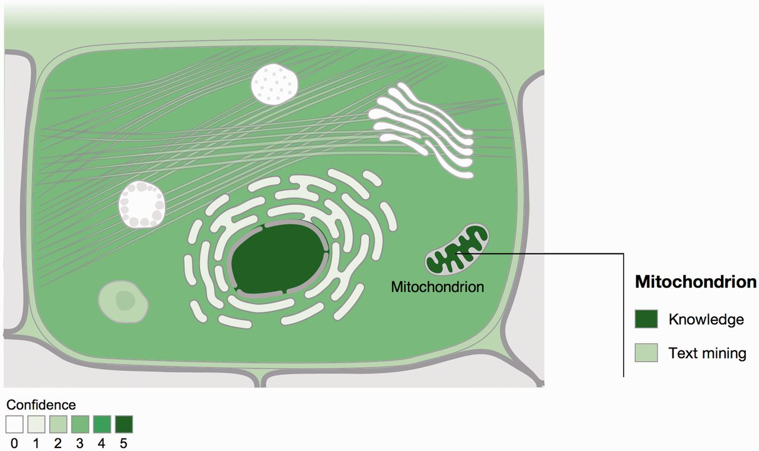
Figure 1. Visualization of localization evidence. When querying the database for a protein, its localization is ...
Notes:
Figure 1. Visualization of localization evidence. When querying the database for a protein, its localization is visualized on a schematic of a cell. When the user hovers the cursor over a compartment, we also graphically summarize the types of evidence supporting this localization. The confidence of the evidence is color coded, ranging from light green for low confidence to dark green for high confidence. White indicates an absence of localization evidence.
Unless provided in the caption above, the following copyright applies to the content of this slide: © The Author(s) 2014. Published by Oxford University Press.This is an Open Access article distributed under the terms of the Creative Commons Attribution License (http://creativecommons.org/licenses/by/3.0/), which permits unrestricted reuse, distribution, and reproduction in any medium, provided the original work is properly cited.

