Slide 1
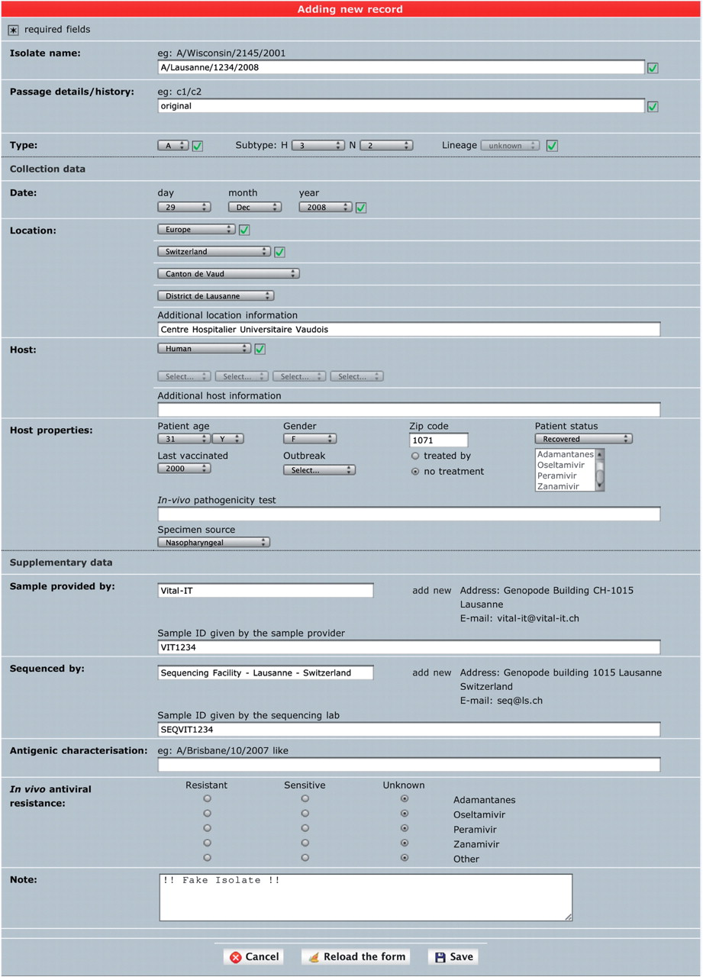
Figure 1. ‘Single isolate upload’ interface. The web form is split into three parts. The top one contains fields to ...
Notes:
Figure 1. ‘Single isolate upload’ interface. The web form is split into three parts. The top one contains fields to specify isolate name, isolate type and passage history. The syntax of the isolate name is verified against sample collection year and standard influenza nomenclature (except for laboratory-derived strains). The middle part contains sample data including host and sample collection date and geographical location. The bottom part contains additional data including sample provider laboratory, sequencer laboratory, in vivo tested antiviral resistance and user note.
Unless provided in the caption above, the following copyright applies to the content of this slide: © The Author(s) 2010. Published by Oxford University Press.This is Open Access article distributed under the terms of the Creative Commons Attribution Non-Commercial License (http://creativecommons.org/licenses/by-nc/2.5), which permits unrestricted non-commercial use, distribution, and reproduction in any medium, provided the original work is properly cited.

