Slide 1
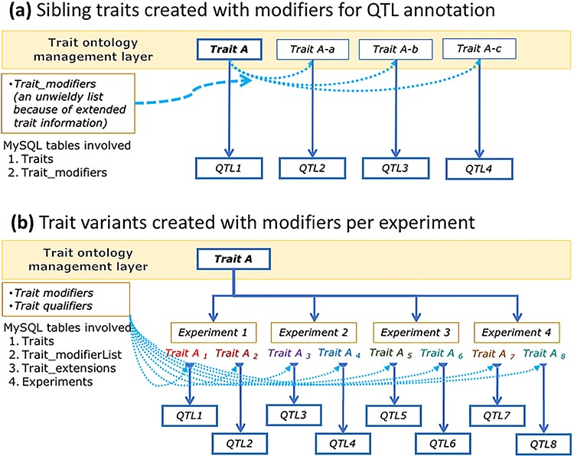
Figure 2. A conceptual graph showing data structure differences between ‘sibling traits’ (modified as part of ontology ...
Notes:
Figure 2. A conceptual graph showing data structure differences between ‘sibling traits’ (modified as part of ontology extensions) (a) and ‘trait variants’ (modified with extended info) created at the experiment level (b), their use in QTL data annotations and their effects on ontology trait data management.
Unless provided in the caption above, the following copyright applies to the content of this slide: © The Author(s) 2023. Published by Oxford University Press.This is an Open Access article distributed under the terms of the Creative Commons Attribution License (https://creativecommons.org/licenses/by/4.0/), which permits unrestricted reuse, distribution, and reproduction in any medium, provided the original work is properly cited.

