Slide 1
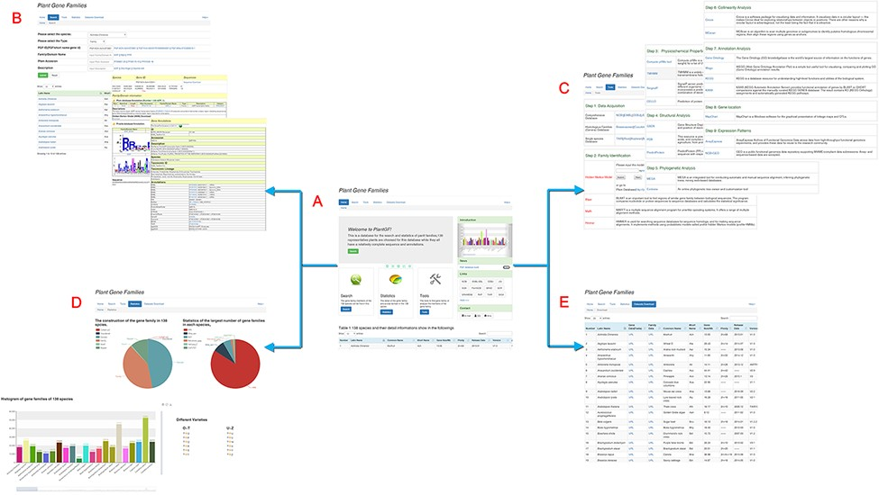
Figure 1. Main PlantGF web page. (A) PlantGF homepage: provides quick entry paths to all main parts. (B) Search: ...
Notes:
Figure 1. Main PlantGF web page. (A) PlantGF homepage: provides quick entry paths to all main parts. (B) Search: contains 2 909 580 gene family members and their specific detail annotations. (C) Tools: consists of nine steps in gene family analysis. Among that, four online tools (HMM-Search, BLAST, MAFFT and HMMER) also exist. (D) Statistics: statistics among these gene families. (E) Datasets Download: provides download links of 138 plant species’ protein sequences and their gene families.
Unless provided in the caption above, the following copyright applies to the content of this slide: © The Author(s) 2022. Published by Oxford University Press.This is an Open Access article distributed under the terms of the Creative Commons Attribution License (https://creativecommons.org/licenses/by/4.0/), which permits unrestricted reuse, distribution, and reproduction in any medium, provided the original work is properly cited.

