Slide 1
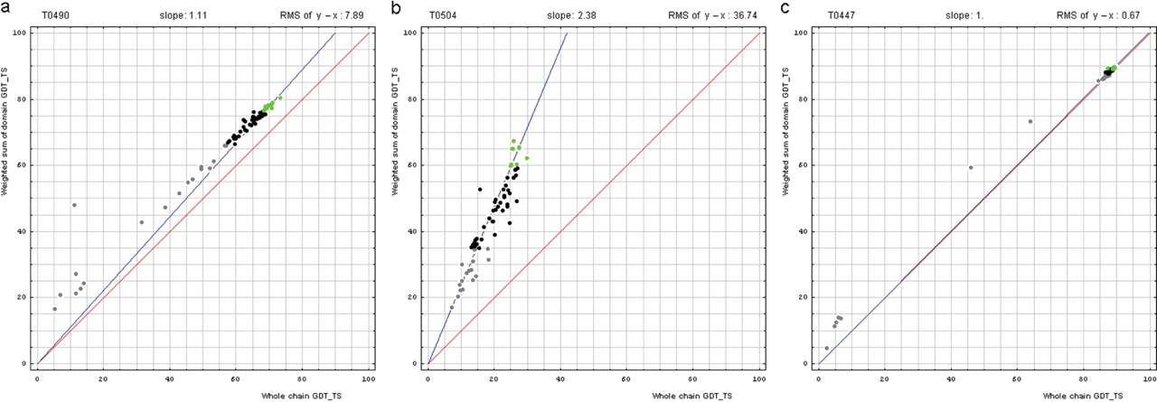
Figure 1. Correlation between domain-based evaluation (y, vertical axis) and whole-chain GDT-TS (x, horizontal axis). ...
Notes:
Figure 1. Correlation between domain-based evaluation (y, vertical axis) and whole-chain GDT-TS (x, horizontal axis). (a) A typical correlation plot for target T0490. (b) A plot of target T0504 showing beneficial domain evaluation for this target. (c) A plot of target T0447 showing unnecessary domain evaluation for this target. Each point represents first server models. Green, gray and black points represent the top 10, the bottom 25% and the remaining prediction models, respectively. The blue line is the best-fit slope (intersection 0) to the top 10 server models. The red line is the diagonal. The slope and RMS y − x distance for the top 10 models (average difference between the weighted sum of domain GDT-TS scores and the whole-chain GDT-TS score) are shown above the plot.
Unless provided in the caption above, the following copyright applies to the content of this slide: © 2009 The Author(s).This is Open Access article distributed under the terms of the Creative Commons Attribution Non-Commercial License (http://creativecommons.org/licenses/by-nc/2.0/uk/) which permits unrestricted non-commercial use, distribution, and reproduction in any medium, provided the original work is properly cited.

