Slide 1
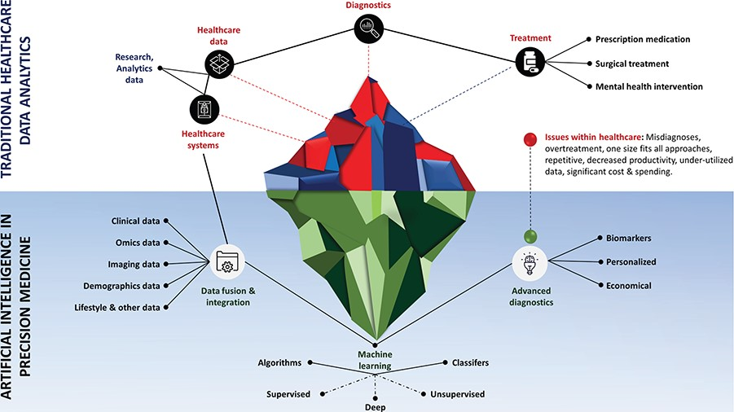
Figure 1 Role of artificial intelligence in traditional healthcare data analytics, and in precision medicine. ...
Notes:
Figure 1 Role of artificial intelligence in traditional healthcare data analytics, and in precision medicine. Addressing key issues in healthcare (e.g. misdiagnoses, overtreatment, one-size-fits-all approaches, repetitive, decreased productivity, under-utilized data, significant cost & spending), and finding key biomarkers to provide economic and personalized treatment by intelligently analyzing heterogeneous data.
Unless provided in the caption above, the following copyright applies to the content of this slide: © The Author(s) 2020. Published by Oxford University Press.This is an Open Access article distributed under the terms of the Creative Commons Attribution License (http://creativecommons.org/licenses/by/4.0/), which permits unrestricted reuse, distribution, and reproduction in any medium, provided the original work is properly cited.

Slide 2
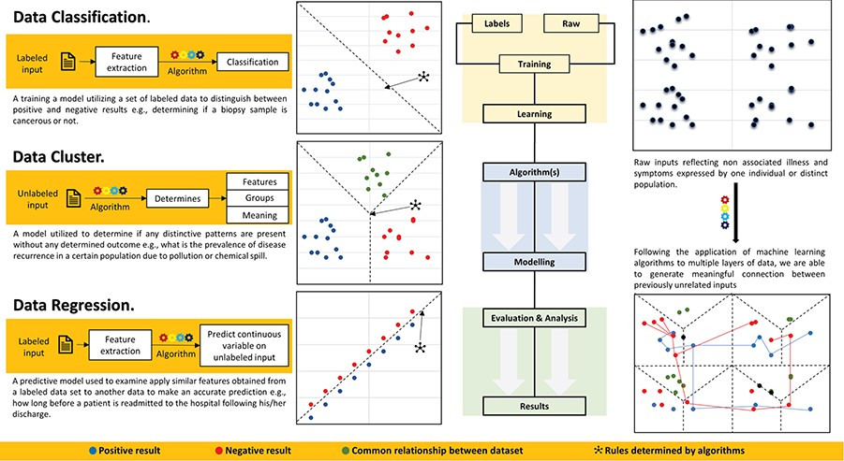
Figure 2 Data classification, clustering and regression for healthcare data analytics. ML application process includes ...
Notes:
Figure 2 Data classification, clustering and regression for healthcare data analytics. ML application process includes creating and labeling of raw data, training classifier for data modeling using appropriate algorithm and analyzing and reporting results.
Unless provided in the caption above, the following copyright applies to the content of this slide: © The Author(s) 2020. Published by Oxford University Press.This is an Open Access article distributed under the terms of the Creative Commons Attribution License (http://creativecommons.org/licenses/by/4.0/), which permits unrestricted reuse, distribution, and reproduction in any medium, provided the original work is properly cited.

Slide 3
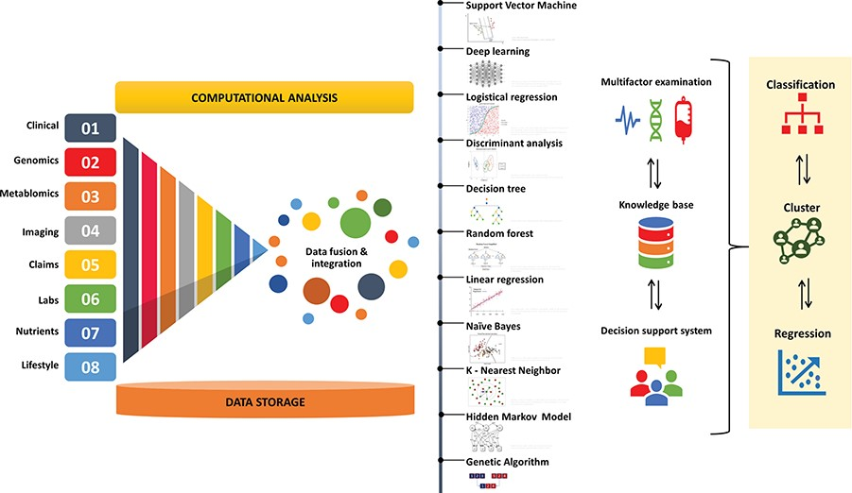
Figure 3 Applying machine learning algorithms for clinical, genomics, metabolomics, imaging, claims, labs, nutrients ...
Notes:
Figure 3 Applying machine learning algorithms for clinical, genomics, metabolomics, imaging, claims, labs, nutrients and life style data fusion, integration and analysis. Machine learning algorithms include, support vector machine, deep learning, logistic regression, discriminant analysis, decision tree, Random forest, linear regression, naïve Bayes, K-nearest neighbor, hidden Markov model and genetic algorithm.
Unless provided in the caption above, the following copyright applies to the content of this slide: © The Author(s) 2020. Published by Oxford University Press.This is an Open Access article distributed under the terms of the Creative Commons Attribution License (http://creativecommons.org/licenses/by/4.0/), which permits unrestricted reuse, distribution, and reproduction in any medium, provided the original work is properly cited.

