Slide 1
Figure 1. Manual summary of MatA from RegulonDB. Numbers in brackets are citations for the articles employed to ...
Notes:
Figure 1. Manual summary of MatA from RegulonDB. Numbers in brackets are citations for the articles employed to elaborate the summary.
Unless provided in the caption above, the following copyright applies to the content of this slide: © The Author(s) 2020. Published by Oxford University Press.This is an Open Access article distributed under the terms of the Creative Commons Attribution License (http://creativecommons.org/licenses/by/4.0/), which permits unrestricted reuse, distribution, and reproduction in any medium, provided the original work is properly cited.

Slide 2
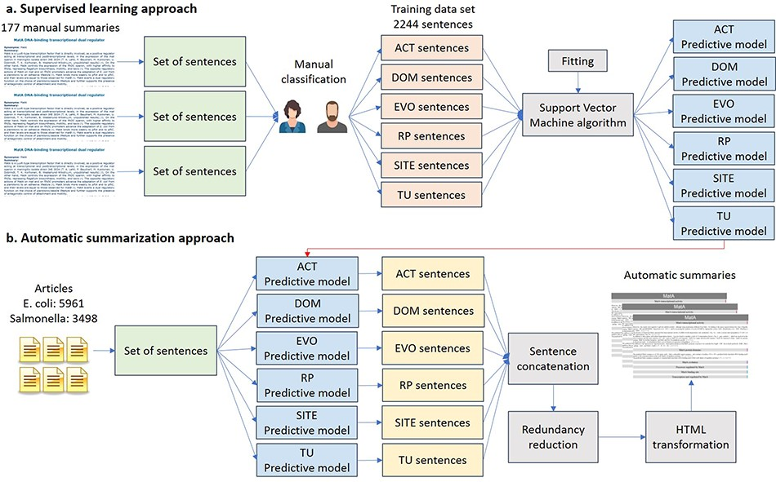
Figure 2. Automatic approach for knowledge extraction of TF properties. (a) Supervised learning approach. (b) Automatic ...
Notes:
Figure 2. Automatic approach for knowledge extraction of TF properties. (a) Supervised learning approach. (b) Automatic summarization.
Unless provided in the caption above, the following copyright applies to the content of this slide: © The Author(s) 2020. Published by Oxford University Press.This is an Open Access article distributed under the terms of the Creative Commons Attribution License (http://creativecommons.org/licenses/by/4.0/), which permits unrestricted reuse, distribution, and reproduction in any medium, provided the original work is properly cited.

Slide 3
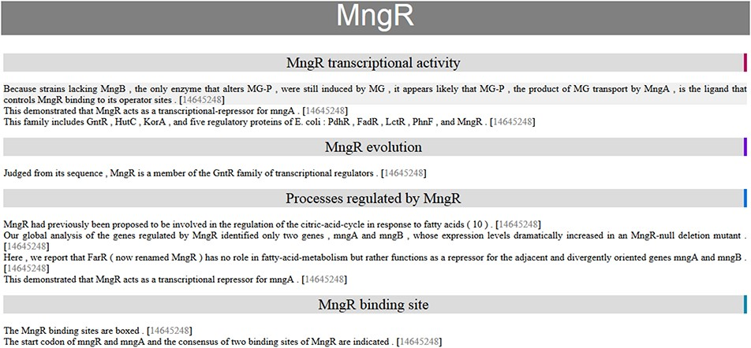
Figure 3. Automatic summary of MngR in HTML format, showing sentences classified into TF properties and with the PubMed ...
Notes:
Figure 3. Automatic summary of MngR in HTML format, showing sentences classified into TF properties and with the PubMed ID hyperlink to the article in the PubMed database. The automatic summary is organized by separating properties in different sections, and sentences are sorted by similarity, so that the curator finds related information together.
Unless provided in the caption above, the following copyright applies to the content of this slide: © The Author(s) 2020. Published by Oxford University Press.This is an Open Access article distributed under the terms of the Creative Commons Attribution License (http://creativecommons.org/licenses/by/4.0/), which permits unrestricted reuse, distribution, and reproduction in any medium, provided the original work is properly cited.

Slide 4
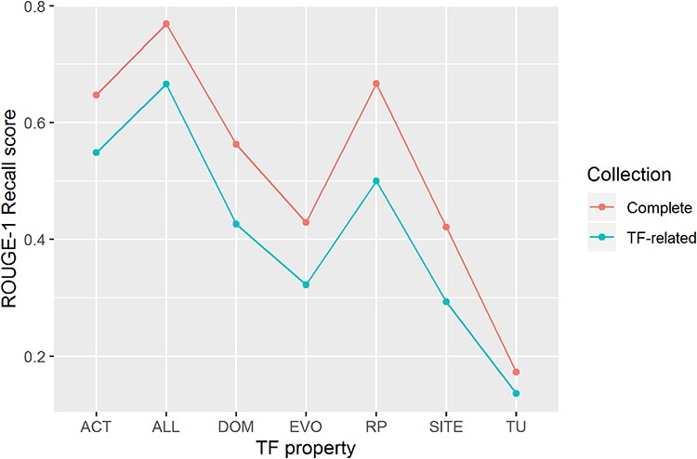
Figure 4. ROUGE-1 recalls scores obtained by automatic summaries without stop words for all properties (ALL) and for ...
Notes:
Figure 4. ROUGE-1 recalls scores obtained by automatic summaries without stop words for all properties (ALL) and for each property. Automatic summaries were created using the complete article collection (Complete) and using only TF-related articles (TF-related).
Unless provided in the caption above, the following copyright applies to the content of this slide: © The Author(s) 2020. Published by Oxford University Press.This is an Open Access article distributed under the terms of the Creative Commons Attribution License (http://creativecommons.org/licenses/by/4.0/), which permits unrestricted reuse, distribution, and reproduction in any medium, provided the original work is properly cited.

Slide 5
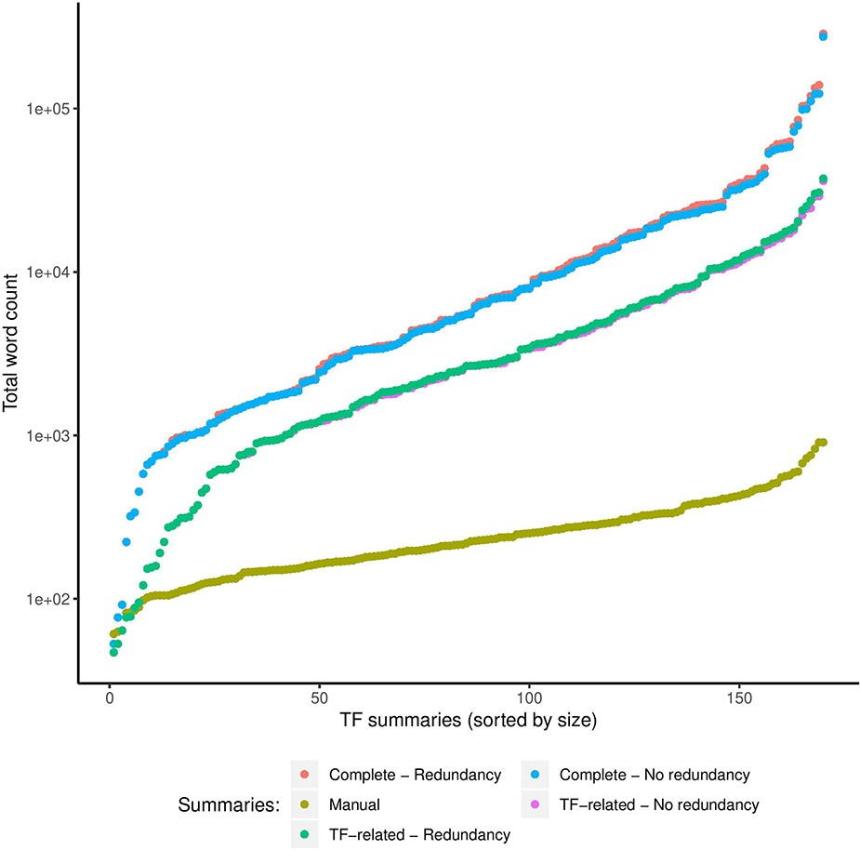
Figure 5. Comparison of sizes in total words (log scale) of manual and automatic summaries. We show the size of ...
Notes:
Figure 5. Comparison of sizes in total words (log scale) of manual and automatic summaries. We show the size of automatic summaries generated from the complete article collection and from the TF-related articles. Also, we show the size of the automatic summaries with (redundancy) and without redundant sentences (no redundancy).
Unless provided in the caption above, the following copyright applies to the content of this slide: © The Author(s) 2020. Published by Oxford University Press.This is an Open Access article distributed under the terms of the Creative Commons Attribution License (http://creativecommons.org/licenses/by/4.0/), which permits unrestricted reuse, distribution, and reproduction in any medium, provided the original work is properly cited.

