Slide 1
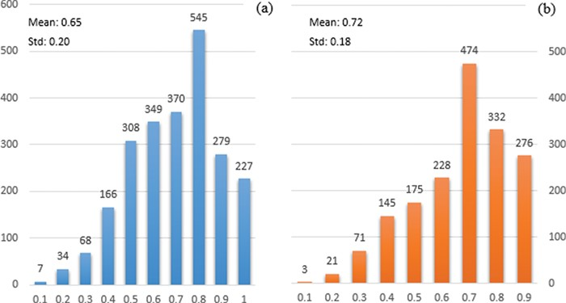
Figure 2 Distribution of the probability of documents having interactions identified by PIE the search. The x-axis ...
Notes:
Figure 2 Distribution of the probability of documents having interactions identified by PIE the search. The x-axis displays the probability score output by PIE the search (normalized to [0, 1]); a higher score indicates higher probability of having interaction. The y-axis reflects the number of documents. (a) and (b) represent the distribution for non-relevant (blue) and relevant documents (orange), respectively.
Unless provided in the caption above, the following copyright applies to the content of this slide: © The Author(s) 2018. Published by Oxford University Press.This is an Open Access article distributed under the terms of the Creative Commons Attribution License (http://creativecommons.org/licenses/by/4.0/), which permits unrestricted reuse, distribution, and reproduction in any medium, provided the original work is properly cited.

