Slide 1
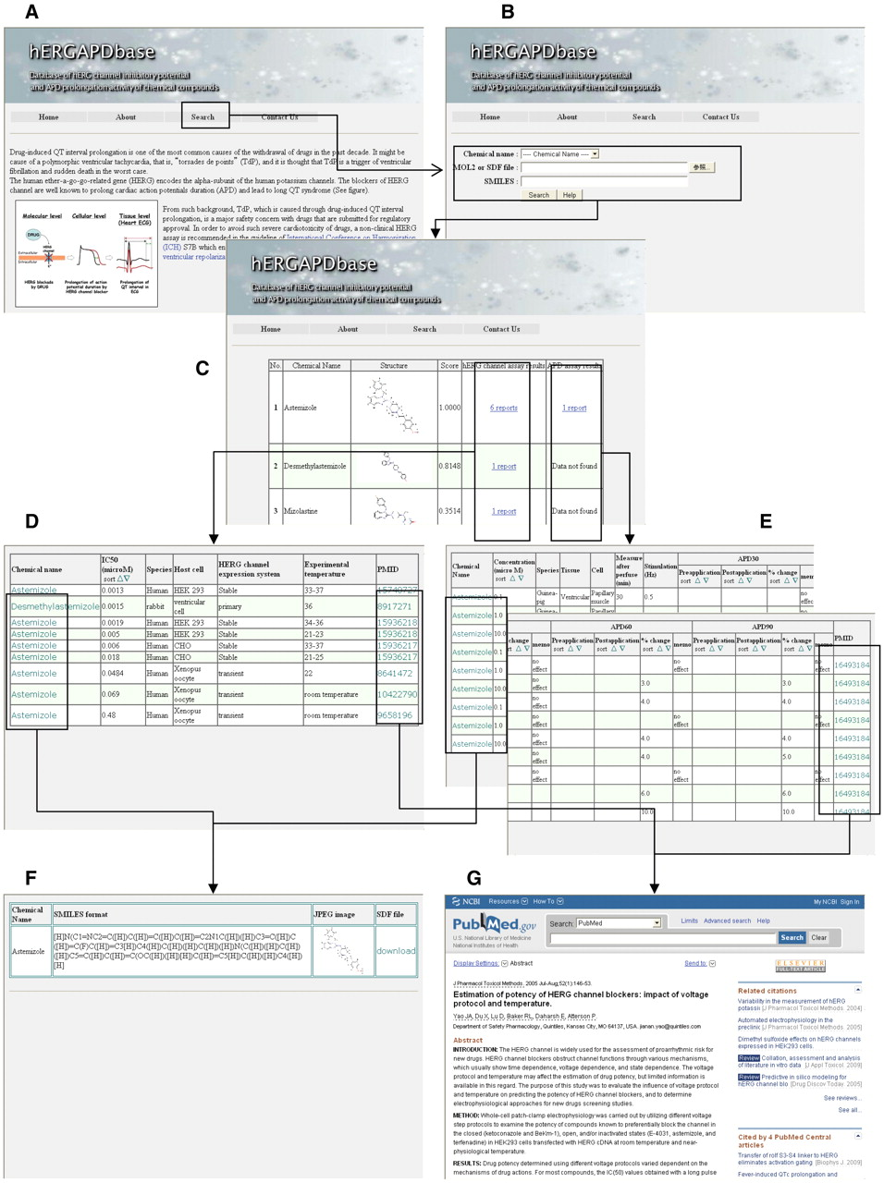
Figure 3. Overall outline of hERGAPDbase. (A) Homepage of hERGAPDbase. (B) Screen capture of the similarity search ...
Notes:
Figure 3. Overall outline of hERGAPDbase. (A) Homepage of hERGAPDbase. (B) Screen capture of the similarity search homepage for query input. In this example, astemizole is specified in the pull-down menu. (C) The resulting table from the similarity search in the FP DB of the hERGAPDbase. (D) Table of the hERG assay data for astemizole in this example. (E) Table of the APD assay data for astemizole. (F) Platform of data download for SDF, SMILES and JPEG files. (G) Paper abstracts of data resources for the hERG and APD assays from PubMed.
Unless provided in the caption above, the following copyright applies to the content of this slide: © The Author(s) 2011. Published by Oxford University Press.This is Open Access article distributed under the terms of the Creative Commons Attribution Non-Commercial License (http://creativecommons.org/licenses/by-nc/2.5), which permits unrestricted non-commercial use, distribution, and reproduction in any medium, provided the original work is properly cited.

