Slide 1
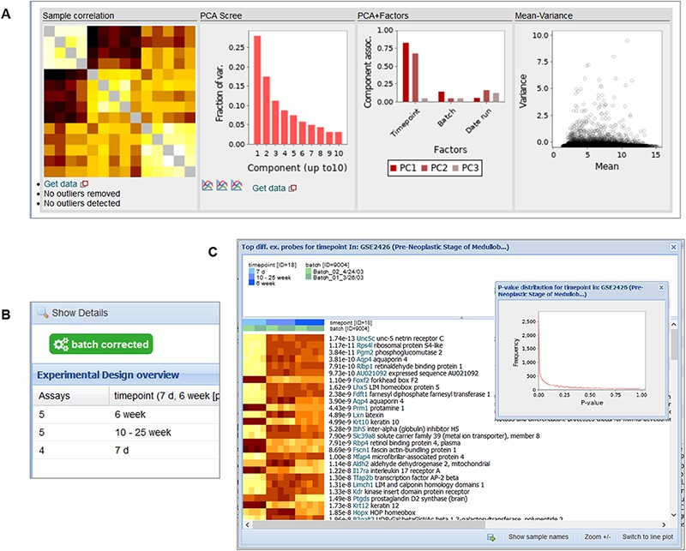
Figure 10. Snapshot of the contents in the ‘Diagnostics’ tab (A), ‘Experimental Design’ tab (B) and the ‘Differential ...
Notes:
Figure 10. Snapshot of the contents in the ‘Diagnostics’ tab (A), ‘Experimental Design’ tab (B) and the ‘Differential Expression’ buttons (C) for GSE2426 [https://tinyurl.com/Gemma-GSE2426, (62)]. Within the diagnostics tab, a sample–sample gene expression correlation heatmap, PCA scree plot, PCA–Factor association plot and mean–variance scatterplot are displayed. For the differential expression details, a heatmap of the top differentially expressed platform elements and histogram of P-value distribution of the platform elements (inset) are provided.
Unless provided in the caption above, the following copyright applies to the content of this slide: © The Author(s) 2021. Published by Oxford University Press.This is an Open Access article distributed under the terms of the Creative Commons Attribution License (http://creativecommons.org/licenses/by/4.0/), which permits unrestricted reuse, distribution, and reproduction in any medium, provided the original work is properly cited.

