Slide 1
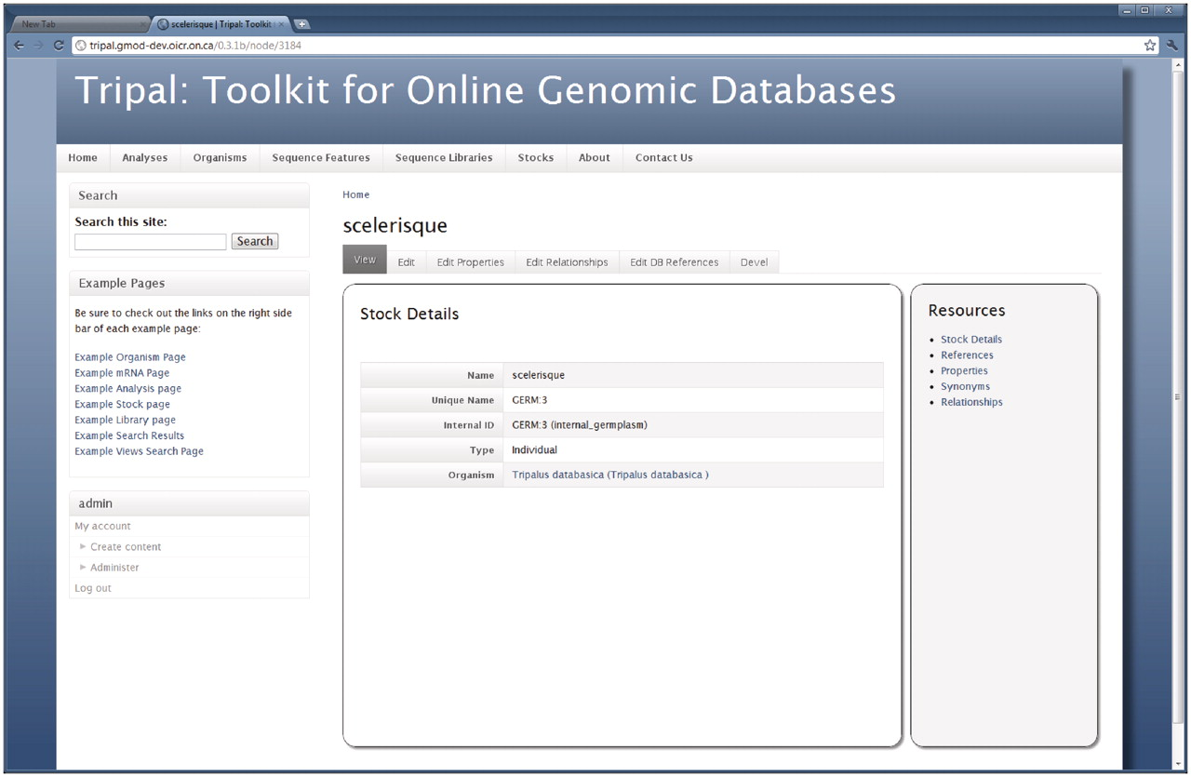
Figure 7. The Stock page. As shown, the Stock page is similar to the Organism and Feature pages in that a visitor first ...
Notes:
Figure 7. The Stock page. As shown, the Stock page is similar to the Organism and Feature pages in that a visitor first views basic details describing the stock. The right sidebar provides information for the given stock including references to the stock in other databases, additional properties for the stock (such as comments), synonyms and relationships with other stocks. The tabs above the stock details allow privileged users to edit the basic details and add, update or delete properties, references or relationships for the current stock. These tabs are not present for non-privileged visitors. As with other pages, the site administrator may tailor the look-and-feel of this page by editing the appropriate template files. In this example, the site administrator is logged on. A navigation box appears on the bottom-right hand side that provides administrative access to the site.
Unless provided in the caption above, the following copyright applies to the content of this slide: © The Author(s) 2011. Published by Oxford University Press.This is an Open Access article distributed under the terms of the Creative Commons Attribution Non-Commercial License (http://creativecommons.org/licenses/by-nc/3.0), which permits unrestricted non-commercial use, distribution, and reproduction in any medium, provided the original work is properly cited.

