Slide 1
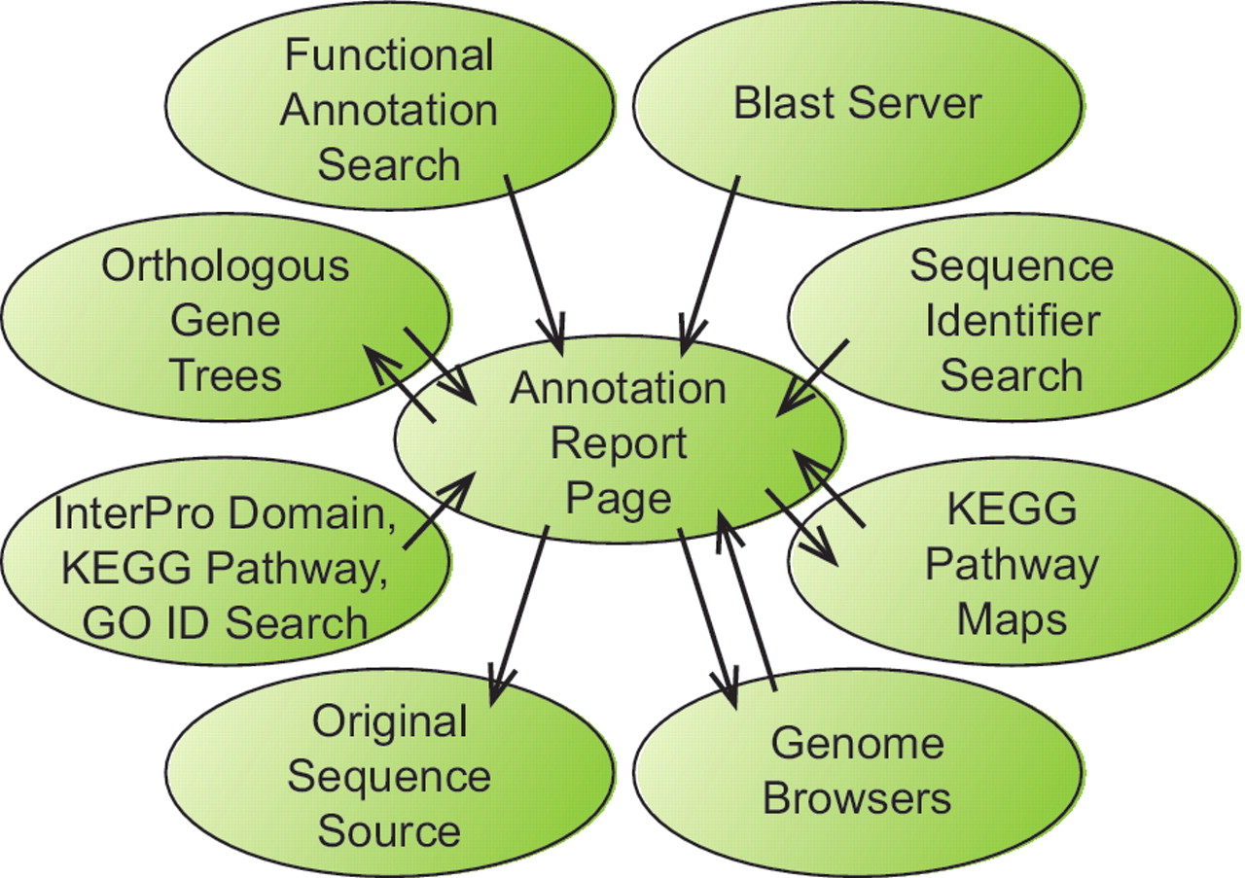
Figure 1. Information flow within the BFGR website. The Annotation Report Page maintains a central position within the ...
Notes:
Figure 1. Information flow within the BFGR website. The Annotation Report Page maintains a central position within the organization of the BFGR database website. Features in tracks on the genome browsers, BLAST results and multiple other search results all provide links to sequence Annotation Report Pages. Additionally, Annotation Report Pages present graphical KEGG pathway maps and orthologous gene trees have links to the Annotation Report Pages for other sequences. Links also exist from Annotation Report Pages to the BFGR genome browsers and the original sequence source of the sequence.
Unless provided in the caption above, the following copyright applies to the content of this slide: © The Author(s) 2012. Published by Oxford University Press.This is an Open Access article distributed under the terms of the Creative Commons Attribution Non-Commercial License (http://creativecommons.org/licenses/by-nc/3.0), which permits unrestricted non-commercial use, distribution, and reproduction in any medium, provided the original work is properly cited.

