Slide 1
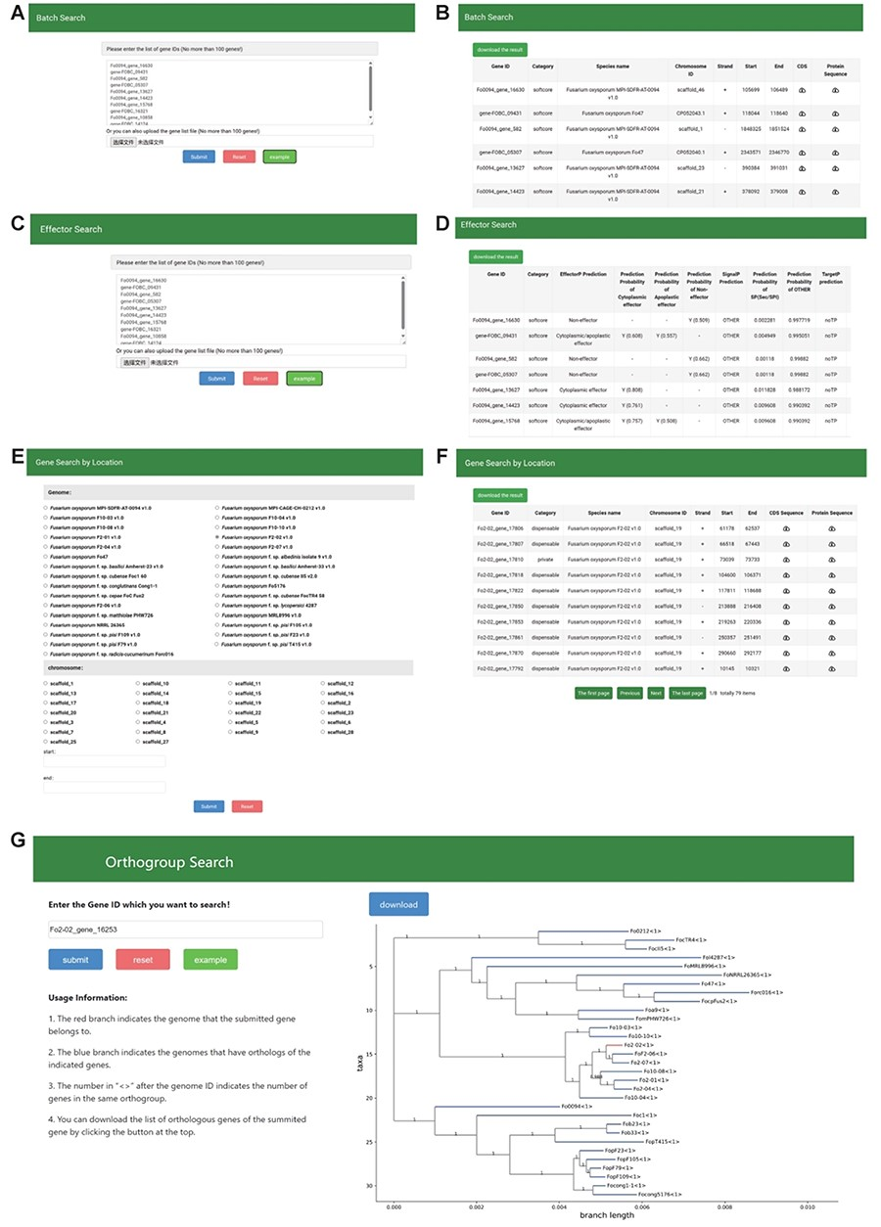
Figure 5. The Search module sections. (A, B) Search page and result page of Batch Search, (C, D) Search page and result ...
Notes:
Figure 5. The Search module sections. (A, B) Search page and result page of Batch Search, (C, D) Search page and result page of effector search, (E, F) Search page and result page of Gene Search By Location, (G) Search page and result page of Orthogroup search.
Unless provided in the caption above, the following copyright applies to the content of this slide: © The Author(s) 2024. Published by Oxford University Press.This is an Open Access article distributed under the terms of the Creative Commons Attribution License (https://creativecommons.org/licenses/by/4.0/), which permits unrestricted reuse, distribution, and reproduction in any medium, provided the original work is properly cited.

