Slide 1
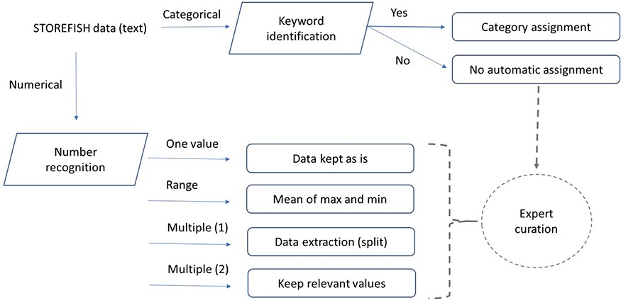
Figure 1. Data processing and feature extraction workflow. Traits defined as numbers were extracted using python’s ...
Notes:
Figure 1. Data processing and feature extraction workflow. Traits defined as numbers were extracted using python’s regular expression, text entries were extracted semi-automatically by keywords extraction. Incomplete or difficult data extraction were curated by experts.
Unless provided in the caption above, the following copyright applies to the content of this slide: © The Author(s) 2020. Published by Oxford University Press.This is an Open Access article distributed under the terms of the Creative Commons Attribution License (http://creativecommons.org/licenses/by/4.0/), which permits unrestricted reuse, distribution, and reproduction in any medium, provided the original work is properly cited.

Slide 2
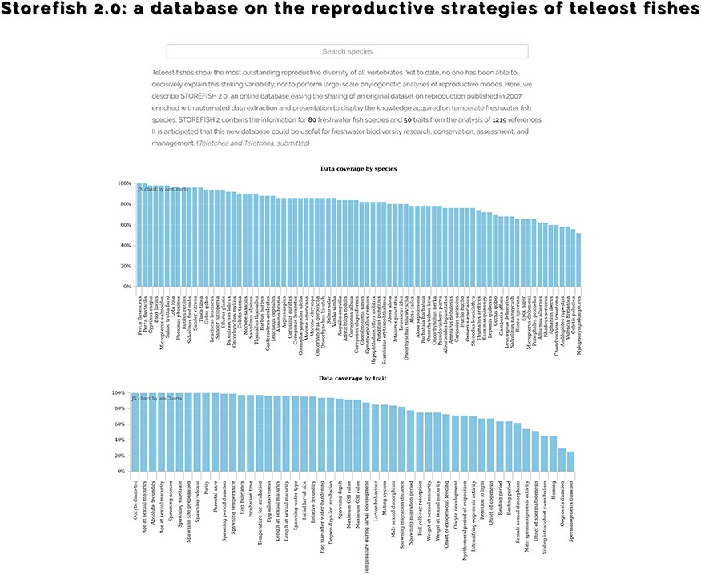
Figure 2. STOREFISH home page. Accessible data are available by species, traits or by reference. A search-as-you-type ...
Notes:
Figure 2. STOREFISH home page. Accessible data are available by species, traits or by reference. A search-as-you-type box allows to rapidly find a species of interest.
Unless provided in the caption above, the following copyright applies to the content of this slide: © The Author(s) 2020. Published by Oxford University Press.This is an Open Access article distributed under the terms of the Creative Commons Attribution License (http://creativecommons.org/licenses/by/4.0/), which permits unrestricted reuse, distribution, and reproduction in any medium, provided the original work is properly cited.

Slide 3
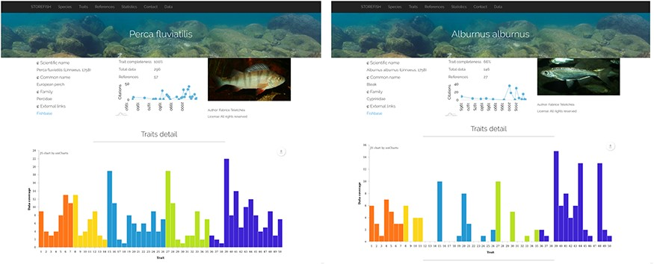
Figure 3. Comparison of trait enrichment between Perca fluviatilis (442 primary data, resulting in 237 secondary data) ...
Notes:
Figure 3. Comparison of trait enrichment between Perca fluviatilis (442 primary data, resulting in 237 secondary data) and Alburnus alburnus (146 primary data, resulting in 102 secondary data).
Unless provided in the caption above, the following copyright applies to the content of this slide: © The Author(s) 2020. Published by Oxford University Press.This is an Open Access article distributed under the terms of the Creative Commons Attribution License (http://creativecommons.org/licenses/by/4.0/), which permits unrestricted reuse, distribution, and reproduction in any medium, provided the original work is properly cited.

Slide 4
Figure 4. Example of detailed database statistics for numerical traits (oocyte diameter, left) and categorical traits ...
Notes:
Figure 4. Example of detailed database statistics for numerical traits (oocyte diameter, left) and categorical traits (reaction to light, right). The graphs are interactive online, discrete values are shown upon mouse hovering on the displayed data. Void categories indicate there is no primary data, No category indicates that no category was detected, ambiguous values indicate that multiple categories were found for one species, with no category being more representative of the secondary than any other.
Unless provided in the caption above, the following copyright applies to the content of this slide: © The Author(s) 2020. Published by Oxford University Press.This is an Open Access article distributed under the terms of the Creative Commons Attribution License (http://creativecommons.org/licenses/by/4.0/), which permits unrestricted reuse, distribution, and reproduction in any medium, provided the original work is properly cited.

