Slide 1
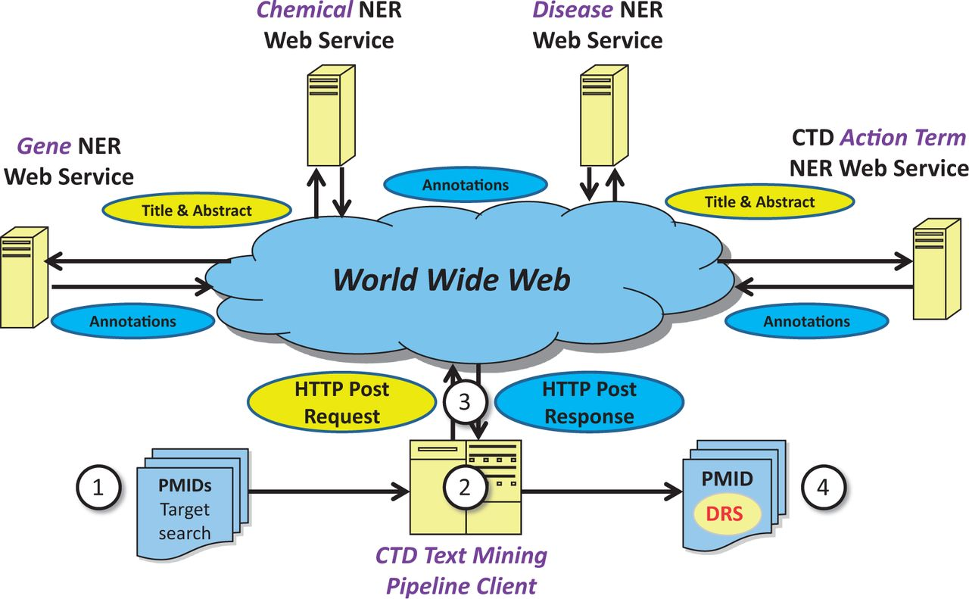
Figure 1. Web service-based NER logical design. Under a Web service-based conceptual design, (1) a list of potentially ...
Notes:
Figure 1. Web service-based NER logical design. Under a Web service-based conceptual design, (1) a list of potentially relevant PubMed IDs (PMIDs) is secured via a search of PubMed, typically for a target chemical. (2) The list is processed asynchronously by batch-oriented processes. Rather than performing NER using locally installed NER tools, (3) HTTP calls containing text passages are made to remote Web services; the results of NER are used as a key component in document ranking algorithms. (4) PMIDs are then assigned a DRS by the document ranking algorithms.
Unless provided in the caption above, the following copyright applies to the content of this slide: © The Author(s) 2014. Published by Oxford University Press.This is an Open Access article distributed under the terms of the Creative Commons Attribution License (http://creativecommons.org/licenses/by/3.0/), which permits unrestricted reuse, distribution, and reproduction in any medium, provided the original work is properly cited.

