Slide 1
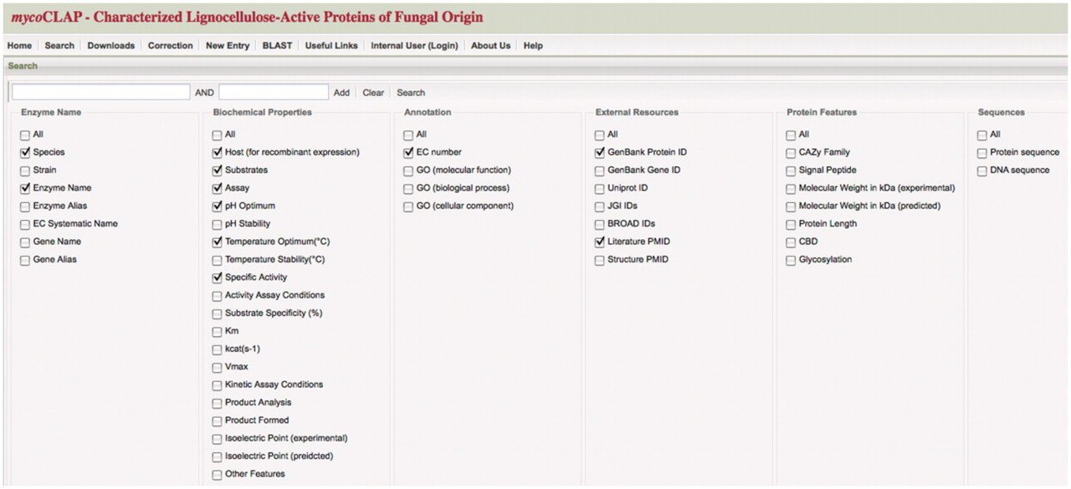
Figure 1. mycoCLAP search page. The main search page from mycoCLAP is shown here. Keywords such as enzyme activity, ...
Notes:
Figure 1. mycoCLAP search page. The main search page from mycoCLAP is shown here. Keywords such as enzyme activity, glycoside hydrolase family or a substrate name can be entered as search terms. Leaving the field blank and clicking on ‘search’ allows a user to browse the database. The information recorded during the curation process has been divided into six categories shown here; Enzyme Name, Biochemical Properties, Annotation, External Resources, Protein Features and Sequence. By checking boxes under these categories a user can determine which types of information will be displayed on the results page. The default settings are shown here. The tabs along the top allow quick and easy navigation through all of mycoCLAP’s features.
Unless provided in the caption above, the following copyright applies to the content of this slide: © The Author(s) 2011. Published by Oxford University Press.This is Open Access article distributed under the terms of the Creative Commons Attribution Non-Commercial License (http://creativecommons.org/licenses/by-nc/2.5), which permits unrestricted non-commercial use, distribution, and reproduction in any medium, provided the original work is properly cited.

Slide 2
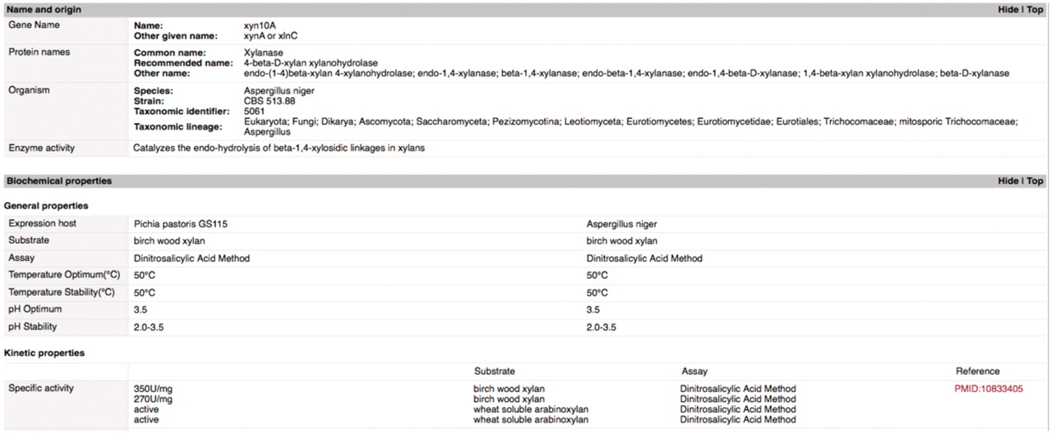
Figure 2. Gene page example. This screen shot illustrates the set-up and types of data available on mycoCLAP. This is ...
Notes:
Figure 2. Gene page example. This screen shot illustrates the set-up and types of data available on mycoCLAP. This is part of the gene page for the glycoside hydrolase XYN10A_ASPNG (a family 10 xylanase from Aspergillus niger). The ‘Names and Origin’ section includes any names or abbreviations used to identify the enzyme in the literature or on other databases. A search by any of those names will deliver this enzyme as a hit. The next section contains biochemical properties extracted from the literature. This entry has the enzyme’s specific activity, pH optima and temperature optima on birch wood xylan when expressed from two different hosts. Other information recorded on gene pages includes nucleotide and amino acid sequences, protein domains, assay conditions, enzyme family, literature citations and other features recorded in the literature that make the entry unique.
Unless provided in the caption above, the following copyright applies to the content of this slide: © The Author(s) 2011. Published by Oxford University Press.This is Open Access article distributed under the terms of the Creative Commons Attribution Non-Commercial License (http://creativecommons.org/licenses/by-nc/2.5), which permits unrestricted non-commercial use, distribution, and reproduction in any medium, provided the original work is properly cited.

