Slide 1
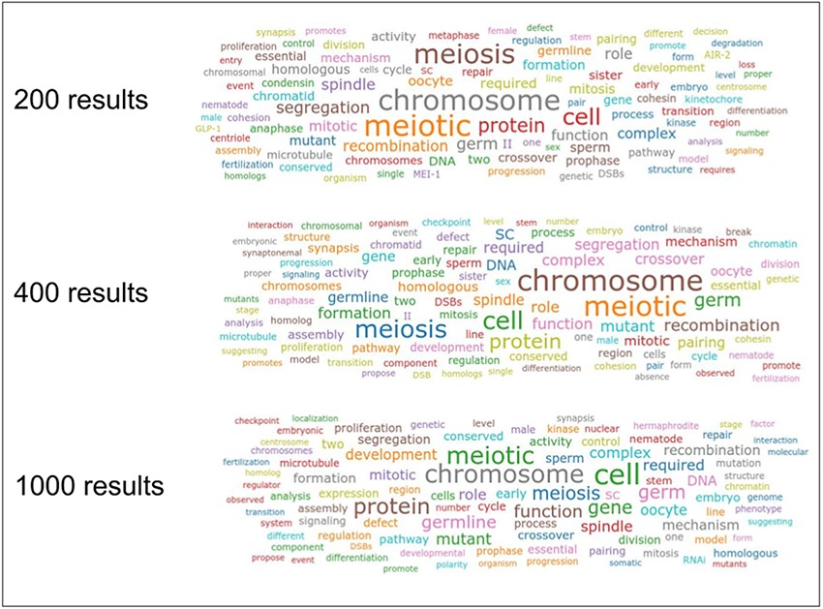
Figure 2. Word clouds for the keyword ‘meiosis’ obtained by combining 200, 400 and 1000 maximum results from the ...
Notes:
Figure 2. Word clouds for the keyword ‘meiosis’ obtained by combining 200, 400 and 1000 maximum results from the Textpresso API and with plain frequency word counts.
Unless provided in the caption above, the following copyright applies to the content of this slide: Published by Oxford University Press 2021. This work is written by (a) US Government employee(s) and is in the public domain in the US.This work is written by (a) US Government employee(s) and is in the public domain in the US.

