Slide 1
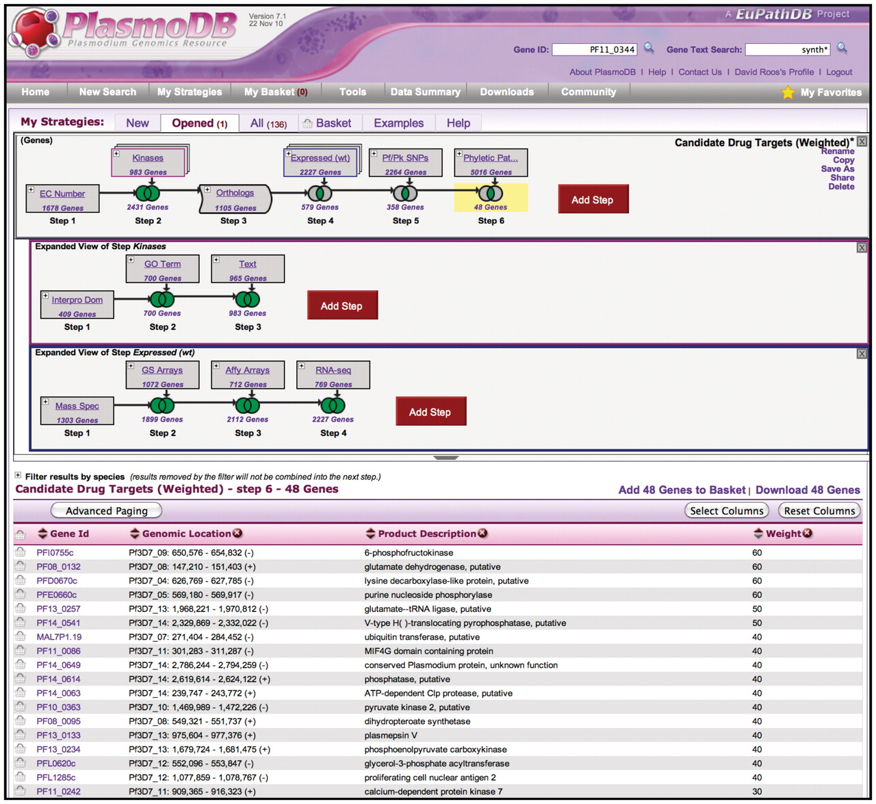
Figure 1. The WDK Strategies system in PlasmoDB.org. The top panel shows a strategy with a succession of gene searches ...
Notes:
Figure 1. The WDK Strategies system in PlasmoDB.org. The top panel shows a strategy with a succession of gene searches (strategy steps) proceeding from left to right, combined using set operators (e.g. union, intersection) indicated by Venn diagrams. Steps 2 and 4 are nested steps, indicated by an overlapping box icon with colored border. They are expanded as sub-strategies in the indented panels below, where their component steps are visible. Step 3 is a transform expanding the results from Step 2 to include orthologous genes. Strategies may be named and saved for future reference, refinement, or sharing with others. The bottom half of the display is the summary table which shows a page of results, where each row is one gene found. By default this display shows the result of the strategy as a whole (the last step so far), but clicking on any step box or Venn diagram highlights that box in yellow and shows the intermediate result at that point. Any of these results are downloadable. The summary table can be customized by adding any of approximately 50 columns, and by sorting, filtering and paging.
Unless provided in the caption above, the following copyright applies to the content of this slide: © The Author(s) 2011. Published by Oxford University Press.This is Open Access article distributed under the terms of the Creative Commons Attribution Non-Commercial License (http://creativecommons.org/licenses/by-nc/2.5), which permits unrestricted non-commercial use, distribution, and reproduction in any medium, provided the original work is properly cited.

