Slide 1
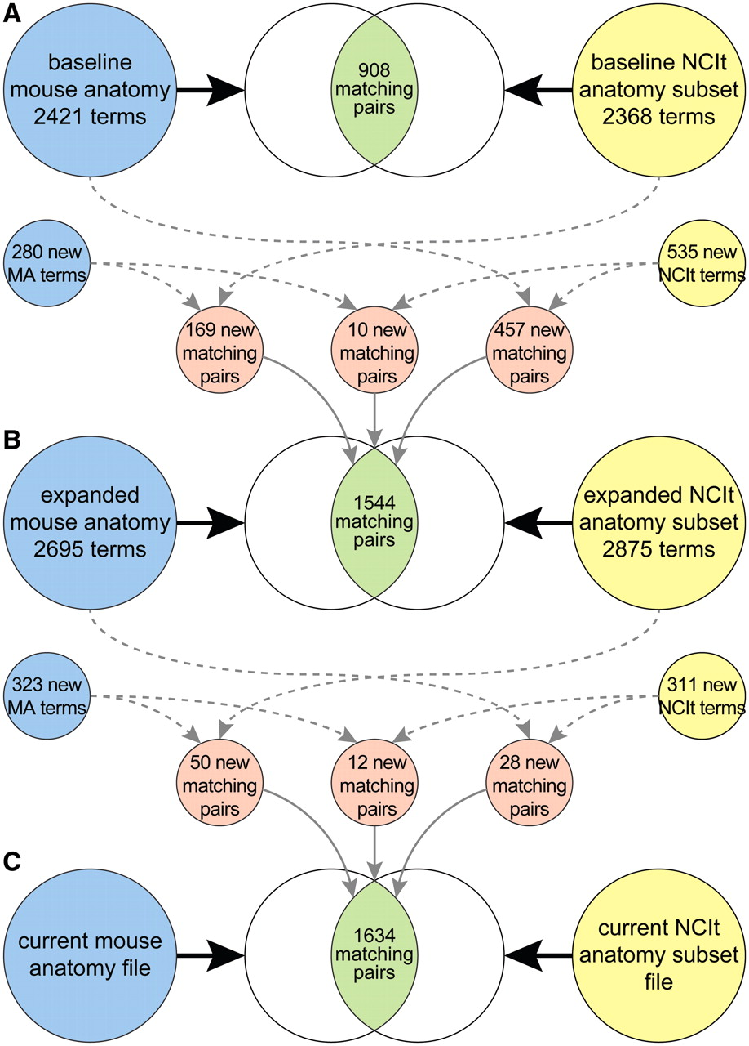
Figure 3. Mouse and human anatomy ontology terms, and corresponding matched sets of terms, at start of study (A), after ...
Notes:
Figure 3. Mouse and human anatomy ontology terms, and corresponding matched sets of terms, at start of study (A), after extension and harmonization of the ontologies (B) and after recent updates to the files (C).
Unless provided in the caption above, the following copyright applies to the content of this slide: © The Author(s) 2012. Published by Oxford University Press.This is an Open Access article distributed under the terms of the Creative Commons Attribution Non-Commercial License (http://creativecommons.org/licenses/by-nc/3.0), which permits unrestricted non-commercial use, distribution, and reproduction in any medium, provided the original work is properly cited.

