Slide 1
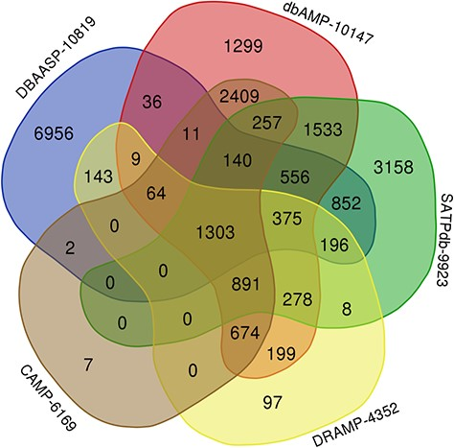
Figure 3 Venn diagram demonstrating peptides cross links among the top 5 databases in LAMP2 (plotted using ...
Notes:
Figure 3 Venn diagram demonstrating peptides cross links among the top 5 databases in LAMP2 (plotted using http://bioinformatics.psb.ugent.be/webtools/Venn/).
Unless provided in the caption above, the following copyright applies to the content of this slide: © The Author(s) 2020. Published by Oxford University Press.This is an Open Access article distributed under the terms of the Creative Commons Attribution License (http://creativecommons.org/licenses/by/4.0/), which permits unrestricted reuse, distribution, and reproduction in any medium, provided the original work is properly cited.

