Slide 1
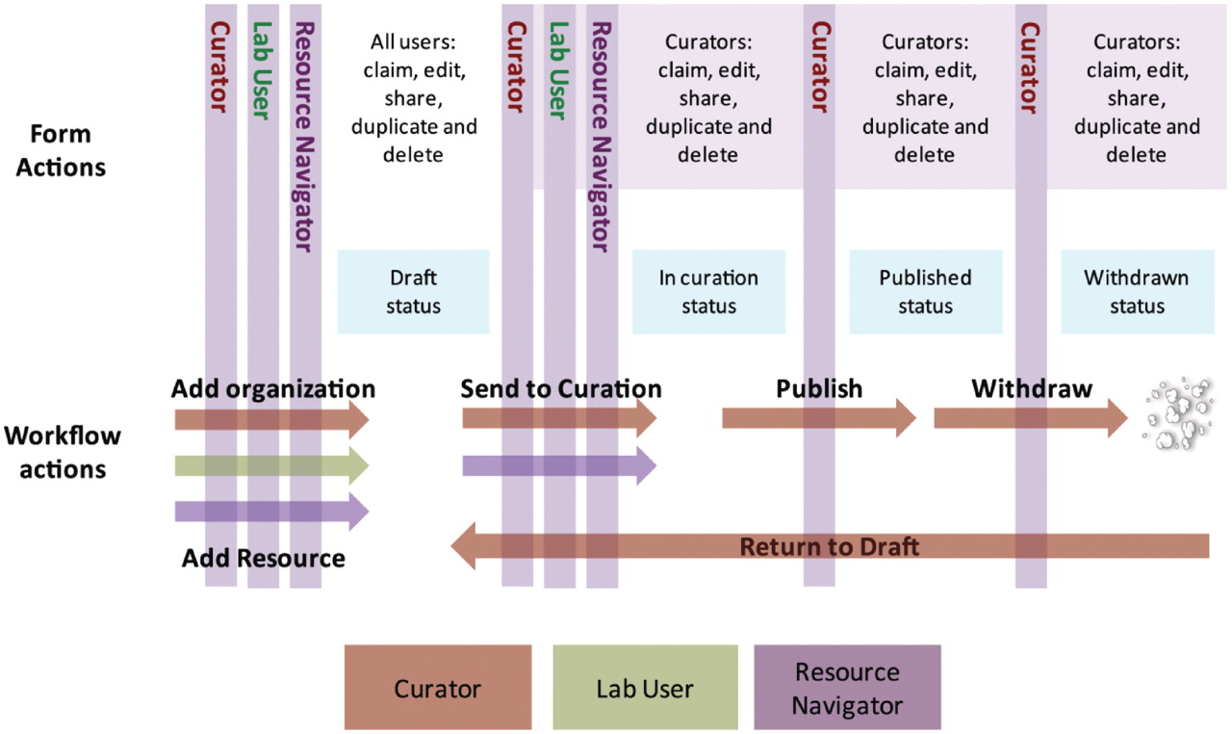
Figure 1. Workflow of the eagle-i team. The role of the Resource Navigators is to collect and add data to the system, ...
Notes:
Figure 1. Workflow of the eagle-i team. The role of the Resource Navigators is to collect and add data to the system, such as organizations or resources. All users (Curators, Lab Users and Resource Navigators) can enter data into the Data Collection tool in draft state. To edit a record, it must be ‘claimed’ by the user and then ‘shared’ after editing. Curators and Resource Navigators can send resources to curation. Data ‘in curation’ is managed by the Curation team and subsequently published, where it is visible in the Search interface. After a record is published, a Curator can withdraw, duplicate or delete the record, or return the record to draft for further editing.
Unless provided in the caption above, the following copyright applies to the content of this slide: © The Author(s) 2012. Published by Oxford University Press.This is an Open Access article distributed under the terms of the Creative Commons Attribution Non-Commercial License (http://creativecommons.org/licenses/by-nc/3.0), which permits unrestricted non-commercial use, distribution, and reproduction in any medium, provided the original work is properly cited.

Slide 2
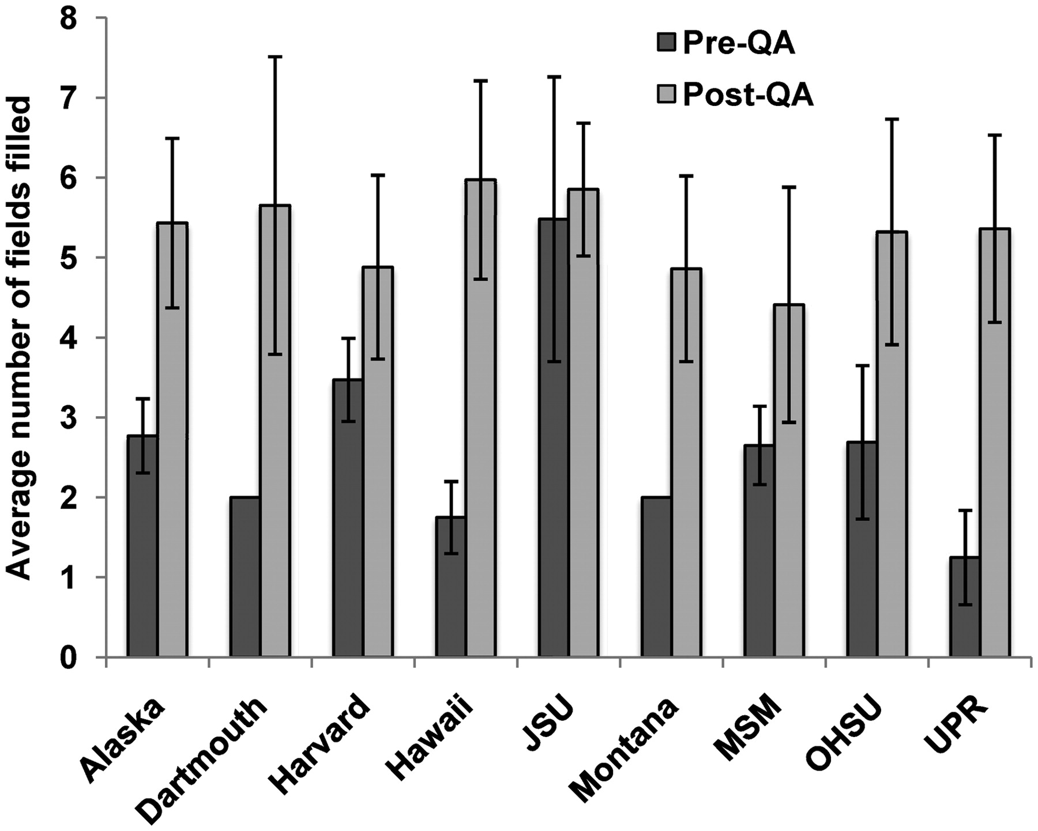
Figure 4. Average number of fields recorded for instruments before and after a QA effort. There was a 1.1–4.3-fold ...
Notes:
Figure 4. Average number of fields recorded for instruments before and after a QA effort. There was a 1.1–4.3-fold increase in the average number of filled fields after the QA effort. Error bars indicate standard deviation.
Unless provided in the caption above, the following copyright applies to the content of this slide: © The Author(s) 2012. Published by Oxford University Press.This is an Open Access article distributed under the terms of the Creative Commons Attribution Non-Commercial License (http://creativecommons.org/licenses/by-nc/3.0), which permits unrestricted non-commercial use, distribution, and reproduction in any medium, provided the original work is properly cited.

Slide 3
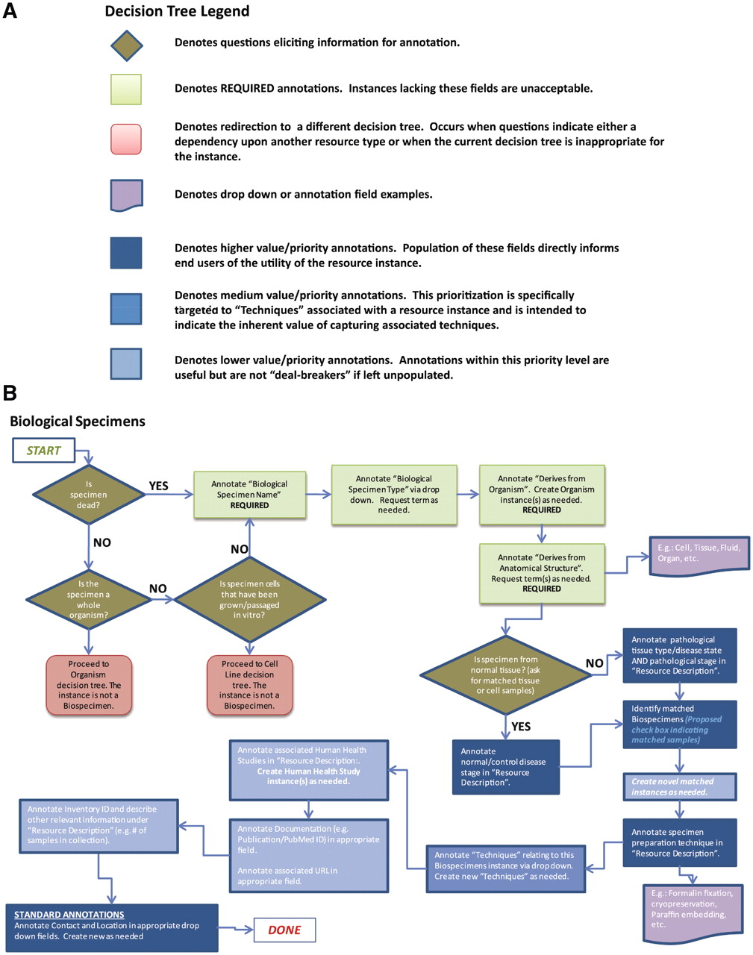
Figure 3. Decision trees were used to assist with data collection and curation. (A) Decision tree legend. (B) The ...
Notes:
Figure 3. Decision trees were used to assist with data collection and curation. (A) Decision tree legend. (B) The decision tree for biological specimens. Required and highly desired fields are indicated by green and blue colors, respectively. Each resource type had 2–3 required fields, between 4–8 highly desired fields and the other fields were considered optional or applied only to specific subtypes of resources.
Unless provided in the caption above, the following copyright applies to the content of this slide: © The Author(s) 2012. Published by Oxford University Press.This is an Open Access article distributed under the terms of the Creative Commons Attribution Non-Commercial License (http://creativecommons.org/licenses/by-nc/3.0), which permits unrestricted non-commercial use, distribution, and reproduction in any medium, provided the original work is properly cited.

Slide 4
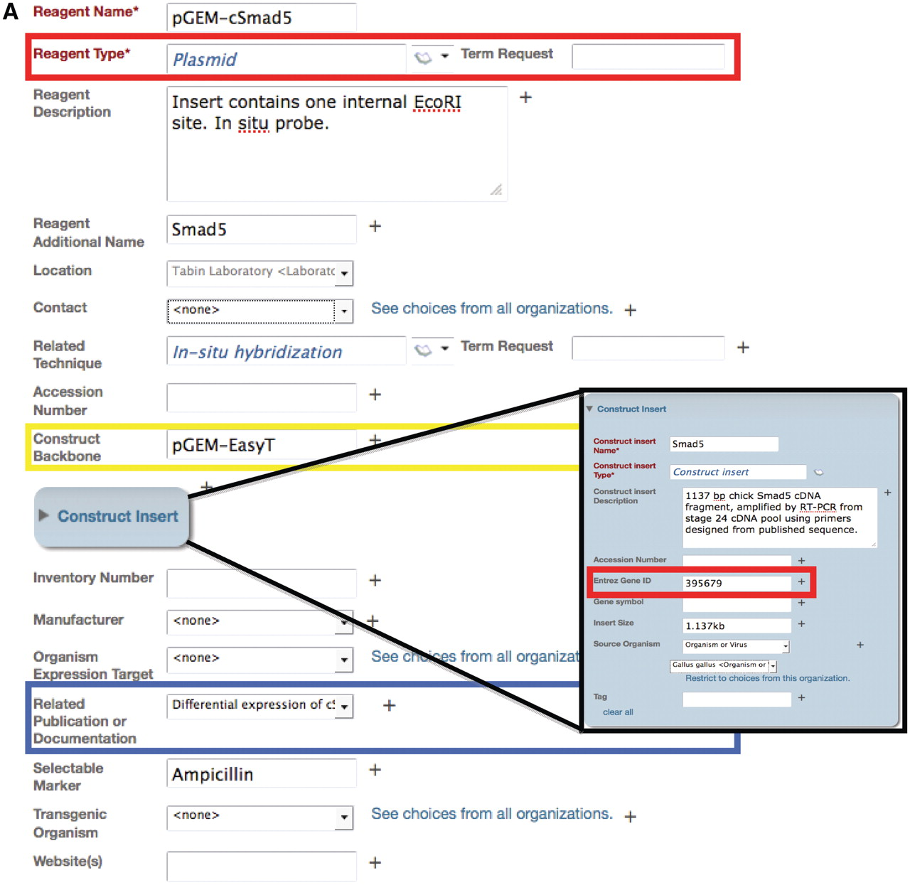
Figure 2. Example of an annotation form in the Data Collection Tool for the plasmid reagent type. (A) The Data ...
Notes:
Figure 2. Example of an annotation form in the Data Collection Tool for the plasmid reagent type. (A) The Data Collection Tool contains annotation fields that are auto-populated using the ontology (red box) and free text (yellow box). Fields in the Data Collection Tool can also link records to other records in the repository, such as related publications or documentation (blue box). Users can request new terms be added to the ontology using the Term Request field. Inset: Construct insert is an embedded class in the plasmid form and contains information that corresponds to other databases, such as Entrez Gene ID. (B) The search result upon searching for this specified plasmid. Only the fields that are filled out in the data tool are displayed in the search interface. Search results can be returned for this plasmid by searching on any of the fields that are annotated for this record. Text that is colored blue links to other records in the search interface. Hovering over the ‘i’ icons displays the ontological definition of the term, as in the example of the technique, in situ hybridization.
Unless provided in the caption above, the following copyright applies to the content of this slide: © The Author(s) 2012. Published by Oxford University Press.This is an Open Access article distributed under the terms of the Creative Commons Attribution Non-Commercial License (http://creativecommons.org/licenses/by-nc/3.0), which permits unrestricted non-commercial use, distribution, and reproduction in any medium, provided the original work is properly cited.

Slide 5
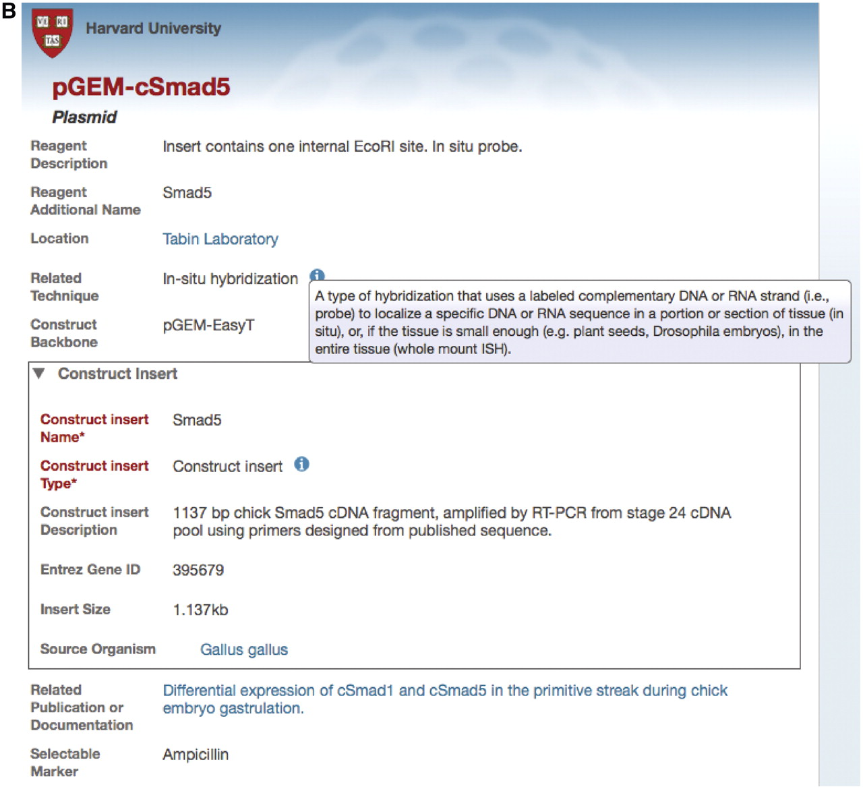
Figure 2. Example of an annotation form in the Data Collection Tool for the plasmid reagent type. (A) The Data ...
Notes:
Figure 2. Example of an annotation form in the Data Collection Tool for the plasmid reagent type. (A) The Data Collection Tool contains annotation fields that are auto-populated using the ontology (red box) and free text (yellow box). Fields in the Data Collection Tool can also link records to other records in the repository, such as related publications or documentation (blue box). Users can request new terms be added to the ontology using the Term Request field. Inset: Construct insert is an embedded class in the plasmid form and contains information that corresponds to other databases, such as Entrez Gene ID. (B) The search result upon searching for this specified plasmid. Only the fields that are filled out in the data tool are displayed in the search interface. Search results can be returned for this plasmid by searching on any of the fields that are annotated for this record. Text that is colored blue links to other records in the search interface. Hovering over the ‘i’ icons displays the ontological definition of the term, as in the example of the technique, in situ hybridization.
Unless provided in the caption above, the following copyright applies to the content of this slide: © The Author(s) 2012. Published by Oxford University Press.This is an Open Access article distributed under the terms of the Creative Commons Attribution Non-Commercial License (http://creativecommons.org/licenses/by-nc/3.0), which permits unrestricted non-commercial use, distribution, and reproduction in any medium, provided the original work is properly cited.

