Slide 1
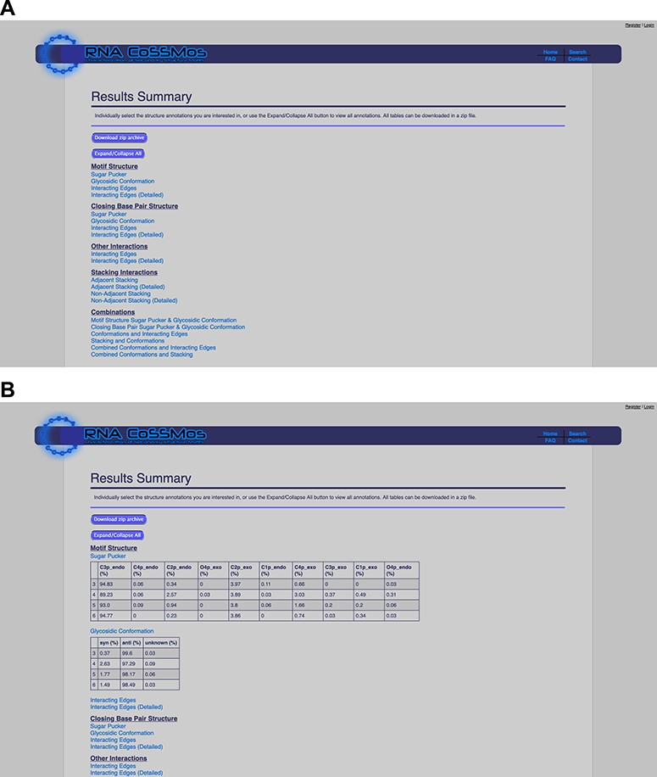
Figure 2 The RNA CoSSMos results summary page (A) collapsed and (B) expanded for ‘Sugar Pucker’ and ‘Glycosidic ...
Notes:
Figure 2 The RNA CoSSMos results summary page (A) collapsed and (B) expanded for ‘Sugar Pucker’ and ‘Glycosidic Conformation’.
Unless provided in the caption above, the following copyright applies to the content of this slide: © The Author(s) 2020. Published by Oxford University Press.This is an Open Access article distributed under the terms of the Creative Commons Attribution License (http://creativecommons.org/licenses/by/4.0/), which permits unrestricted reuse, distribution, and reproduction in any medium, provided the original work is properly cited.

