Slide 1
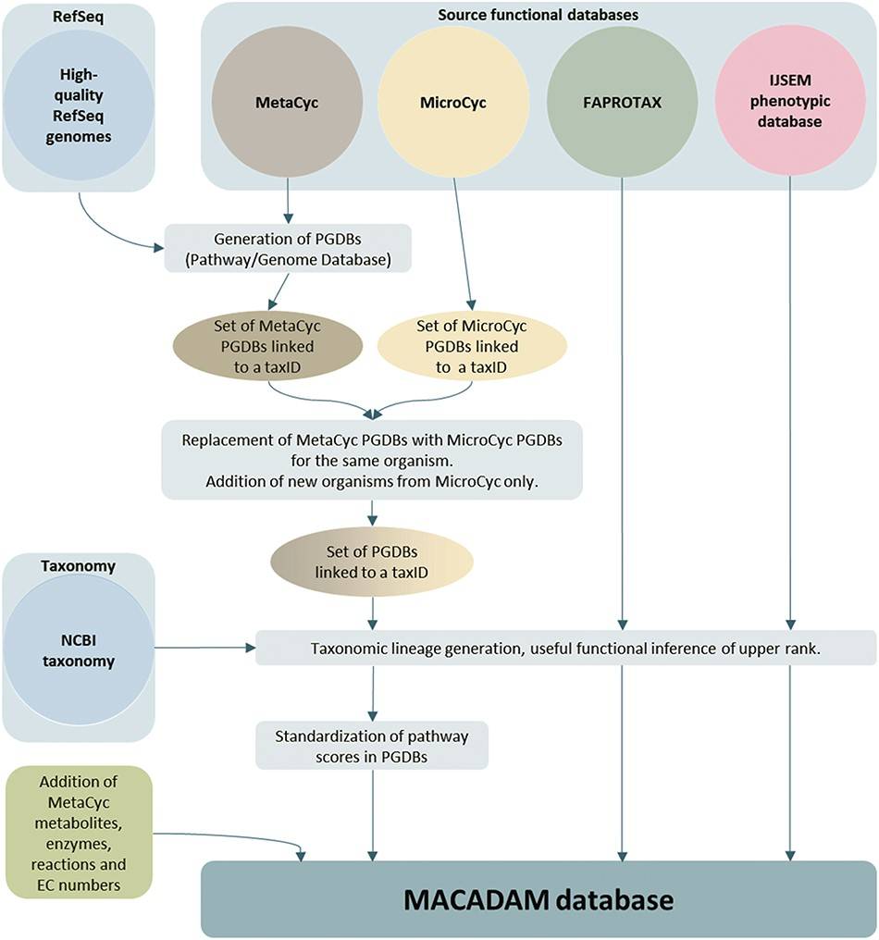
Figure 1 MACADAM building workflow.
Notes:
Figure 1 MACADAM building workflow.
Unless provided in the caption above, the following copyright applies to the content of this slide: © The Author(s) 2019. Published by Oxford University Press.This is an Open Access article distributed under the terms of the Creative Commons Attribution License (http://creativecommons.org/licenses/by/4.0/), which permits unrestricted reuse, distribution, and reproduction in any medium, provided the original work is properly cited.

Slide 2
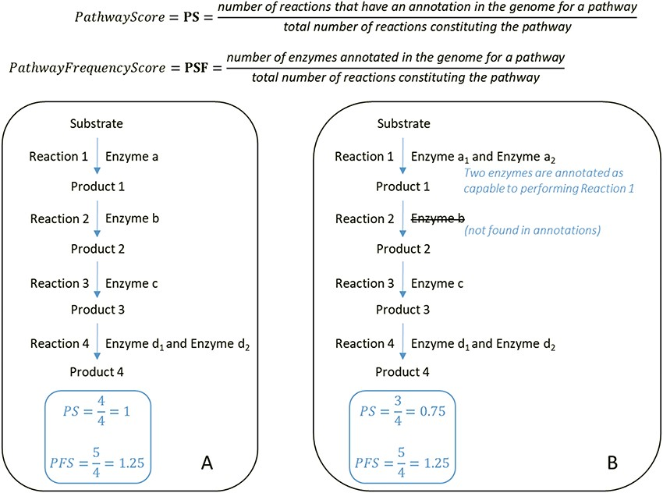
Figure 2 At the top, formulas for the computation of the PS and PFS. Below, examples of two types of computations of ...
Notes:
Figure 2 At the top, formulas for the computation of the PS and PFS. Below, examples of two types of computations of the PS and PFS based on an example of a hypothetical metabolic pathway. By comparing the PS and PFS in A and B, pathway A shows greater evidence of its veracity.
Unless provided in the caption above, the following copyright applies to the content of this slide: © The Author(s) 2019. Published by Oxford University Press.This is an Open Access article distributed under the terms of the Creative Commons Attribution License (http://creativecommons.org/licenses/by/4.0/), which permits unrestricted reuse, distribution, and reproduction in any medium, provided the original work is properly cited.

Slide 3
Figure 3 Comparison of PS of all metabolic pathways of PGDBs present in both MetaCyc PGDBs and MicroCyc PGDBs. A: ...
Notes:
Figure 3 Comparison of PS of all metabolic pathways of PGDBs present in both MetaCyc PGDBs and MicroCyc PGDBs. A: among Bacteria; B: among Archaea.
Unless provided in the caption above, the following copyright applies to the content of this slide: © The Author(s) 2019. Published by Oxford University Press.This is an Open Access article distributed under the terms of the Creative Commons Attribution License (http://creativecommons.org/licenses/by/4.0/), which permits unrestricted reuse, distribution, and reproduction in any medium, provided the original work is properly cited.

Slide 4
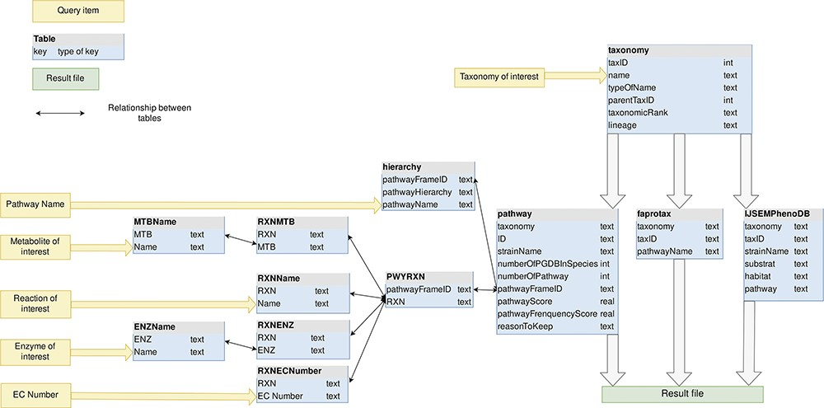
Figure 4 MACADAM database schema. Yellow arrows indicate the entry points of the database.
Notes:
Figure 4 MACADAM database schema. Yellow arrows indicate the entry points of the database.
Unless provided in the caption above, the following copyright applies to the content of this slide: © The Author(s) 2019. Published by Oxford University Press.This is an Open Access article distributed under the terms of the Creative Commons Attribution License (http://creativecommons.org/licenses/by/4.0/), which permits unrestricted reuse, distribution, and reproduction in any medium, provided the original work is properly cited.

Slide 5
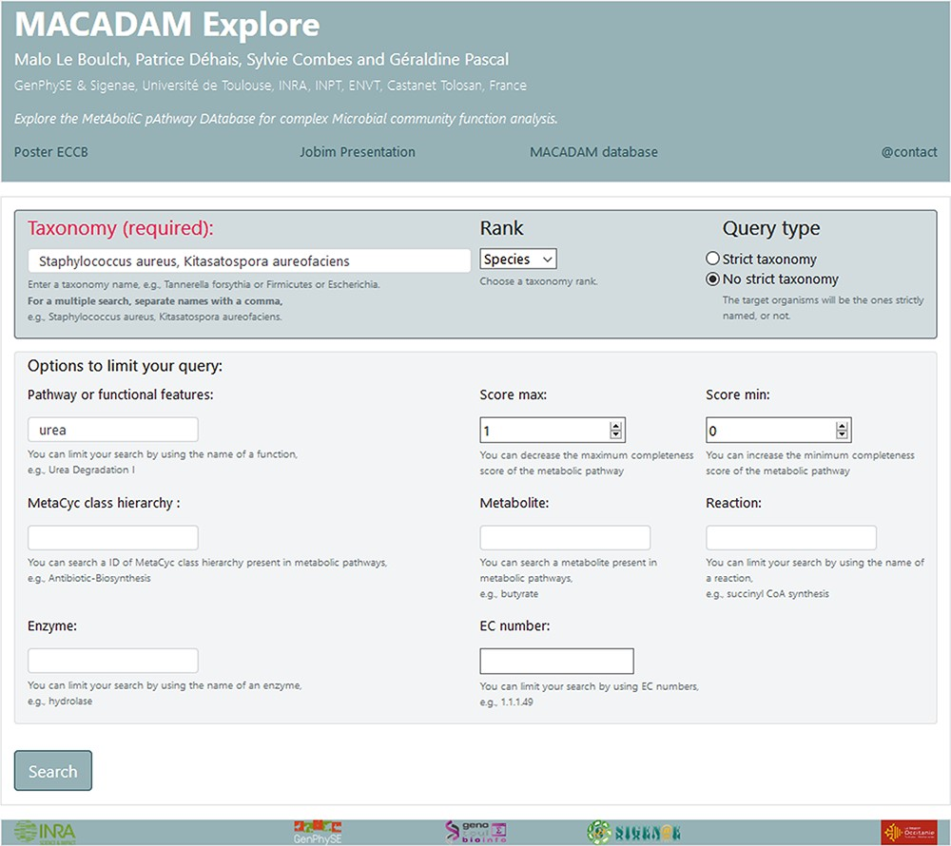
Figure 5 Screenshot of MACADAM Explore website showing the query of all functional information containing the word ...
Notes:
Figure 5 Screenshot of MACADAM Explore website showing the query of all functional information containing the word ‘urea’ in the species ‘Staphylococcus aureus’ and ‘Kitasatospora aureofaciens’.
Unless provided in the caption above, the following copyright applies to the content of this slide: © The Author(s) 2019. Published by Oxford University Press.This is an Open Access article distributed under the terms of the Creative Commons Attribution License (http://creativecommons.org/licenses/by/4.0/), which permits unrestricted reuse, distribution, and reproduction in any medium, provided the original work is properly cited.

Slide 6
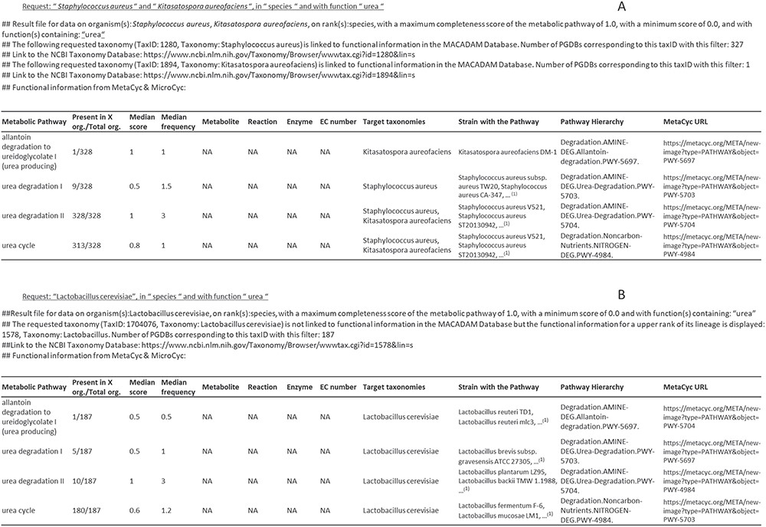
Figure 6 Examples of output files corresponding to requests on MACADAM. (A) The user has searched for all metabolic ...
Notes:
Figure 6 Examples of output files corresponding to requests on MACADAM. (A) The user has searched for all metabolic pathways in S. aureus and K. aureofaciens, using the term ‘urea’ in the function field text. (B) The user has searched for all metabolic pathways in Lactobacillus cerevisiae using the term ‘urea’ in the function field text. Since there is no data on this organism in MACADAM, the information was searched for higher up in the taxonomy hierarchy, i.e. Lactobacillus. (1)List of organisms in MACADAM with the targeted metabolic pathway.
Unless provided in the caption above, the following copyright applies to the content of this slide: © The Author(s) 2019. Published by Oxford University Press.This is an Open Access article distributed under the terms of the Creative Commons Attribution License (http://creativecommons.org/licenses/by/4.0/), which permits unrestricted reuse, distribution, and reproduction in any medium, provided the original work is properly cited.

Slide 7
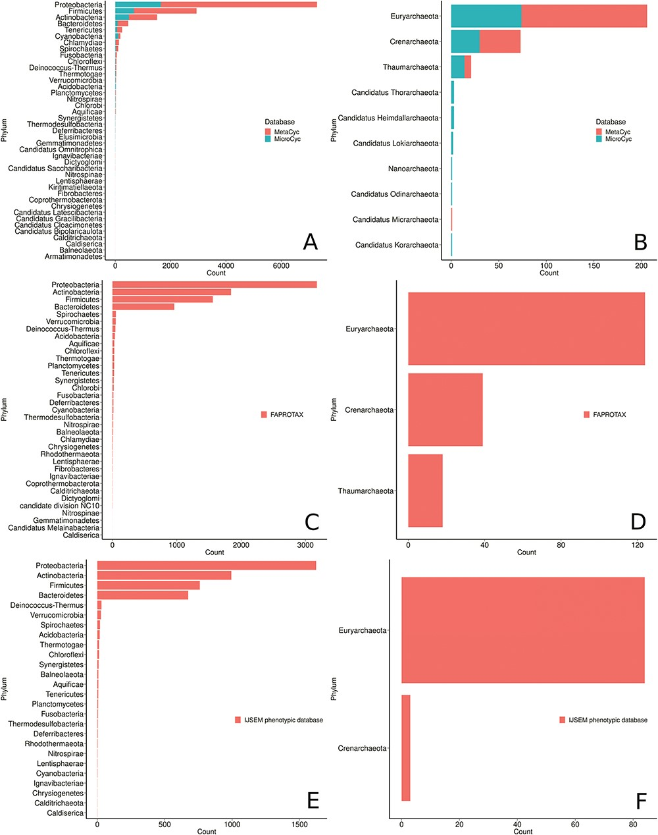
Figure 7 Phyla distribution in the MACADAM database according to their database of origin. (A) MetaCyc and MicroCyc ...
Notes:
Figure 7 Phyla distribution in the MACADAM database according to their database of origin. (A) MetaCyc and MicroCyc for bacterial organisms, (B) MetaCyc and MicroCyc for archaea organisms, (C) FAPROTAX for bacterial organisms, (D) FAPROTAX for archaea organisms, (E) IJSEM phenotypic database for bacterial organisms and (F) IJSEM phenotypic database for archaea organisms.
Unless provided in the caption above, the following copyright applies to the content of this slide: © The Author(s) 2019. Published by Oxford University Press.This is an Open Access article distributed under the terms of the Creative Commons Attribution License (http://creativecommons.org/licenses/by/4.0/), which permits unrestricted reuse, distribution, and reproduction in any medium, provided the original work is properly cited.

Slide 8
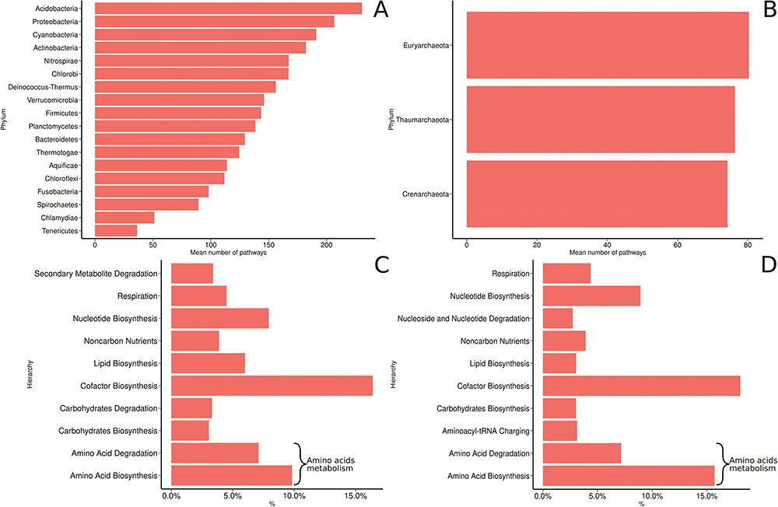
Figure 8 MACADAM functional diversity for phyla with >10 PGDBs in MACADA (A) among bacterial phyla, (B) among archaea ...
Notes:
Figure 8 MACADAM functional diversity for phyla with >10 PGDBs in MACADA (A) among bacterial phyla, (B) among archaea phyla, (C) the 10 main hierarchical groups of pathways in all bacterial organisms and (D) the 10 main hierarchical groups of pathways in all archaea organisms.
Unless provided in the caption above, the following copyright applies to the content of this slide: © The Author(s) 2019. Published by Oxford University Press.This is an Open Access article distributed under the terms of the Creative Commons Attribution License (http://creativecommons.org/licenses/by/4.0/), which permits unrestricted reuse, distribution, and reproduction in any medium, provided the original work is properly cited.

