Slide 1
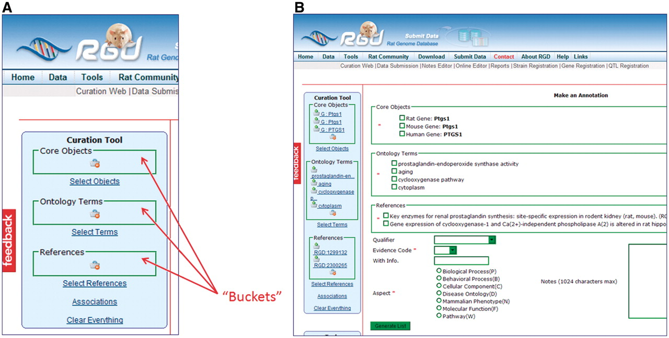
Figure 4. (A) The Ontology Annotation Creation and Editing Tool homepage has ‘buckets’ for holding selected items. Each ...
Notes:
Figure 4. (A) The Ontology Annotation Creation and Editing Tool homepage has ‘buckets’ for holding selected items. Each bucket (core objects, ontology terms and references) has its own search function, which appears in the right frame of the page when ‘Select Objects’, ‘Select Terms’ or ‘Select References’ is clicked. (B) Annotation frame. All the items from the buckets are repeated in the annotation frame to allow them to be selected for annotations. More information choices are available below the bucket items as drop-down text boxes for qualifier terms and evidence codes, radio buttons for ontology aspect and text boxes for free text information.
Unless provided in the caption above, the following copyright applies to the content of this slide: © The Author(s) 2011. Published by Oxford University Press.This is Open Access article distributed under the terms of the Creative Commons Attribution Non-Commercial License (http://creativecommons.org/licenses/by-nc/2.5), which permits unrestricted non-commercial use, distribution, and reproduction in any medium, provided the original work is properly cited.

