Slide 1
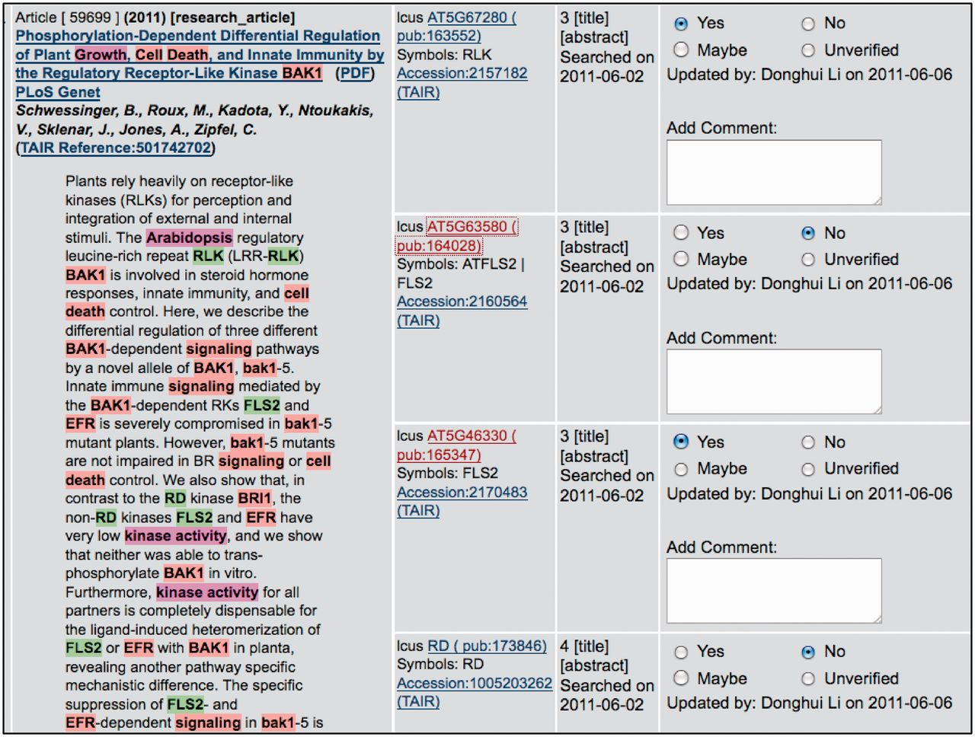
Figure 2 PubSearch gene name recognition interface. The left panel displays article abstract with various entities ...
Notes:
Figure 2 PubSearch gene name recognition interface. The left panel displays article abstract with various entities (gene name: e.g. FLS2, species name: e.g. Arabidopsis and keywords: e.g. kinase activity) highlighted. The highlighted entities are automatically identified by PubSearch. Candidate gene identifiers suggested by PubSearch are displayed in center panel. The right panel allows curators to record the results of manual verification. In this example, the symbol FLS2 in the abstract is mapped to two gene identifiers: AT5G63580 and AT5G46330. Curators link FLS2 to the correct gene identifier by analyzing the context in the abstract, as well as existing annotations to these two genes. Due to space constraint, this figure only displays a partial list of candidate gene identifiers suggested by PubSearch. For example, BAK1, which corresponds to AT4G33430 is not shown in this figure.
Unless provided in the caption above, the following copyright applies to the content of this slide: © The Author(s) 2012. Published by Oxford University Press.This is an Open Access article distributed under the terms of the Creative Commons Attribution License (http://creativecommons.org/licenses/by-nc/3.0/), which permits non-commercial reuse, distribution, and reproduction in any medium, provided the original work is properly cited. For commercial re-use, please contact journals.permissions@oup.com.

Slide 2
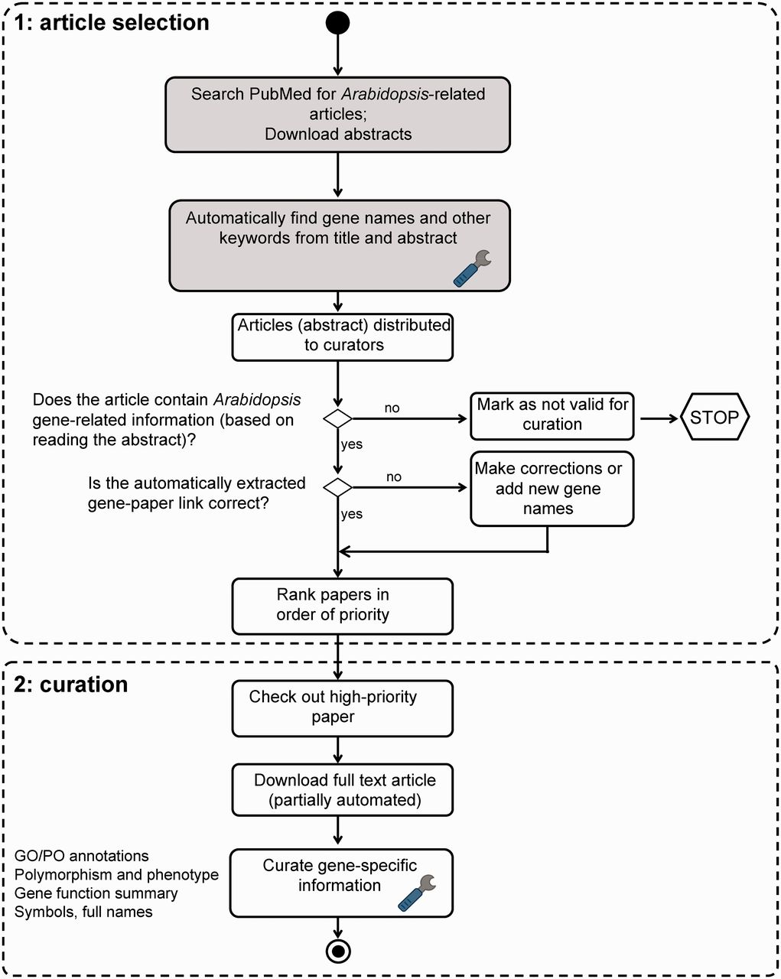
Figure 1 TAIR literature curation workflow. The curation process consists of both automated (shaded boxes) and manual ...
Notes:
Figure 1 TAIR literature curation workflow. The curation process consists of both automated (shaded boxes) and manual steps. Full text PDF download is partially automated. PubSearch automatically downloads PDFs from selected journals, other articles not retrieved by PubSearch are manually downloaded by curators. Potentially curatable papers are identified by searching PubMed for ‘Arabidopsis’. Gene names are automatically identified from abstracts, then manually verified by curators. Articles that contain Arabidopsis gene-related information are flagged by curators for manual curation. Paper ranking is based on a combination of journal impact factor and manual prioritization. Papers describing previously uncharacterized genes are given the highest priority. Curators then proceed to extract comprehensive gene-specific information from high-priority papers. Steps that involve text mining are indicated by the wrench icon.
Unless provided in the caption above, the following copyright applies to the content of this slide: © The Author(s) 2012. Published by Oxford University Press.This is an Open Access article distributed under the terms of the Creative Commons Attribution License (http://creativecommons.org/licenses/by-nc/3.0/), which permits non-commercial reuse, distribution, and reproduction in any medium, provided the original work is properly cited. For commercial re-use, please contact journals.permissions@oup.com.

Slide 3
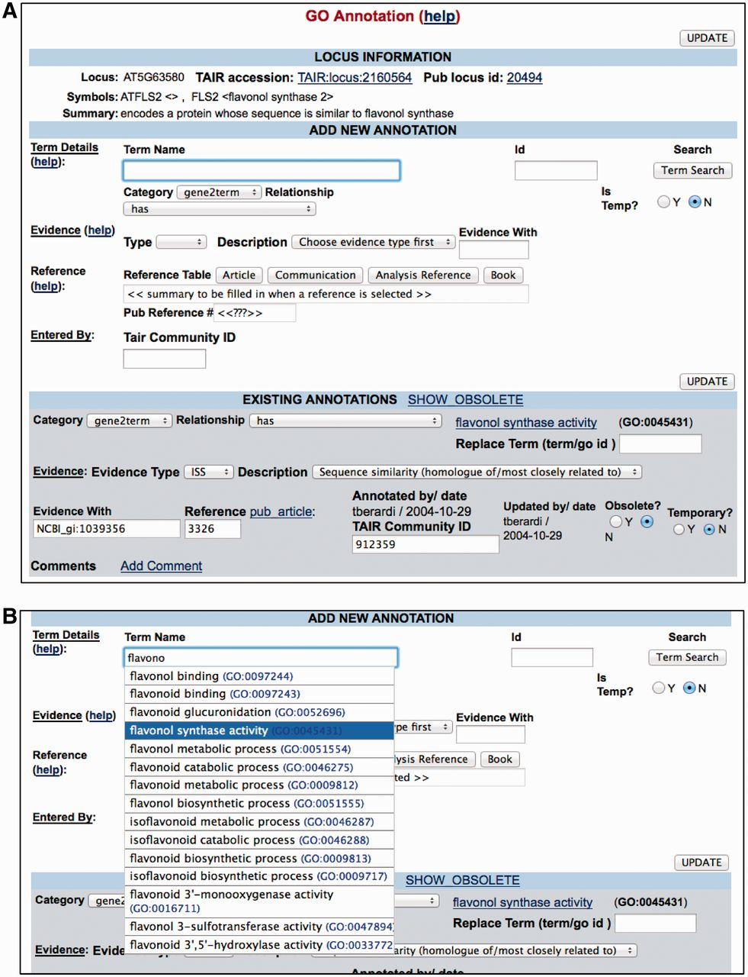
Figure 3 PubSearch GO annotation interface. (A) Top panel Locus Information provides a summary of gene function. The ...
Notes:
Figure 3 PubSearch GO annotation interface. (A) Top panel Locus Information provides a summary of gene function. The ‘Add New Annotation’ section allows curators to compose all essential components required for a GO annotation. Lower panel displays existing annotations. (B) The built-in GO term auto-complete functionality allows curators to select from a list of GO terms as they type. The same interface is also used for PO annotations.
Unless provided in the caption above, the following copyright applies to the content of this slide: © The Author(s) 2012. Published by Oxford University Press.This is an Open Access article distributed under the terms of the Creative Commons Attribution License (http://creativecommons.org/licenses/by-nc/3.0/), which permits non-commercial reuse, distribution, and reproduction in any medium, provided the original work is properly cited. For commercial re-use, please contact journals.permissions@oup.com.

