Slide 1
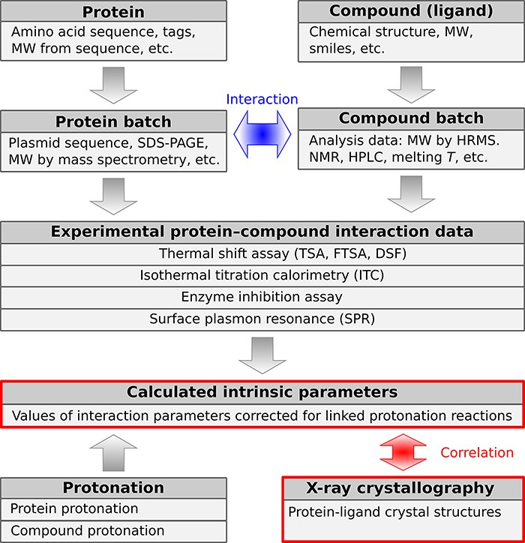
Figure 2. A schematic representation of PLBD. The database lists information about the structure, purification, actual ...
Notes:
Figure 2. A schematic representation of PLBD. The database lists information about the structure, purification, actual batches of proteins and compounds and thermodynamic and structural information on protein–compound interaction. Arrows indicate the direction of information exchange between major structural units of the PLBD. The database structure allows users to trace all relationships between the deposited data.
Unless provided in the caption above, the following copyright applies to the content of this slide: © The Author(s) 2023. Published by Oxford University Press.This is an Open Access article distributed under the terms of the Creative Commons Attribution License (https://creativecommons.org/licenses/by/4.0/), which permits unrestricted reuse, distribution, and reproduction in any medium, provided the original work is properly cited.

