Slide 1
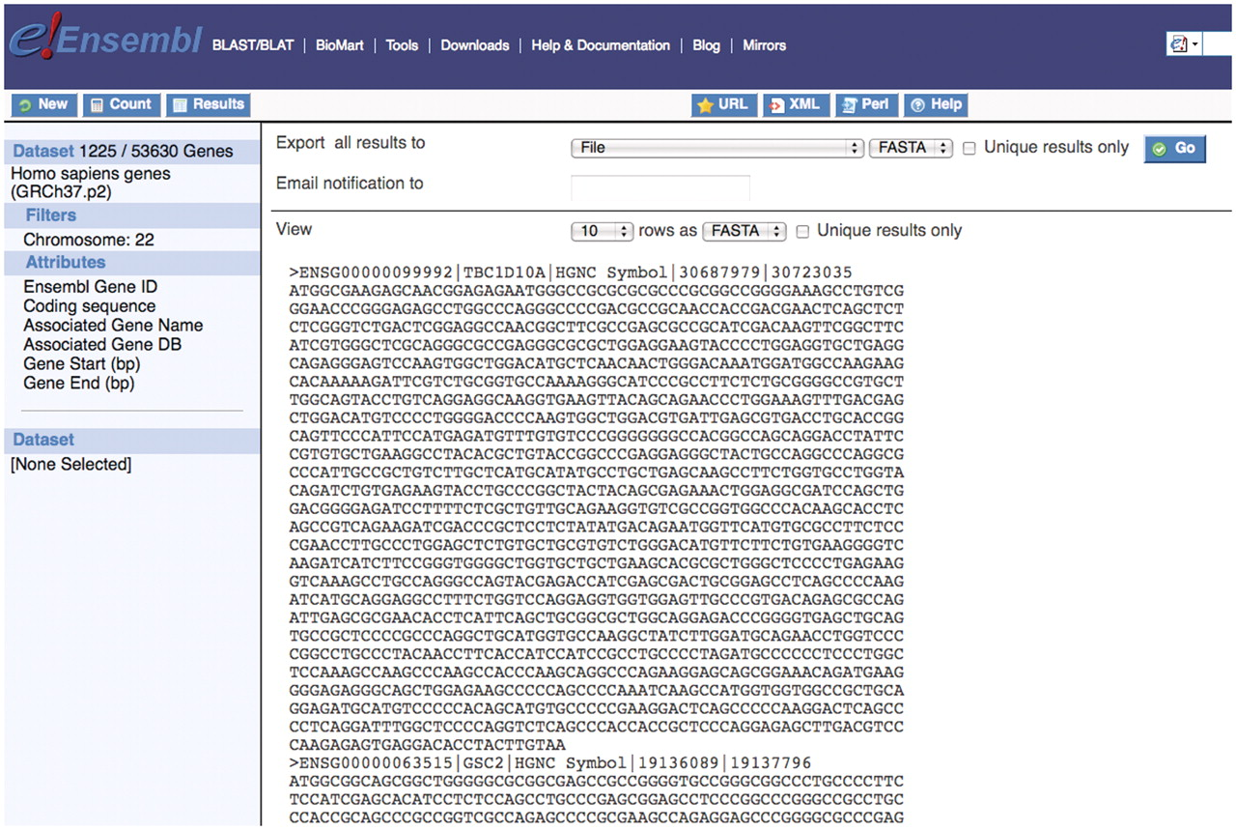
Figure 7. The ability to retrieve sequence information for genes of interest is a powerful feature of the BioMart tool. ...
Notes:
Figure 7. The ability to retrieve sequence information for genes of interest is a powerful feature of the BioMart tool. Here a user can download the coding sequence for all genes on chromosome 22 as well as additional information about each gene and this can be exported in a useful format.
Unless provided in the caption above, the following copyright applies to the content of this slide: © The Author(s) 2011. Published by Oxford University Press.This is Open Access article distributed under the terms of the Creative Commons Attribution Non-Commercial License (http://creativecommons.org/licenses/by-nc/2.5), which permits unrestricted non-commercial use, distribution, and reproduction in any medium, provided the original work is properly cited.

